Slide 1


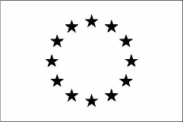
Reconstructing the Industry of Tomorrow
Material for Master Students
Material prepared by IVL Swedish Environmental Research Institute, June 2023
*Please note that this material should not be shared further unless approved by RETROFEED Project Partners.
This project has received funding from the European Union’s Horizon 2020 research and innovation programme under grant agreement No 869939.
www.retrofeed.eu

Slide 2


About the course
This learning material has been developed as part of the RETROFEED project: Implementation of a Smart RETROfitting Framework in the Process Industry towards its Operation with Variable, Biobased and Circular FEEDstock.
In this course, the students will learn about:
What drives the industry to retrofit their traditional processes?
Why & where is retrofitting needed, with concrete examples from five resource and energy intensive sectors - ceramic, cement, aluminum, steel, and agrochemical.
How can a digital Decision Support System be used to monitor, analyze and simulate the potential impact of retrofitting solutions?
What are the latest developments in digital twins for industrial processes?
Which tools are used to evaluate the environmental and social impacts of retrofitting?
What are the challenges in retrofitting the industry? What were the results of retrofitting in the project?
The course is available free of charge and will be distributed to professors in European universities. The project has received funding from the European union’s Horizon 2020 research and innovation programme under Grant Agreement nº869939.
www.retrofeed.eu

Slide 3
Objective of the Course
The objective of this course is to:
To provide up-to-day learning resources on state-of-the-art for REII (resource and energy intensive industries) such as production systems, resource use, energy efficiency, environmental impacts.
To provide knowledge on methods for assessing the best retrofitting options to achieve a high impact over the whole production chain, for example Decision Support System and Life Cycle Assessment.
To enhance knowledge transfer about retrofitting actions undertaken by REIIs while improving their overall technical, economic and environmental performance.
To ensure results replication and the exploitation of the retrofitting potential in REIIs.
To increase the capacity of stakeholders interested in retrofitting industrial processes.
www.retrofeed.eu
Notes:
Objective of the student materials is also to provide a tool for teachers to complement their existing materials.

Slide 4

Course Contents:
  Chapter 1: Drivers for Retrofitting
  Chapter 2: The RETROFEED Project - Get to know the demo-sites
    2.1 The RETROFEED Project
    2.2 Cement Production
    2.3 Aluminium Production
    2.4 Fertilizer Production
    2.5 Steel Production
  Chapter 3: Key Resource Indicators (KRI) , Key Performance Attributes (KPA) and Expected Project Impact
    3.1 KRIs and KPAs
    3.2 Expected Impacts in RETROFEED demo-sites
  Chapter 4: Digital Twin (DT) Development
    4.1 Digital Readiness Level
    4.2 Digital Twins in Industrial Retrofitting
    4.3 Example of Digital Twin for Agrochemical Sector
www.retrofeed.eu

Slide 5
Course Contents:
  Chapter 5: Life Cycle Assessment (LCA)
    5.1 LCA
    5.2 LCC
    5.3 S-LCA
    5.4 Example of LCA from Agrochemical Sector
  Chaper 6: Results from Retrofitting Actions
    6.1 Demo-sites retrofitting actions, goals and results
    6.2 Analyzing LCA and LCC Findings for Fertiberia: Demo's Perspective
    6.3 Navigating Challenges: The Demo Experience
    6.4 Future Outlook: Replicability Potential and Legislation
www.retrofeed.eu

Slide 6
Chapter 1: Drivers for Retrofitting

Slide 7
Group discussion
Prioritize the drivers for retrofitting, for a ceramic industry.
Do you think the drivers would be different for fertilizer industry?
Access to financing
Company culture
Price of fuel
Company organization
Type of market: international or domestic
EU policy framework
Company Regulatory Department
Size of the company
Reduction of CAPEX and OPEX
Company in-house capacity (expert staff, R&D, environmental, innovation departments..)
Price of feedstock
Competitiveness level
www.retrofeed.eu
Notes:
ETS: https://climate.ec.europa.eu/eu-action/eu-emissions-trading-system-eu-ets_en

Slide 8

A. EU Policy Framework
EU’s 2030 target
Reduce GHG emissions by 55% compared to 1990
1.1 The Emissions Trading System (ETS)
  First and biggest carbon market
  Power plants, industry factories (oil refineries, steel works and production of iron, aluminium, metals, cement, lime, glass, ceramics, pulp, paper, cardboard, acids, and bulk organic chemicals) and the aviation sector has a limited emission of green house gases called cap, which decreases every year to ensure the decrease of emissions.
  Within the cap each company receives or buys emission allowances
  Each emission allowance is equivalent to 1 ton of CO2 or the equivalent amount of other greenhouse gases, N2O and perfluorocarbons (PFCs)
  Phase 4: 2021-2030
    Annual reduction cap of 2.2%
www.retrofeed.eu
Notes:
ETS: https://climate.ec.europa.eu/eu-action/eu-emissions-trading-system-eu-ets_en

Slide 9
Other relevant EU policies for industries
1.2 Energy Efficiency Directive (EED)
  Mandatory Audits at least every four years for industries
  EU countries must save annually 1.5% of final energy consumption (currrently 0.8%) from 2024 to 2030 (concerns end-use sectors such as buildings and industry)
1.3 The European Green Deal
  The Circular Economy Action Plan
  Green and digital transitions of EU industry
1.4 The EU Resource Efficiency Roadmap
  Use of life-cycle assessment methodologies
  Use of a harmonized environmental footprint of products
Final energy consumption: All energy supplied to industry, transport, households, services and agriculture. It excludes deliveries to the energy transformation sector and the energy industries themselves;
www.retrofeed.eu
Notes:
Info from:
1.2 - https://energy.ec.europa.eu/topics/energy-efficiency/energy-efficiency-targets-directive-and-rules/energy-efficiency-directive_en
1.3 - https://commission.europa.eu/strategy-and-policy/priorities-2019-2024/european-green-deal/industry-and-green-deal_en
https://ec.europa.eu/commission/presscorner/detail/en/ip_22_2238
1.4 - https://ec.europa.eu/environment/resource_efficiency/targets_indicators/ongoing/index_en.htm

Slide 10
B. Price Signals
Fuel costs
Feedstock costs
Fossil based
Oil, NG, Diesel
Homogeneous, high energy density
Not fossil based
Biomass,biogas, hydrogen
Lower energy density
Prices going up
Will prices go dowm?
Virgin material
Some resources are getting scarce. Ex: P
Energy is needed to extract them
Recycle streams
Streams created by the same factory or nearby one
Depending on the material characteristics, more or less energy will be needed to process it
Added cost
Saves in costs
In any case: need of a better control system for fuel and feedstock supply seems important for the industry to optimize its use and save in costs
www.retrofeed.eu
Notes:
There is a desire to reduce fuel costs to lower overall cost of production. This was true for cement, as an example. For the demonstration site partner SECIL, fuel replacement is a priority but there are concerns that fossil fuel replacement leads to higher variations in fuel characteristics (alternative fuels) with the effect that heat consumption goes up and production efficiency goes down. However, they see this being addressed through better digital control, as seen in RETROFEED. They also assume that alternative fuels will soon be cheaper than fossil fuels and this would be beneficial to the entire cement industry.
For the demonstration site partner ASAŞ, the main objective is to lower input costs by increasing the share of contaminated scrap instead of pure aluminium ingots by being able to also use oily/coloured scrap in addition to today’s scrap used. The company expects to use less energy due to better control and that scrap takes up about 10 times less energy to be molten than pure aluminium. The use of the painted/oily – and thus cheaper – scrap will lower raw material costs.

Slide 11
C. International Competition
Exports have an important focus
Companies are more aggressive trying to reduce costs
Lower cost help them compete in the international market.
Reducing raw material cost is important
Most of the industries are competing in the international market, not only domestic. Companies that are export-oriented tend to be more aggressive to reduce costs in order to be more competitive.
International market
www.retrofeed.eu

Slide 12
Module 1
D. Company Culture
Feedback/view from consumers
Public image
Company culture also plays an important role in exploring ways to be more sustainable.
Company Culture
Involvement of company in ”eco” projects
Quality by certifications
www.retrofeed.eu
Notes:
Company culture also plays an important role in exploring ways to be more sustainable. Note that the demonstration site partner Fertiberia participates in several “eco” projects, such as green hydrogen and green fertiliser. Some plants have been certified under ISO 50001 for an energy management system.
The company culture also includes concerns about public image, within their region and related to their position within the entire sector. Fertiberia raised the point that this also means listening to consumers and what they expect from companies in terms of their approach to sustainability in its broadest sense.
Looking at it slightly differently, companies also develop certain expectations on returns on investment and that, essentially, is part of a corporate culture. This will be explored more during the execution of this project.
The company culture can include aspects of in-house capacity, discussed below.

Slide 13
Did you know?
SPAIN
The largest market of ceramic is concentrated in this country:
There are 40 manufacture facilities of frits in Europe, 21 in Spain followed by 9 in Italy
The estimated annual production of frit in Europe is between 0.9 and 1.125 million metric tonne
Gypsum
The major raw material used in the cement industry (in mass flow)
Gypsum is a mineral composed of calcium sulphate dihydrate. Gypsum, Limestone and Marl are used in the cement industry in quantities of 100 thousand in order of magnitude. Sand is used in quantities of thousand in order of magnitude.
150-370 €/ton (in 2020)
The price of fertilizers €/tonne bulk uin 202 ranges between
There has been a steep increase in the price of fertilizers since 2020. In 2022, the price was in the range of 500-800€/ton. This is due to the increase in the price of raw materials such as ammonia, phosphorous, sulphur, and natural gas.
www.retrofeed.eu

Slide 14
Did you know?
The world’s direct industrial CO₂ emissions that can be contributed to aluminium production:
3%
The sector was directly responsible for 275 Mt of CO2 emissions in 2021, of the world’s 9.4 Gt of direct industrial CO2 emissions in 2021. If indirect emissions from electricity consumption are included, the emissions from aluminium jump to around 1.1 Gt of CO2.
75%
The energy demand that comes from coal to produce steel on a global scale:
Coal currently meets around 75% of the energy demand of the sector. Reducing reliance on coal and increasing electricity use are essential for the steel industry to get on track with the Net Zero Scenario. One innovative solution is direct reduction of iron utilizing hydrogen instead of coal and coke. This is being developed in the HYBRIT project in Sweden.
www.retrofeed.eu

Slide 15


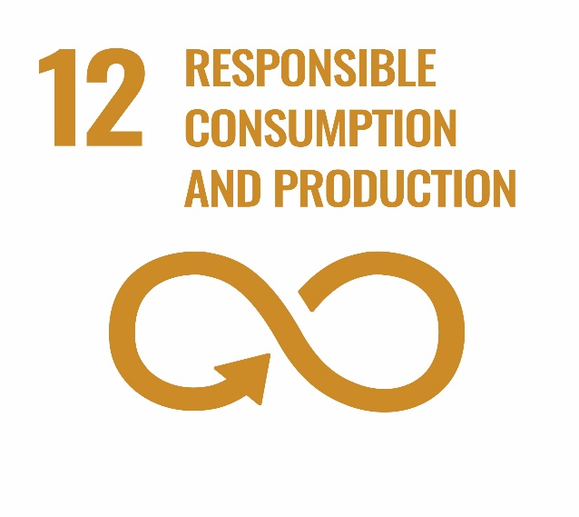

Retrofitting in the process Industry contributes to the following SDGs
www.retrofeed.eu
Notes:
https://www.un.org/sustainabledevelopment/news/communications-material/

Slide 16

Goal 9: Industry, innovation and infrastructure
9.4 By 2030, upgrade infrastructure and retrofit industries to make them sustainable, with increased resource-use efficiency and greater adoption of clean and environmentally sound technologies and industrial processes, with all countries taking action in accordance with their respective capabilities
Indicator: CO2 emissions per unit of value added
www.retrofeed.eu
Notes:
Indicators: https://sdg-tracker.org/infrastructure-industrialization

Slide 17
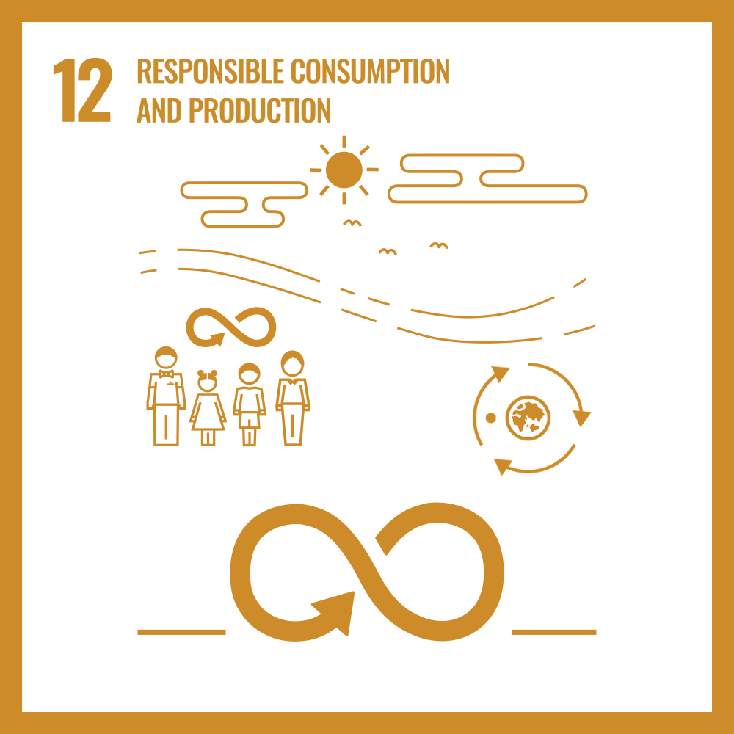
Goal 12: Responsible consumption and production
12.2 By 2030, achieve the sustainable management and efficient use of natural resources
Indicator: Material footprint, material footprint per capita and material footprint per GDP
12.5 By 2030, substantially reduce waste generation through prevention, reduction, recycling and reuse
Indicator: national recycling rate, tons of material recycled
12.6 Encourage companies, especially large and transnational companies, to adopt sustainable practices and to integrate sustainability information into their reporting cycle
Indicator: number of companies publishing sustainable reports
www.retrofeed.eu
Notes:
https://www.un.org/sustainabledevelopment/sustainable-consumption-production/
Indicators: https://sdg-tracker.org/sustainable-consumption-production

Slide 18
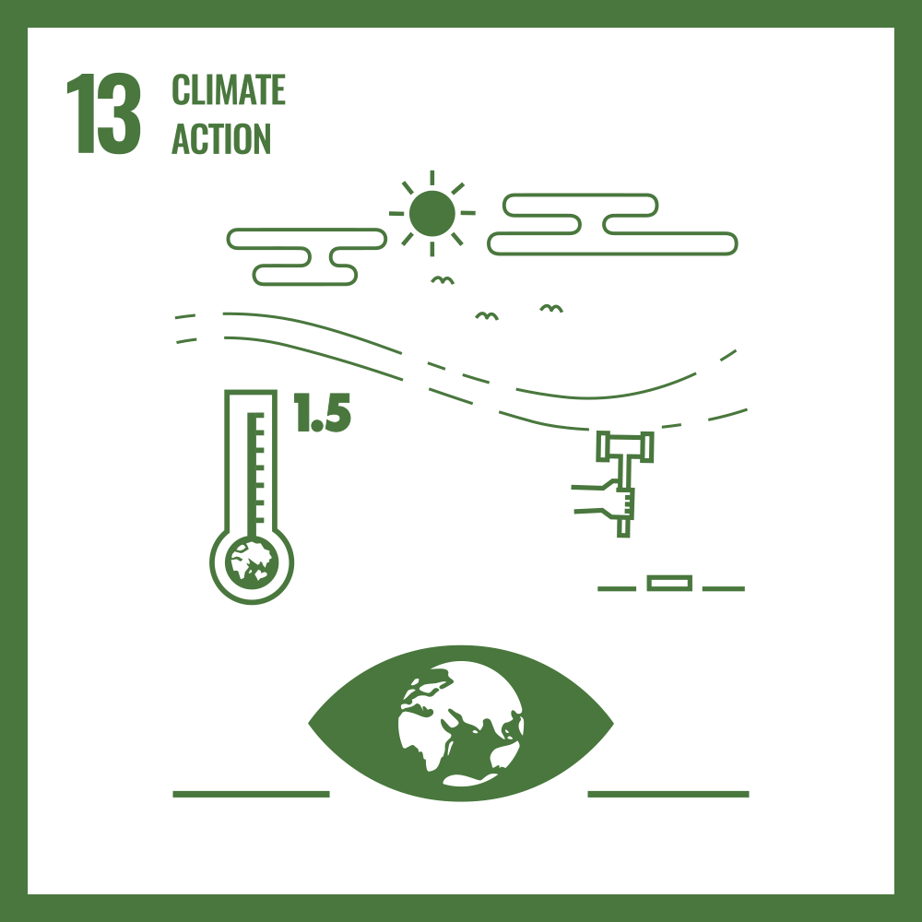
Goal 13: Climate action
13.3: By 2030 improve education, awareness-raising and human and institutional capacity on climate change mitigation, adaptation, impact reduction and early warning.
www.retrofeed.eu

Slide 19
Summary of Chapter 1
We have learnt about four major drivers for retrofitting:
EU policy framework
Price Signals
International Competition
Company Culture
We have also learnt about which Sustainable development goals (SDGs) retrofitting actions in process industry contributes to.
Goal 9: Industry, innovation and infrastructure
Goal 12: Responsible consumption and production
Goal 13: Climate action
www.retrofeed.eu

Slide 21
Chapter 2: The RETROFEED Project
- Get to know the demo-sites
Notes:
Now let’s learn more about the EU project RETROFEED and each of the 6 demo-sites from the project.

Slide 22

Overview of Chapter 2
  Chapter 2 is divided into the following subchapters:
    2.1 The RETROFEED Project
    2.2 Cement Production
    2.3 Aluminium Production
    2.4 Fertilizer Production
    2.5 Steel Production
  For each sector the demo-sites are introduced and the retrofitting actions.
www.retrofeed.eu
Notes:
In this chapter, we will learn about the RETROFEED Project and the demosites.

Slide 23
Chapter 2.1
The RETROFEED PROJECT

Slide 24
The RETROFEED project
AIM: Implement a smart RETROfitting framework in the process industry towards its operation with variable, biobased and circular FEEDstock
Potential of increasing the resource and energy efficiency with consequent reduction in costs and GHG emissions.
Making change in the core processes without affecting the quality of the feedstock
Implementation in 6 sites of 5 different sectors in 5 different countries, six demo-sites
www.retrofeed.eu
Notes:
This slides gives you the overall aim of the project as well as some information about the project in bulletpoints.

Slide 25
The RETROFEED project
Concrete actions:
  Development of digital twins of the core process to be retrofitted.
  Implement circular economy by introducing by-products and waste streams as alternative feedstock.
  Adapt equipment for the provision and use of bio-based and recycled feedstock whether as fuel or raw material, thus replacing traditional feedstock.
  Improve the control system of the retrofitted processess.
  Develop a Decision Support System for assessing the best retrofitting options and operation plan of the improved processes.
www.retrofeed.eu
Notes:
In this slide the concrete actions that was taken by the different demo-sites are described. Not all actions were taken for each demosites, but all of the demosites have improved the control system and a decision support system/digital twin has been developed within the project for each demo-site. To get to know what exact actions one demo-site has taken you will get to know this in the following subchapters and in the slide ”Overview of demo-sites retrofitting solutions”.

Slide 26
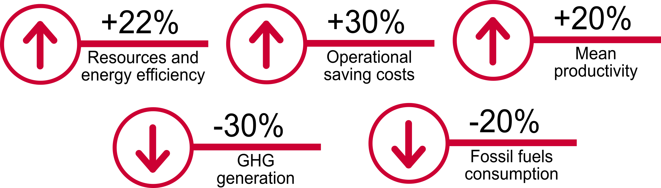
RETROFEED: Main goals expected
www.retrofeed.eu
Notes:
More info on Project goals here: https://retrofeed.eu/objectives/

Slide 27







Introducing the Demo-Sites
There are six demo-sites in the RETROFEED project.
Steel sector
Steel sector
Cement sector
Ceramic sector
Aluminium sector
Agrochemical sector
www.retrofeed.eu
Notes:
There are six demo-sites in the Retrofeed project, within the cement, ceramic, steel, agrochemical and aluminum sector.
Two demo-sites within steel sector. This slide will give you an overview where the demo-sites are located.
During the RETROFEED project the demo-sites have been open for study visits, but might no longer offer this.

Slide 28
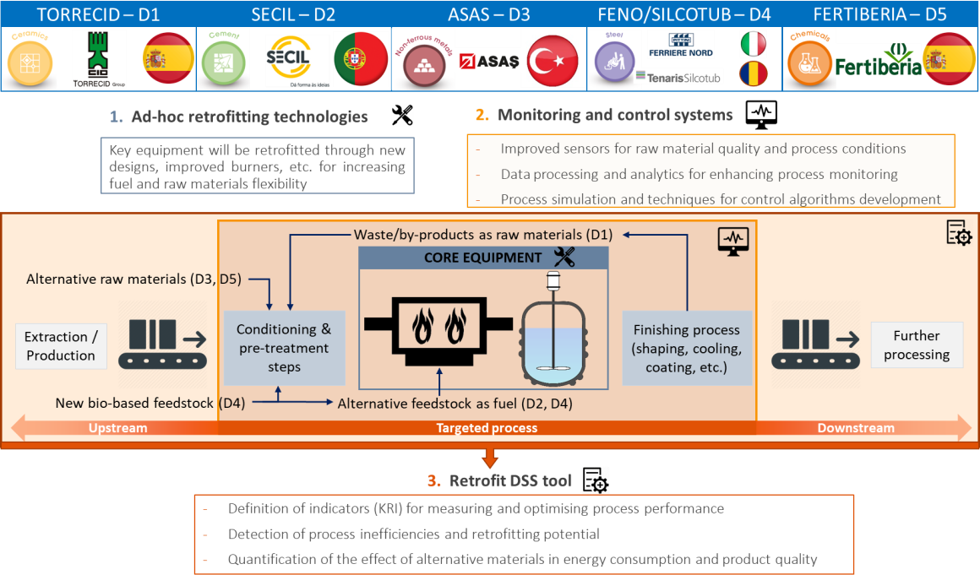
Overview of demo-sites retrofitting actions
www.retrofeed.eu
Notes:
This slide illustrates where the different retrofitting actions are taken by the different demo-sites. How to interpret this illustration:
Firstly:
For all of the demosites the 1., 2. and 3. are included. All will have retrofitted some key equipment, improved the M&C systems and has the goal to incorperate the retrofit decision support system tool (DSS tool) developed within the RETROFEED project.
Secondly:
Torrecid – D1 – retrofit so they can use waste/byproducts as raw materials.
Secil – D2 – retrofit so they can use alternative feedstock as fuel
Asas – D3 – retrofit so they can use alternative rawmaterial, increase the amount of scrap
Feno/Silcotub – D4 – retrofit so they can use new biobased feedstock as well as other alterantive feedstock as fuel.
Fertiberia – D5 – retrofit so they can use alternative rawmaterial.
More about the actions for each site in the coming subchapters.
Abbreviations:
Silcotub - Tenaris Silcotube (steel sector)
FENO – Pittini (steel sector)
M&C – Monitoring and control systems
DSS – Decision support system

Slide 29
Chapter 2.2
Cement production
Notes:
In this subchapter you will learn more about the company and the demo-site within the cement production.
Secil is the company with one of the demo-sites within the RETROFEED project. You will get to know:
Background information of the company.
Production process in Secil – all the steps within the production from raw material extraction to cement grinding.
Secil characterization in terms of primary energy requirements and GHG gas emissions before retrofitting.
Why retrofitting is needed and where retrofitting is needed.
Summary of actions and goals.
Discussion exercise.

Slide 30
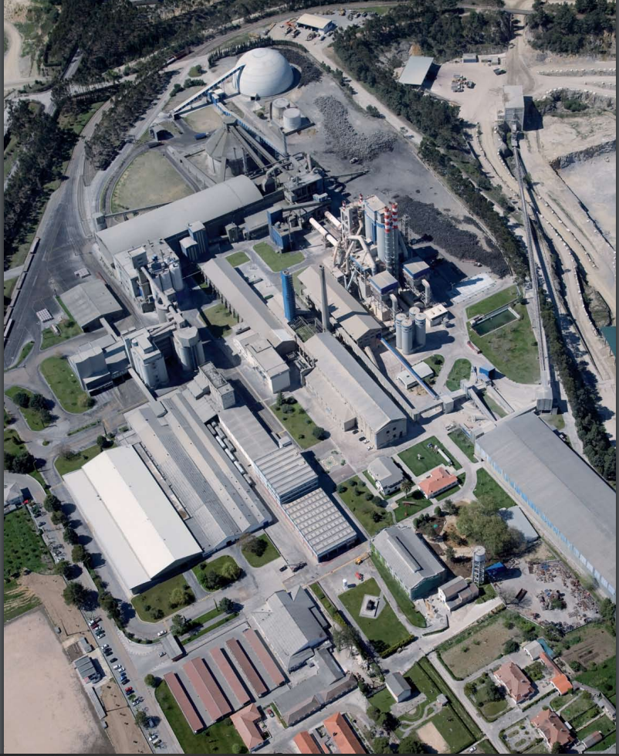
SECIL was founded in 1930 and is today one of Portugal’s leading cement producers. Although cement production is its core business, SECIL lies at the heart of a group of around 40 companies operating in complementary areas such as concrete, pre-fabricated concrete products, hydraulic lime, plasters, claddings, as well as quarrying. Currently, the Group has 8 cement plants with a total capacity of approximately 9.6 million tons, with 3 facilities in Portugal, 2 in Brazil and 1 in each country: Tunisia, Lebanon and Angola, respectively. The factory in Maceira-Liz produces around 600 ton/year of cement.
Maceira-Liz Factory
Picture taken from Secil’s 2011 environmental declaration report
www.retrofeed.eu

Slide 31
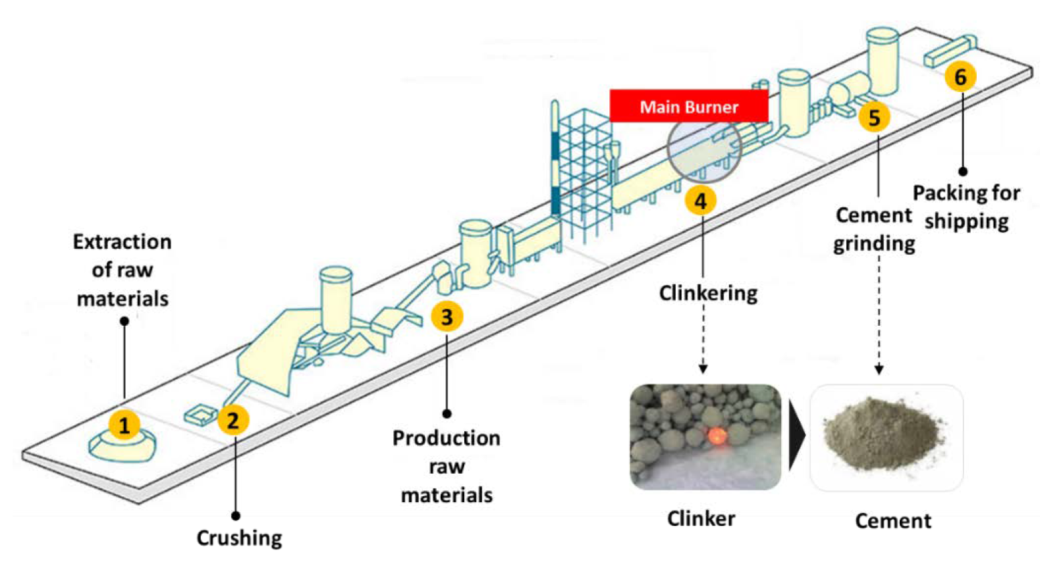
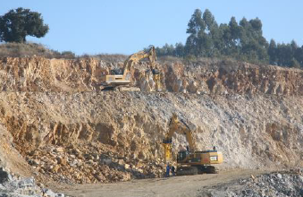
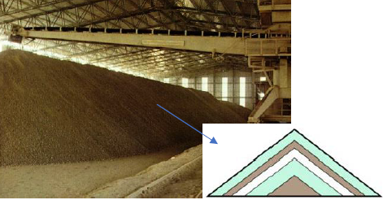
Production process in SECIL
Process description
Raw materials are extracted and conditioned to get specific chemical compositions. Then they are introduced in a kiln where clinker are formed at high temperature. Clinker is later cooled down and fed to a ball mill where it is ground and mixed with additives.
SECIL’s cement manufacturing process
www.retrofeed.eu
Notes:
Detail process explanation:
Extraction of raw materials -> The main raw materials, limestone and marl are usually quarried by blasting at the quarries near the plant then are transported to the crushing stage by trucks.
Crushing -> The extracted material is broken in a crusher with the purpose of obtaining material whose dimensions are less than 9 cm. The materials are also mixed to approach the desired chemical composition.
Production raw materials -> After crushing, the material is transported to vertical silos (Limestone) and horizontal storage (Marl) where the homogenization occurs. Considering the quality of the product to be obtained (clinker) the raw materials are selected proportionally. The mix is then transported to the raw mill, where a finely ground mixture is obtained in a well-defined proportion of the raw materials. It is also during this process that the chemical composition of the raw materials is finely adjusted using materials or residues (sand and iron oxide).
Clinkering -> Before entering the kiln, the raw material passes through a cyclone tower to preheat it, this heating is done through the hot gases from the kiln that pass in counter-current and heat the raw material, achieving that by the end of the cyclone tower, its temperature is already above 800°C and all the water present has been lost. In the rotary kiln the raw material, already calcined, from the cyclone tower, is heated again, this time until a temperature of 1450°C to which a part of the material melts and the clinker is obtained. Due to the rotation movement of the kiln and its inclination of 3.5%, the raw material advances from the upper end of the kiln(coldest part) to the lower end (hottest part), where is the flame from the burner. The feedstock used in the burner could be petcoke, fuel or alternative fuels. The mineralogical characteristics of the clinker, as well as the properties of the final cement product, are determined by factors inherent to the clinkering of the raw material, namely its chemical and mineralogical composition, the residence time and the temperature profile in the kiln. The clinker leaves the kiln and enters the cooler at a temperature between 1200 – 1300 °C where it is cooled with air. When the clinker reaches a temperature of about 125 - 180 °C, it leaves the cooler and is stored in silos, where the cooling ends and the product is left to reach room temperature.
Cement grinding -> the clinker is then fed to a ball mill, where it is ground together with a previously designated amount of gypsum to increase the setting time (i.e. time it takes for cement to harden when mixed with water) among other additives with hydraulic properties, thus forming the cement. This grinding with different materials implies that there are types of cement with various properties, so depending on the type of cement, there is an associated characteristic designation. Each type of cement produced is stored in the respective silo where it is homogenized and ready to be sent off for packing and shipping.

Slide 32
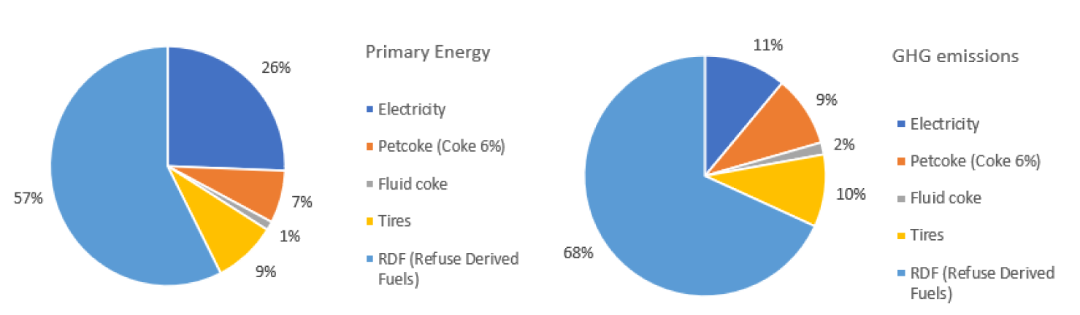
SECIL Characterization
SECIL’s primary energy requirements are RFD (refuse derived fuels), followed by electricity, tires, petcoke and fluid coke. The average energy usage for SECIL lays below the average value of the sector.
The GHG emissions associated with the consumption of these sources of energy and the raw meal reactions (kiln feed decarbonation) lay slightly above the average of the sector. It is important to remark that the emissions from electricity is low thanks to the renewable sources (wind and hydro) included in the Portuguese power generation mix
Primary energy consumption and GHG emission of the site in Maceira-Liz (Portugal)
KPI | SECIL value | Cement sector average value*
Thermal energy indicator | 0.06 toe/t clinker | 0.07 toe/t clinker
Electricity demand | 0.12 MWh/t cement | 0.09-0.15 MWh/t cement
Environmental performance | 0.848 tCO2eq/t clinker | 0.766 tCO2eq/t clinker
*Based on Commission Delegated Regulation (EU) 2019/331.
www.retrofeed.eu

Slide 33
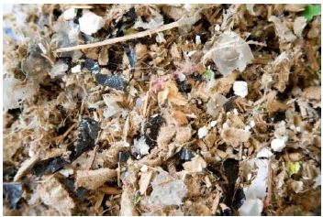
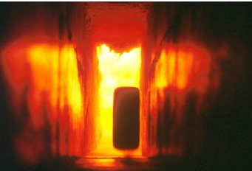
RETROFEED at SECIL
Why is retrofit needed at SECIL?
Maceira-Liz already uses alternative fuels (RDF, tires, fluff) for clinker production, but these types of fuel are characterized by high heterogeneity, high variation of lower calorific value (LCV) and high variation of moisture content, posing operational problems and flame control difficulties.
Where is retrofit needed at SECIL?
RDFs (Refuse Derived Fuels) with plastic, paper and textile
The combustion system (design of a new main burner) of the clinker rotary kiln needs to be retrofitted to allow the increase in knowledge about the process conditions and feedstock characteristics, resulting in a higher use of alternative fuels as opposed to their fossil-based counterparts.
With these actions, it is expected to achieve higher energy efficiency and lower CO₂ emissions.
Tires used as fuel
www.retrofeed.eu

Slide 34
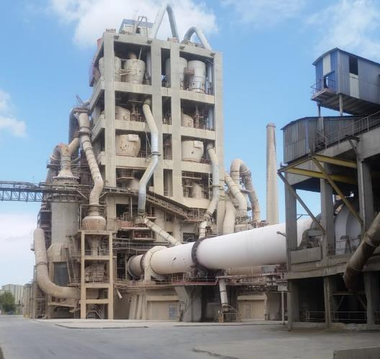
Summary of actions and goals of SECIL retrofitting
Retrofitting actions
Full-scale multi-fuel burner design
Image based combustion diagnosis tool
Alternative fuels properties determination
Real time clinker optical characterization
Goals
CO₂ emissions reduction
Replacement of fossil fuel close to 80%
Increment in energy efficiency
M&C improvement
www.retrofeed.eu
Notes:
Secil is one of the Portugal’s cement producer leader. In this case, retrofitting actions Will be centered in the core equipment, the rotatory kiln. A full-scale multifuel burner Will be design to be used with alternative fuels. New innovative sensors Will be developed and installed to monitor the combustión process based on flame images and characteristics of the Clinker composition by means optical techniques. In addition, alternative fuel Will be also characterize to support the kiln performance. The implementation of these actions Will lead to expect a substitution of 60-80% of fossil fuel. Which Will contribute to a reduction of CO2 emissions. Besides, it is expected a 5% of specidifc energy consumption decreasing and so, an increment in energy efficiendy. A flue gases analyzer Will improve the M&C system.

Slide 35
Group Activity:
From the list of raw materials, identify which raw materials/feedstock should be adapted in the future to make the industry more sustainable? Think about:
Availability of materials
Price signals
Political risks
SECIL - Main material inputs at the plant
Product | 2017 | 2018 | 2019
Limestone | 621,550 | 592,126 | 519,001
Marl | 276,952 | 266,708 | 291,084
Sand | 4,678 | 4,688 | 4,410
Gypsum | 28,448 | 33,894 | 657,925
Secondary Raw Material | 29,634 | 32,500 | 28,670
Petcoke | 23,324 | 22,227 | 23,270
Fuel | 200 | 138 | 99
Tires | 6,510 | 6,491 | 6,289
RDF (Refuse Derived Fuels) | 44,632 | 43,915 | 44,676
www.retrofeed.eu
Notes:
To read more about alternative feedstock: D2.6 - ALTERNATIVE FEEDSTOCK BENCHMARKING, see Public Deliverables – RETROFEED.

Slide 36
Chapter 2.3
Aluminium production
Notes:
In this subchapter you will learn more about the company and the demo-site within the aluminum production.
ASAS is the company with one of the demo-sites within the RETROFEED project. You will get to know:
Background information of the company.
Production process in ASAS– all the steps within the production from raw material extraction to cement grinding.
Secil characterization in terms of primary energy requirements and GHG gas emissions before retrofitting.
Why retrofitting is needed and where retrofitting is needed.
Summary of actions and goals.
Discussion exercise.

Slide 37
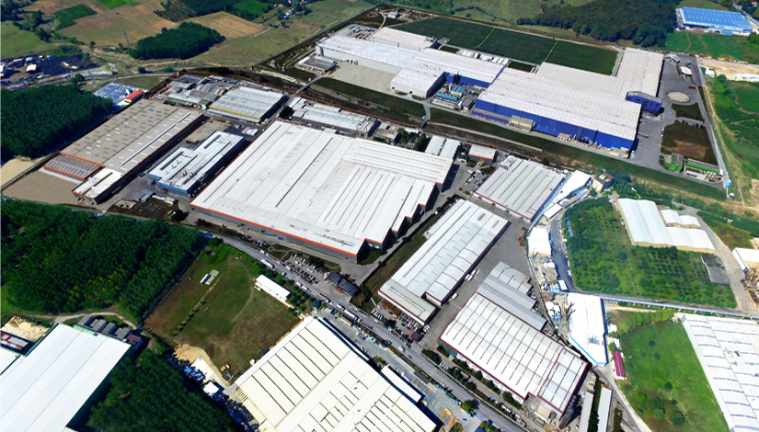
  Since its establishment in 1990 in Gebze, Turkey, ASAS has become one of the leading aluminum products manufacturers in Europe, carrying out exports to more than 80 countries all over the world . In 2015, the total revenue from international operations was estimated at 83 million USD and the company’s annual turnover approached 400 million, with this value increasing by roughly 26% every year. ASAS counts with five distinct production facilities: aluminum extrusion, aluminum flat rolled products, aluminum composite panel, PVC profile and roller shutter. The annual production of ASAS is:
  Aluminum Billet: 90,000 t/year,
  Aluminum Profile: 75,000 t/year,
  Anodized Profile: 40,000 t/year,
  Powder Coated Profile: 25,000 t/year,
  Aluminum Composite Panel: 7,500,000 m2/year,
  Aluminum Flat Rolled Products: Casting: 60,000 t/year, Rolling pin: 140,000 t/year, Folio: 25,000 t/year, Dyed Plate: 50,000 t/year,
  PVC Profile production: 35,000 t/year,
  Lamella Roller Shutter: 30,000,000 linear meters/year.
ASAS facilities
www.retrofeed.eu
Notes:
Picture source: https://www.asaspen.com.tr/corporate/about-us/asas/

Slide 38
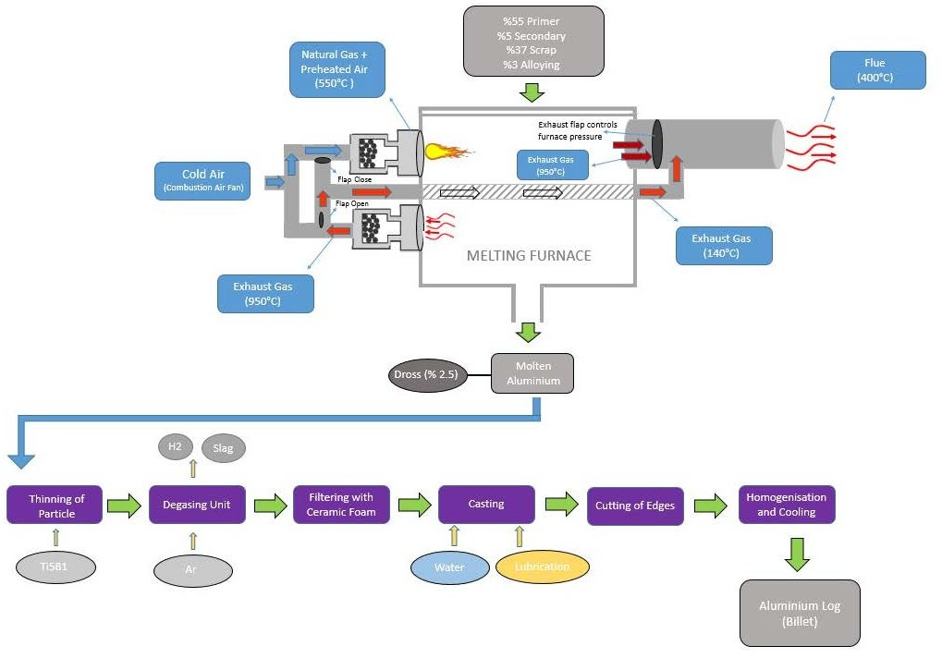
1. Raw materials loading
Production process in ASAS
Process description
A mixture of raw materials is introduced into the melting furnace. Additives are added to the molten aluminum to improve its mechanical properties. Argon or nitrogen gas is bubbled in the molten aluminum to remove hydrogen and any remaining slag. The molten aluminum is cast into billets and solidified. The billets are cut to the desired length, heated and held at the desired temperature to remove segregations and create adequate conditions for phase changes.
2. Melting process
3.
4.
5.
6.
7.
8.
9.
www.retrofeed.eu
Notes:
The main stages involved in the manufacturing of the billed products are:
Raw materials loading: The raw material used in the process is a mixture of primary (55%) and secondary (5%) aluminum, scrap (37%) and other materials for alloying (3%) which are introduced into the melting furnace at a temperature of 25 ºC. Raw materials are fed to the furnace at an average rate of 2,500 kg/h.
Melting process: The melting process lasts 4.5 h and is finalized when the aluminum’s temperature is increasing. The discharging phase then begins.
Thinning of particle: Additives are added to the aluminum to improve its mechanical properties. ASAS employs ti5b1 as a grain thinner.
Degassing: Due to the reactive nature of aluminum, any water that may come into contact with the melt will decompose and release hydrogen. The degassing operation consists mainly on removing this compound which may create inclusions (impurities on the metal structure) and thus weaken the final product, through bubbling an inert gas in the liquid. In this case, argon is used, but nitrogen is also a popular option. Any remaining slag is also separated from the bulk liquid at this point.
Filtering with ceramic foam: Ceramic foam has an excellent temperature resistance, and thus is used to remove any undesirable non-metallic inclusions in molten metals.
Casting: Liquid aluminum is casted and solidified.
Cutting of the edges: In this step, all segments are obtained in the desired length. Quality assurance is attained through the cutting of edges since the billets’ microstructure is not same with edges and remains. To obtain a homogeneous microstructure, billets are cut from top and bottom in a proportion equal to their diameter (for example, if the billet diameter is 203 mm, it is cut 203 mm from top and bottom).
Homogenization and cooling: The billets are heated-up and held at the desired temperature for a specific time (depending on the alloy type). The goal of the homogenization is to remove segregations and create adequate conditions for phase changes. The billets are then removed from the furnace and cooled down.
Final product – billet: In this step, billets are stored to be extruded and later on cut to the desired length in the extrusion process.

Slide 39
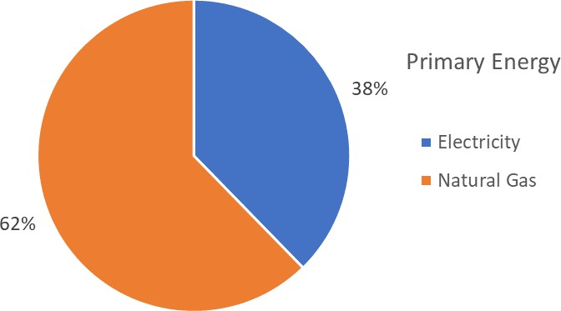
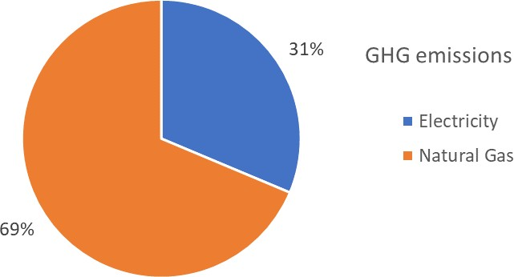
ASAS Characterization
ASAS energy demand is supplied by electricity and natural gas. In terms of primary energy, natural gas represents the highest share since it covers 62 % of the total consumption and it is required mainly for the extrusion and flat rolling processes, as well as for electricity production through cogeneration. The relatively lower share of electricity, 38 %, is also mainly used for the extrusion and flat rolling processes and, to a lesser extent, for the composite panels’ and PVC profiles’ production.
Primary energy consumption and GHG emission of ASAS’ whole plant in Gebze (Turkey)
KPI | ASAS value | Aluminium sector average value*
Primaryenergy requirements | 0.26 toe/t | 0.05-0.21 toe/t
Electricity demand | 0.55 MWh/t | -
Natural gas demand | 1.90 MWh/t | -
Environmental performance | 0.57 tCO2eq/t | 0.154 tCO2eq/t
*Based on Commission Delegated Regulation (EU) 2019/331.
www.retrofeed.eu

Slide 40
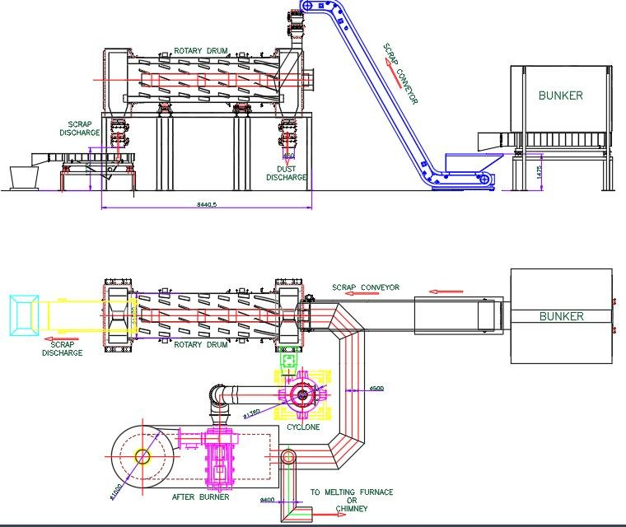
RETROFEED at ASAS
Why is retrofit needed at ASAS?
Through modifications in the raw materials pre-treatment and optimization of the combustion environment in the furnace, ASAS expects to achieve higher energy efficiency in the aluminum melting process, while controlling emissions and associated costs.
Where is retrofit needed at ASAS?
The RETROFEED activities will take place in one of the melting furnaces. The main goal is to increase the share of scrap in the raw material. It is expected that the increase in scrap share will be possible with the application of a delacquering process, which will remove contaminants from the scrap surface and thereby reduce the dross (a mass of solid impurities) accumulation in the melting process. At the same time, increasing the proportion of scrap that is fed to the furnace, may reduce the energy demand, since scrap requires considerably less energy than aluminium ingots to be molten. Each batch of aluminium production is called “a heat”.
Delacquering system schematic
With these actions, it is expected to achieve higher energy efficiency and controlling emissions and associated costs.
www.retrofeed.eu

Slide 41
Summary of actions and goals of ASAS retrofitting
Goals
50% increment in the amount of scrap
Reduction of the energy consumption 15 times
More efficient combustion
Reduction of the GHG emissions
Improved M&C system
Retrofitting actions
Delacquering system
O₂ injection system
New burner head design
O₂ and TOC analyzers
www.retrofeed.eu
Notes:
ASAS, which is one of the leader aluminum manufactures' in Europe, persues to increase the amount of scrap in the melting process maintaining product standards. In this manner, a reduction of the primary aluminum billet use can be reduced. For this regard, a O2 injection system and head burner will be designed and installed to improve the combustion performance inside the furnace.. In addition, a delacquiring system will be installed to remove the coated layers as Paint, oil and so on to allow to increase the share of low quality scrap in the feeding line. O2 and TOC analyzers Will be installed also to support in the process management and to ensure the adequate emission level which lead to an improved M&C system. The expected goals are related with the increment of the share of the scrap up 50% which Will reduce the energy consumption in 15 times. Besides, these actions Will generate a more efficient combustion and so, a reduction of the GHG emissions.

Slide 42
Chapter 2.4
Fertilizer production

Slide 43

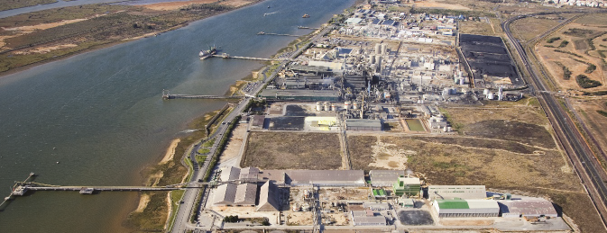
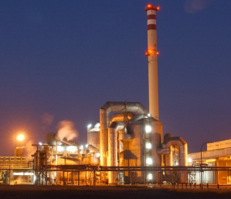
FERTIBERIA Group is a Spanish fertilizer and industrial products producer and one of the leading international providers of ammonia and its derivates. FERTIBERIA and its subsidiaries’ fertilizer production capacities amount to 75% of the total production in Spain and 100% in Portugal. It has 14 factories distributed across Spain, Portugal and France, producing roughly 8 million annual tons of fertilizer products.
FERTIBERIA’s fertilizers can be categorized as simple and complex. In Huelva, Spain, Fertiberia manufactures these complex NPK (nitrogen-phosphorous-potassium) products, with an annual production of 250,000 tons.
Fertiberia’s Huelva plant in Spain
Close-up of the production facility
www.retrofeed.eu
Notes:
Simple fertilizers:
Contain urea, nitrates and compounds exclusively composed either of nitrogen (N) or phosphorous (P),
Complex fertilizers:
Contain different proportions of N, P and potassium (K), as well as other additives. NPK fertilizers compositions are expressed in terms of their N, P and K contents, measured as %N, %P2O5 and %K2O, respectively. Therefore, a 10-10-10 fertilizer for example, has 10% Nitrogen, 10% P2O5 and 10% K2O. The actual quantities of P and K may be deduced from the oxide’s contents.

Slide 44
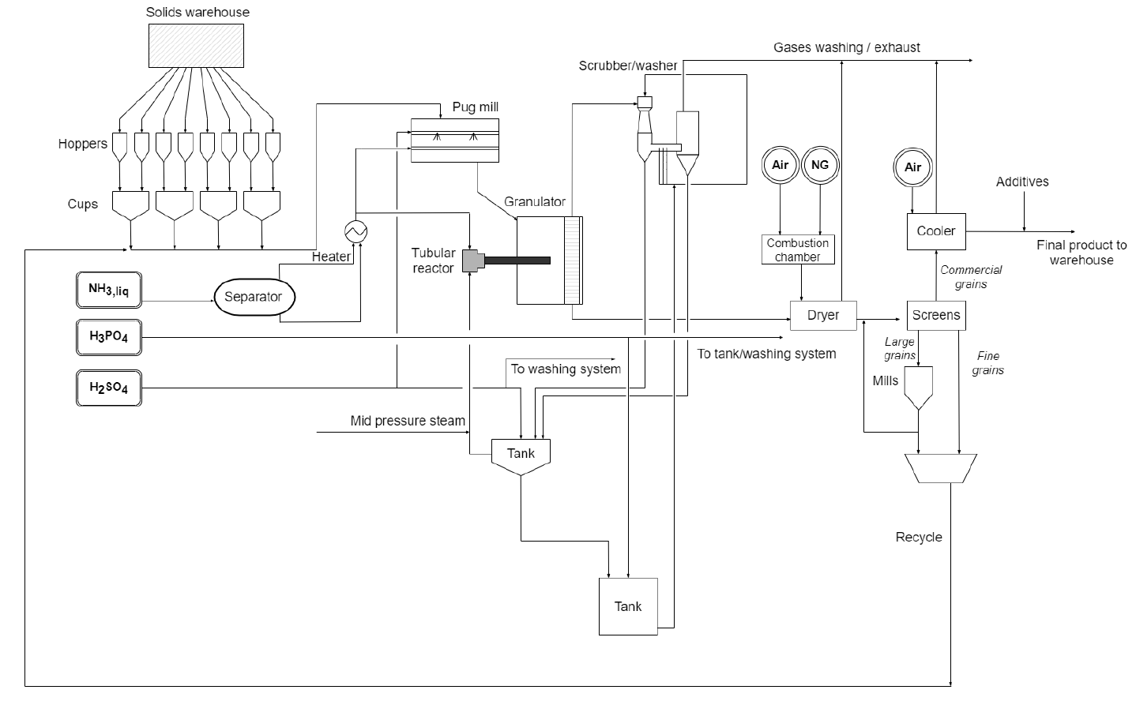
Production process in FERTIBERIA
UNIT 1
UNIT 6
UNIT 2
UNIT 5
UNIT 3
UNIT 4
Process description
Solid and liquid raw materials of specific formulation are mixed, reacted and heated up in a granulator forming granules from a slurry. These granules are then dried, screened and cooled down to achieve the final product. The product out of physical specification is recycled to the granulator after been grinded. Gas emission is washed, and water is recycled to process. No wastewater is produced.
Block diagram of Fertiberia’s demo-site
www.retrofeed.eu
Notes:
Detail of process:
1. The NPK production process begins with the solids transport from the warehouse. Fine grains of solid compounds are distributed along various hoppers and are sorted and mixed in adequate proportions.
2: recycle transports these solid formulations to the pug mill where they are mixed with gaseous ammonia (NH3) and sulfuric acid (H2SO4) forming a slurry
3: The slurry is then sent to a granulator, where heat is provided through a pipe reactor of ammonia and phosphoric acid to evaporate the water from the solution and produced granules by the rotating movement. Heat provided by the pipe reactor is the result of the exothermic reaction between phosphoric acid (H3PO4) and ammonia NH3. Depending on the formulation, mid-pressure steam is also employed to supply additional heat.
4: The granulated compounds are sent to a drying stage which uses natural gas as fuel, followed by screening. The screening step allows to separate the granules according to their size and recirculate those out of specification. This involves grinding coarse granules to be screened again and recycling all fine particles resulting from the process.
5: Once the granules have been sorted out, commercial-sized particles are cooled down using air, before being sent off for final treatment and storage
6: Gases leaving each process unit are washed progressively in scrubbers with aqueous H3PO4 solutions, until they are released to the atmosphere. This process works under a zero-waste discharge principle. Water is treated and reused, and rejected products are recycled and reutilized in the fertilizer production.

Slide 45
Production process in FERTIBERIA
UNIT 1
UNIT 6
UNIT 2
UNIT 5
UNIT 3
UNIT 4
Process description
Solid and liquid raw materials of specific formulation are mixed, reacted and heated up in a granulator forming granules from a slurry. These granules are then dried, screened and cooled down to achieve the final product. The product out of physical specification is recycled to the granulator after been grinded. Gas emission is washed, and water is recycled to process. No wastewater is produced.
Block diagram of Fertiberia’s demo-site
www.retrofeed.eu
Notes:
Detail of process:
1. The NPK production process begins with the solids transport from the warehouse. Fine grains of solid compounds are distributed along various hoppers and are sorted and mixed in adequate proportions.
2: recycle transports these solid formulations to the pug mill where they are mixed with gaseous ammonia (NH3) and sulfuric acid (H2SO4) forming a slurry
3: The slurry is then sent to a granulator, where heat is provided through a pipe reactor of ammonia and phosphoric acid to evaporate the water from the solution and produced granules by the rotating movement. Heat provided by the pipe reactor is the result of the exothermic reaction between phosphoric acid (H3PO4) and ammonia NH3. Depending on the formulation, mid-pressure steam is also employed to supply additional heat.
4: The granulated compounds are sent to a drying stage which uses natural gas as fuel, followed by screening. The screening step allows to separate the granules according to their size and recirculate those out of specification. This involves grinding coarse granules to be screened again and recycling all fine particles resulting from the process.
5: Once the granules have been sorted out, commercial-sized particles are cooled down using air, before being sent off for final treatment and storage
6: Gases leaving each process unit are washed progressively in scrubbers with aqueous H3PO4 solutions, until they are released to the atmosphere. This process works under a zero-waste discharge principle. Water is treated and reused, and rejected products are recycled and reutilized in the fertilizer production.

Slide 46
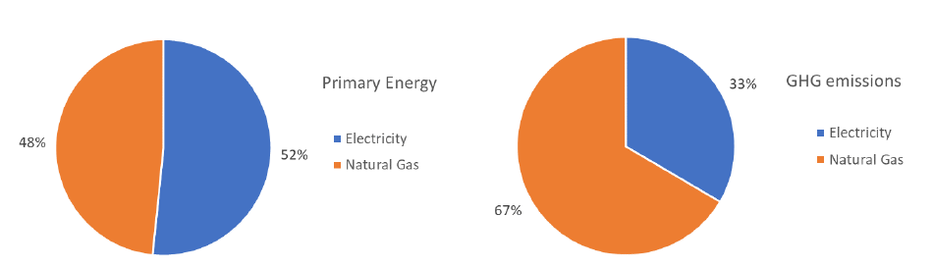
FERTIBERIA - Characterization
Fertiberia’s primary energy requirements for the NPK production line are from electricity, followed by natural gas. The average energy usage for Fertiberia lays below the average value of the NPK production line.
Primary energy consumption and GHG emission of the NPK production line
KPI | Fertiberia NPK value | NPK line average value
Electricity requirements | 0.07 MWh/t | 0.03-0.08 MWh/t
Natural gas requirements | 0.14 MWh/t | 0.209 MWh/t
Environmental performance | 0.04 tCO2eq/t | -
*Based on Commission Delegated Regulation (EU) 2019/331.
www.retrofeed.eu
Notes:
In the RETROFEED project, indicators are used to assess technological changes in the process industry. A set of criteria can be useful to evaluate the indicators themselves or, at least, to validate the set of indicators chosen. Different sets of criteria for indicators have been presented in various contexts.

Slide 47
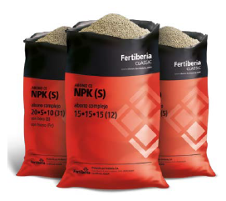
RETROFEED at FERTIBERIA
Why is retrofit needed at FERTIBERIA?
Phosphorous compounds are a major concern since they are widely used across all NPK fertilizer formulations. These are obtained by extraction of P2O5 from phosphoric rock, known to be a highly polluting process. Sulphur compounds, such as ammonium sulphate, are purchased from a third party, although they could potentially be produced on-site if adequate raw materials and reactor were made available. It is therefore of particular interest, to obtain alternate P and S sources. These alternative resources normally require more heat to be processed.
Where is retrofit needed at FERTIBERIA?
NPK fertilizers from Fertiberia
The tubular reactor which currently supplies energy for granulation by means of a chemical reaction (aided on occasions by steam) will be replaced with a novel reactor where a more exothermic reaction of sulfuric acid and ammonia will take place. This will not only allow to reduce steam consumption, but also achieve greater flexibility in the raw material sources the process can admit, thus reducing costs associated to purchasing feedstock and increasing the overall process sustainability. Also, P2O5 from circular economy such as ashes, need higher temperature and lower pH to be solubilized in the slurry and so be available as fertilizer. The novel pipe reactor can cope with both goals.
With these actions, it is expected to achieve energy consumption reduction (Steam) and contribute to circular economy and industrial symbiosis by using waste streams from other industries in replacement from virgin P and S sources
www.retrofeed.eu

Slide 48
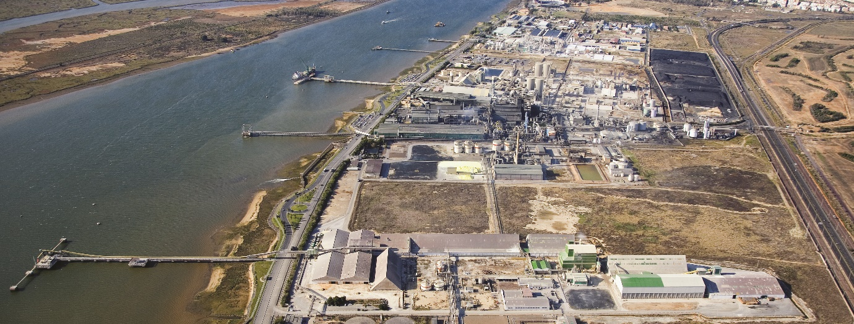
Summary of actions and goals of FERTIBERIA retrofitting
Goals
Replace at least 10% of the currently used phosphorous sources.
Recover valuable raw materials from wastes such as ashes, struvites, etc.
Reduction of cost and energy consumption (reduction of CO2 emission).
M&C system improvement.
Retrofitting actions
New design of an in-line reactor for alternative phosphorus sources.
www.retrofeed.eu
Notes:
Fertiberia, is a Spanish fertilizer producer and one of the leading international providers of ammonia and its derivate. In this case, the retrofitting activities are centered in the phosphorous reactor. The idea is to replace the imported phosphorous designing a new reactor to incorporate biobased waste. This modification will lead to a substitution of 10% of the currently used of phosphorous sources integrating raw material from waste and reducing cost. New sensors to monitor and control the new system will improve the M&C system.

Slide 49
Chapter 2.5
Steel production

Slide 50

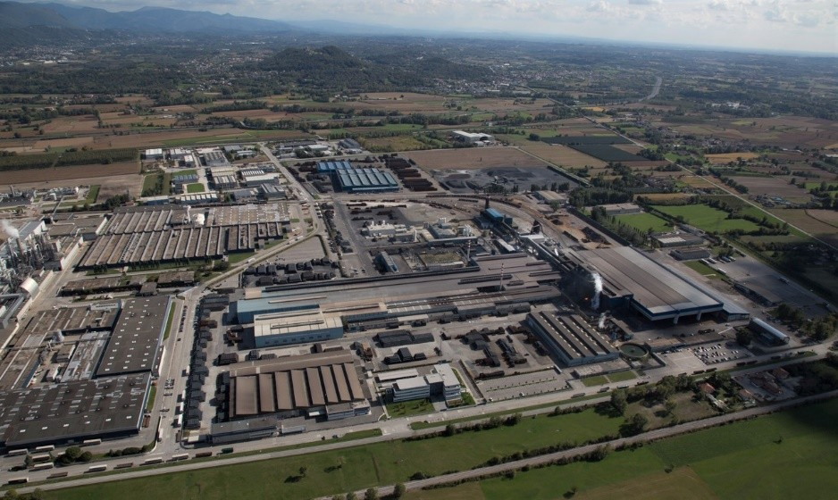
  FERRIERE NORD S.p.A. (FENO), founded in the sixties, is nowadays the leading company of the Pittini Group, an international firm that operates in the field of steel, mainly for the construction and mechanical industries. Pittini group, with its three manufacturing facilities in Osoppo, Potenza and Verona, can rely on three electric steel mills, three rolling mills for the production of steel bars and coils for reinforced concrete, one rolling plant for wire rod and several plants for the production of meshes and lattice girders. FERRIERE NORD S.p.A. steel production in the Osoppo site reaches 1.5 million tons per year using a single EAF (electric arc furnace) charged with scrap.
  FERRIERE NORD S.p.A.’s manufacturing practices are centered around the company’s Zero Waste Project, devoting efforts to recycling raw materials and waste. The facilities have been certified under ISO 9001:2015 for meeting quality management standards and ISO 14001:2015 and 50001:2011 corresponding to environmental and energy management standards compliance, respectively.
View of Ferriere Nord’s facility at Osoppo
www.retrofeed.eu

Slide 51
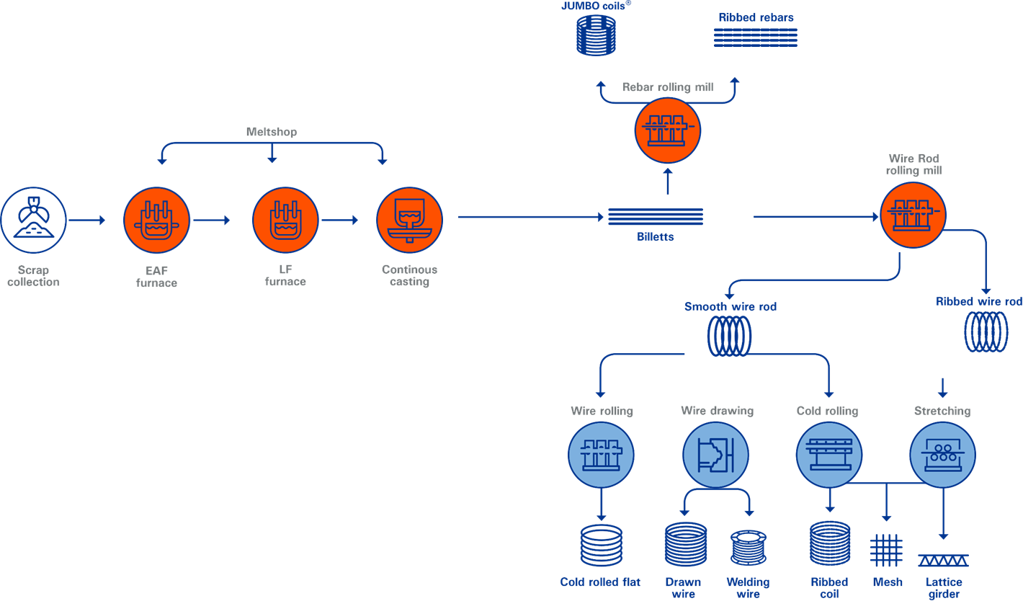
Production process in PITTINI-FENO
5.
5.
1.
2.
3.
4.
Process description
The Electric Arc Furnace melts the scrap to liquid steel and increases its temperature to the desired value. The liquid steel is treated in the Ladle Furnace, where the chemical composition and steel temperature are adjusted. It is then put into a Continuous Casting Machine where liquid steel becomes solid in the shape of square billets.
www.retrofeed.eu
Notes:
The production cycle begins with the charging of the steel scrap into dedicated scrap buckets.
The scrap buckets are moved inside the melting bay to be charged in the furnace. The Electric Arc Furnace (EAF) melts the scrap to liquid steel and increases its temperature to the desired value, suitable for the following refinement treatment. To melt the scrap, electrical and chemical energy are used, reducing time for melting and costs. The melting of scrap is a batch process where every 45 minutes liquid steel are produced in the EAF. At the end of each melting cycle, the liquid steel at about 1580 °C is poured into a dedicated pot, named ladle, used to carry the liquid steel to the subsequent production steps.
After exiting the EAF, the liquid steel is treated in the Ladle Furnace (LF) plant, where the chemical composition and steel temperature are adjusted.
The ladle is then carried to a Continuous Casting Machine (CCM) where liquid steel becomes solid in the shape of square billets (160 x 160 mm), with a length that ranges between 12 m and 13 m and then cooled down to room temperature.
The solidified billets are heated up again to around 1150 °C to be rolled in shape of round wire rods

Slide 52
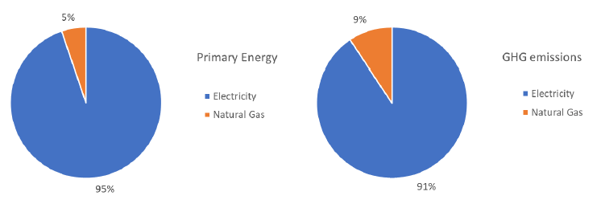
PITTINI-FENO Characterization
The FENO furnace is mainly relying on electricity and natural gas. In terms of primary energy, electricity represents the higher share since it covers 95 % of the total consumption.
The GHG emissions associated with the consumption of these sources of energy lay below the average of the sector.
Primary energy consumption and GHG emission of FENO’s Electric Arc Furnace (EAF) in Osoppo (Italy)
KPI | FENO’s EAF value | Steel sector (EAF) average value
Primary energy requirements | 0.08 toe/t | -
Electricity demand | 0.42 MWh/t | 0.404-748**
Natural gas demand | 0.05 MWh/t | 0.138-0.417**
Environmental performance | 0.11 tCO2eq/t | 0.283 tCO2eq/t*
The tones refer to EAF carbon steel produced
*Based on Commission Delegated Regulation (EU) 2019/331
**Based on JRC referens report Best Available Techniques (BAT) Reference Document for Iron and Steel Production
www.retrofeed.eu

Slide 53
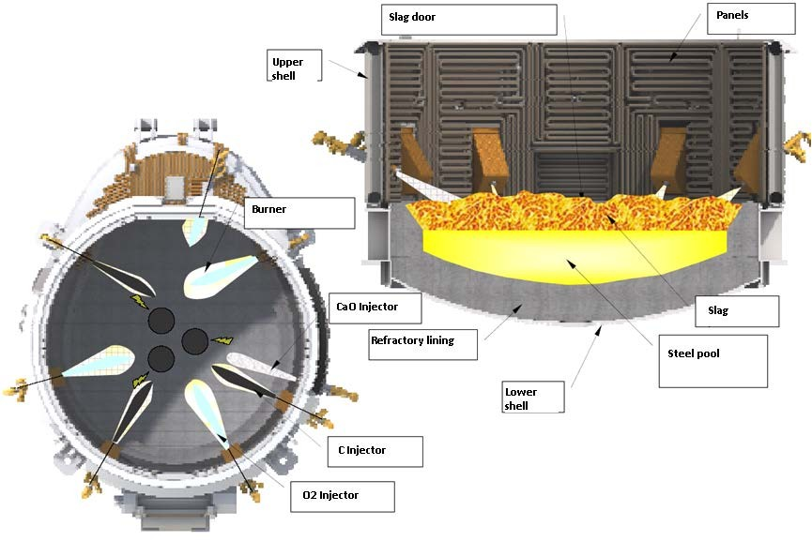
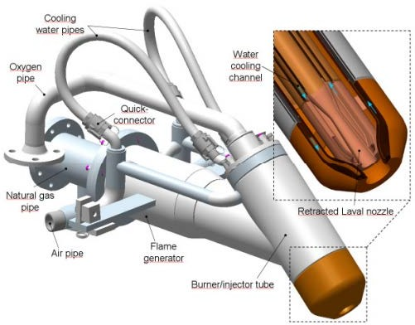
RETROFEED at FENO
Why is retrofit needed at FENO?
The main motivation for FERRIERE NORD S.p.A. to take part in the RETROFEED project is to significantly cut back on their fossil fuel reliance and associated CO2 emissions through the adaptation of key process equipment to recycled and biobased sources, while leaving productivity and product quality unaffected.
Where is retrofit needed at FENO?
The objective of the project is to achieve a reduction in the fossil fuel consumption of the steel production process, through utilization of wastes and biobased sources as fuel and fossil carbon replacements. Pathways devised to accomplish such goal are to modify a burner to be able to burn plastic grains and biochar as fuel alternatives to natural gas, and revamp an injector, allowing it to blow biochar instead of anthracite to the melt.
FERRIERE NORD EAF, position of burners and injectors
With these actions, it is expected to achieve achieve a reduction in the fossil fuel consumption and associated CO2 emissions of the steel production process.
Burner example
www.retrofeed.eu

Slide 54
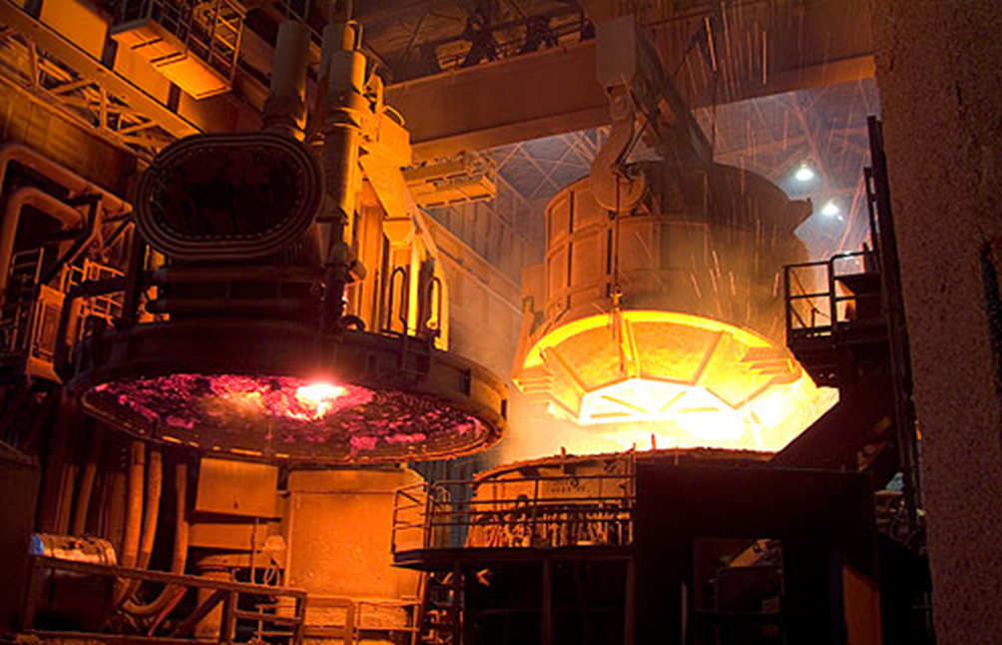
Summary of actions and goals of FENO retrofitting
Goals
Reduction of GHG emissions
Use of alternative feedstock
M&C system improvement
Retrofitting actions FENO
Burner modification for feeding biochar and plastic grains
Injection system
www.retrofeed.eu
Notes:
In the steel sector, two end users are involved: FENO and SILCOTUB. In both cases the activities will be centered in the Electrical Arc furnace where circular economy concepts will be applied. In the case of FENO, biochar and plastic grains will substitute the use of fossil fuel for combustion. At the same time, anthracite will be replaced by biochar as Carbon source. so that, the injection system and burner are required to be modified. Whereas in Silcotub, rubber and plastic injection will be used as energy provider in the melting process. In addition, SILCOTUB will intend to replace raw materials incorporating sludges and dust in the furnace. In both cases a reduction of GHG are expected and as I mentioned previously the implementation of circular economy concepts will support the reduction of feedstock.

Slide 55

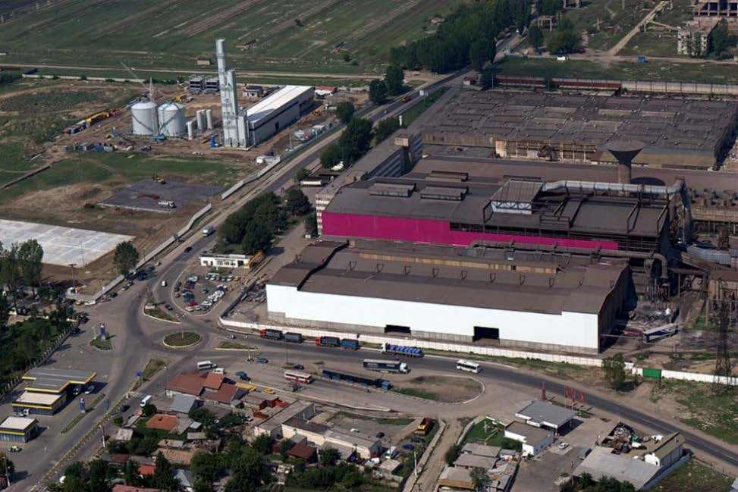
Demo-site 5
  TENARIS is the world’s leading producer of steel pipes for the energy sector and other industrial applications, with a total installed capacity of 7.2 million tons of seamless and welded steel pipes. The company’s annual turnover in 2019 was estimated at 7.3 billion USD, as a result of a distribution and services network which extends to more than 30 countries worldwide, serving more than 2,500 customers. Through its mills in Zalau and Calarasi, TENARIS SILCOTUB S.A. is the leading Romanian producer of small diameter seamless steel pipes used in Oil & Gas, mechanical, automotive, chemical, petrochemical and power generation sectors.
  The mills are part of a fully integrated production process which starts with steel production from scrap at the steel shop in Calarasi, which has a production capacity of 600,000 tons a year. Transformation of raw materials into seamless pipes is performed at the TENARIS SILCOTUB facility in Zalau, with an annual capacity of 225,000 tons and counts with a component centre dedicated to executing added value operations to the tubes, to obtain products employed in the automotive and earth moving machineries sectors. The premises can rely on a new laboratory which performs metallurgical and mechanical tests, as well as a coupling shop which does API and Premium connections threads, responding to the requirements of Oil & Gas companies.
Aerial view of TENARIS SILCOTUB production facilities
www.retrofeed.eu

Slide 56
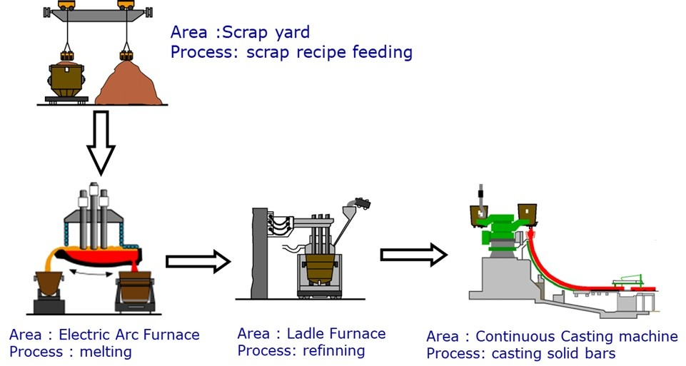
Production process in SILCOTUB
Process description
The steel scrap is first sorted and charged into dedicated scrap buckets. It is then introduced in the electric arc furnace, where the main chemical reactions occur. At the end of each melt, the liquid steel is processed in the Ladle Furnace, where the final chemical and thermal adjustments are made. The ladle is then carried to the Continuous Casting machine where the liquid steel becomes solid in the shape of round blooms and then cooled down to room temperature.
1.
2.
3.
4.
www.retrofeed.eu
Notes:
Liquid steel production is centered around the Electric Arc Furnace (EAF) operation.
The steel scrap is first sorted and charged into dedicated scrap buckets
Scrap buckets are conveyed to the melting bay for further introduction into the EAF, where the main chemical reactions will occur.
At the end of each melt, the liquid steel is processed in the Ladle Furnace plant, where the final chemical and thermal adjustments are made.
The ladle is then carried to the Continuous Casting machine where the liquid steel becomes solid in the shape of round blooms (140 – 270 mm) and then cooled down to room temperature.

Slide 57
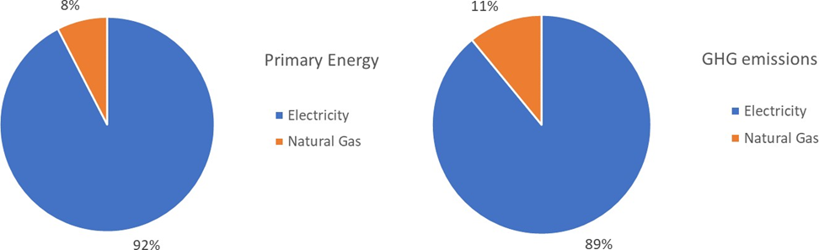
SILCOTUB Characterization
SILCOTUB furnace energy consumption was characterized by 92 % input in form of electricity and 8 % in form of natural gas. Since the Romanian power mix includes renewable and nuclear sources
The furnace GHG emissions related to electricity are lower than the respective share of the primary energy (89 % compared to 92 %). The natural gas is responsible of 11 % of GHG emissions of the total plant.
Primary energy consumption and GHG emission of SILCOTUB ’s Electric Arc Furnace (EAF) in Zalau .
KPI | Silcotub's EAF value | Steel sector (EAF) average value*
Primary energy requirements | 0.08 toe/t | -
Electricity demand | 0.38 MWh/t | -
Natural gas demand | 0.07 MWh/t | -
Environmental performance | 0.13 tCO2eq/t | 0.238 tCO2eq/t
The tones refer to EAF carbon steel produced
*Based on Commission Delegated Regulation (EU) 2019/331.
www.retrofeed.eu

Slide 58
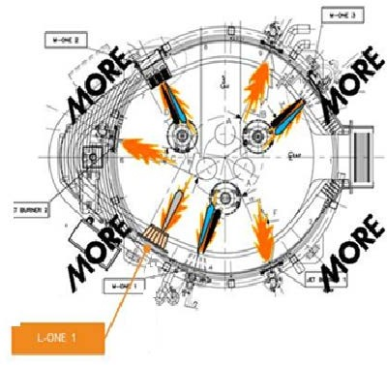
RETROFEED at SILCOTUB
Why is retrofit needed at SILCOTUB?
TENARIS SILCOTUB is committed to reducing the steel process’ environmental footprint, through incorporation of more sustainable feedstock into their processes, following circular economy and industrial symbiosis principles. Through valorization of plastics and rubber recycled from external processes, fossil carbon and natural gas utilizations are expected to be reduced. The extent to which fossil fuels will be replaced will be established during the activities; from performed works, a very good figure is a replacement ratio of coal = 1.2 plastics. The efficiency of the blowing will determine the actual percentage of methane and coal reductions.
Where is retrofit needed at SILCOTUB?
The main objective of the project is to lean the steel production process towards decarbonization, expand circular economy practices and broaden industrial symbiosis relationships. To achieve this, a new injector able to blow rubber, plastic grains, sludges and EAF dust will be designed and installed. Rubber and plastics will be used as carbon and chemical energy sources, replacing coal injected to the EAF and/or natural gas used in the burners. Natural gas substitution by the new materials is indirect since these will not be incorporated into the burners, but rather introduced inside the EAF and burn, releasing heat. Sludges and dust will be blown to recuperate iron from it.
SILCOTUB’s EAF layout
With these actions, it is expected to reduce the steel process’ environmental footprint, through incorporation of more sustainable feedstock into their processes, following circular economy and industrial symbiosis principles.
www.retrofeed.eu

Slide 59
Summary of actions and goals of
SILCOTUB retrofitting
Goals
Reduction of GHG emissions
Use of alternative feedstock
M&C system improvement
Retrofitting actions SILCOTUB
Feeding injection system
www.retrofeed.eu
Notes:
In the steel sector, two end users are involved: FENO and SILCOTUB. In both cases the activities will be centered in the Electrical Arc furnace where circular economy concepts will be applied. In the case of FENO, biochar and plastic grains will substitute the use of fossil fuel for combustion. At the same time, anthracite will be replaced by biochar as Carbon source. so that, the injection system and burner are required to be modified. Whereas in Silcotub, rubber and plastic injection will be used as energy provider in the melting process. In addition, SILCOTUB will intend to replace raw materials incorporating sludges and dust in the furnace. In both cases a reduction of GHG are expected and as I mentioned previously the implementation of circular economy concepts will support the reduction of feedstock.

Slide 61
Chapter 3: Key Resource Indicators (KRI), Key Performance Attributes (KPA) and Expected Project Impact
Notes:
Now let’s learn more about the EU project RETROFEED and each of the 6 demo-sites from the project.

Slide 62

Overview of Chapter 3
  In this chapter, we will learn about:
  Chapter 3.1 KRIs and KPAs
  Chapter 3.2 Expected Impacts in RETROFEED demo-sites
This Photo by Unknown Author is licensed under CC BY
www.retrofeed.eu

Slide 63
Chapter 3.1
KRIs and KPAs
Notes:
Expected Impacts in RETROFEED in terms of some of the selected KRIs and KPA.

Slide 64
KRI and KPA
What is KRI and KPA?
Key Resource Indicators (KRI) reflect environmental and resource efficiency performance.
Key Performance Attributes (KPA) reflect process performance regarding cost, quality and safety.
Why is it important to set KRIs and KPAs?
KRI and KPA is set to monitor the progress of the retrofit actions/the project. The KRI and KPA can be incorporated in the new control of the processes, within the decision support system (DSS) and ease the follow up of targets.
How can indicators in general be evaluated?
The following slides will go through what criterias that can be used to evaluate indicators:
  Criteria for indicators
  SMART
  CREAM
www.retrofeed.eu

Slide 65

Criteria for indicators
    Valid and meaningful
    Sensitive and specific to the underlying phenomenon
    Grounded in research
    Statistically sound
    Intelligible and easily interpreted
    Relate where appropriate to other indicators
    Allow international comparison
    Ability to be disaggregated over time and geography
    Consistency over time
    Timeliness
www.retrofeed.eu
Notes:
In the RETROFEED project, indicators are used to assess technological changes in the process industry. A set of criteria can be useful to evaluate the indicators themselves or, at least, to validate the set of indicators chosen. Different sets of criteria for indicators have been presented in various contexts, which have been identified during a literature review. The most relevant findings from this review are presented in this section, where three frameworks for criteria of indicators are introduced briefly. These frameworks are used as input in the next step, where the relevant documents from each industrial sector were reviewed, before a final selection of indicators was made.
As a starting point, Statistics New Zealand published the following criteria for indicators for use in statistics [Advisory Committee on Official Statistics. (2009). Good practice guidelines for the development and reporting of indicators. Wellingtong: Statistics New Zealand. Cited by Ekvall et al. (2019), p.14.]:
Valid and meaningful – an indicator should adequately reflect the phenomenon it is intended to measure and should be appropriate to the needs of the user.
Sensitive and specific to the underlying phenomenon – sensitivity relates to how significantly an indicator varies according to changes in the underlying phenomenon.
Grounded in research – awareness of the key influences and factors affecting outcomes.
Statistically sound – indicator measurement needs to be methodologically sound and fit for purpose to which it is being applied.
Intelligible and easily interpreted – indicators should be sufficiently simple to be interpreted in practice and intuitive in the sense that it is obvious what the indicator is measuring.
Relate where appropriate to other indicators – a single indicator often tends to show part of a phenomenon and is best interpreted alongside other similar indicators.
Allow international comparison – indicators need to reflect goals specific for the country or region of the study, but where possible they should also be consistent with those used in international indicator programmes enabling comparison.
Ability to be disaggregated over time and geography – indicators should be able to be broken down into population sub-groups or areas of particular interest, such as ethnic groups or regional areas.
Consistency over time – the usefulness of the indicators is directly related to the ability to track trends over time, so as far as possible indicators should be consistent.
Timeliness – there should be minimal time lag between the collection and reporting of data to ensure that indicators are reporting current rather than historical information.
https://waytobi.com/ua/blog/kpi.html - link to the picture

Slide 66

Criteria for indicators
www.retrofeed.eu
Notes:
Another set of criteria identified was proposed by Castro (2011) [Castro, M. F. (2011). Defining and Using Performance Indicators and Targets in Government M&E Systems. The World Bank, Washington, DC. Cited by Ekvall et al. (2019), p.15], who highlights two established principles for the development of performance indicators:
SMART is a framework for management by objectives, presented by Drucker (1954) [Drucker, P. F. (1954). The practice of management. Harper & Row, New York. Cited by Ekvall et al. (2019), p.15] :
Specific (precise and unambiguous)
Measurable (appropriate to subject)
Achievable (of a reasonable cost)
Relevant (serve to assess performance)
Trackable (easy to validate or verify)
https://www.hydratemarketing.com/blog/the-importance-of-setting-smart-goals , link to the picture

Slide 67

Criteria for indicators
    CREAM
      Clear
      Relevant
      Economic
      Adequate
      Monitorable
www.retrofeed.eu
Notes:
CREAM summarizes the requirements on performance indicators for use in the assessment of governmental [Schiavo-Campo, S., & Tommasi, D. (1999). Managing Government Expenditure. Manila: Asian Development Bank. Cited by Ekvall et al. (2019), p.15]):
Clear
Relevant
Economic
Adequate
Monitorable
In summary, the frameworks identified and described above point out at similar criteria; indicators must be monitorable, economically feasible, technically feasible, relevant for the project and its goal and relevant for the industrial sector.
https://www.goodhousekeeping.com/food-recipes/dessert/a22577539/easiest-ever-fruit-and-coconut-ice-cream-recipe/ , link to the picture

Slide 68
Key Resource Indicators (KRI)
Indicator | Unit | Relevance for RETROFEED
KRIs related to energy use and assessment of their relevance
Primary energy consumption | [MJ/output unit] | For all test cases but particularly for the: aluminum case which expects an energy reduction for increase in the share of scrap. the steel and cement factories, which are looking to reduce their primary energy use fertilizer case which aims at modifying their heat source ceramic case which aims at integrating smart combustion and improving the waste heat recovery.
Final energy consumption by type of energy carrier (e.g. natural gas, coal, electricity, etc.) | [MJ/unit product] | For all test cases but particularly for cases mentioned under primary energy consumption.
KRIs related to material flow and assessment of their relevance
Material intensity, as in raw material per unit of product | [kg/unit product] | Relevant for all test cases, as material intensity reductions are expected for all cases.
Input of waste/by products as raw material (not energy carrier) or Input of recycled material | [%] [kg/unit product] | Relevant for all test cases as waste reductions are also expected, but particularly for the: aluminum case which aims at increasing the input of scrap ceramic case which aims at reducing raw material consumption fertilizer case which aims at using alternative sources of phosphate (P), sulfur (S) and potassium (K).
Abiotic depletion Fossil depletion | [kg Sb eq/ FU] [kg oil eq/ FU] | Relevant for all test cases, as reductions of fossil feedstock are expected in all pilot cases.
www.retrofeed.eu
Notes:
The Key Resource Indicators (KRI) are grouped into the following themes:
energy use
material flows
water use
waste generation
GHG generation
other emissions
Table shows:
First column shows the name of the indicator.
Second column shows in which unit the indicators is given.
Third column shows the relevance for the RETROFEEDs different demo-sites/pilot cases.
All the indicators selected are considered to be monitorable as part of the measurements planned for the pilot cases in the project. By being part of the monitoring work in RETROFEED, the economic feasibility of their measurement is also secured. Therefore, the main criteria used for the selection is the relevance of the indicators, as an assessment of the performance of the specific actions planned within the project and as an indicator that is widely measured within the relevant sectors.

Slide 69
Key Resource Indicators (KRI)
Indicator | Unit | Relevance for RETROFEED
KRIs related to water use and assessment of their relevance
(Gross) water use (Overall water input) | [m3/ unit product] | Particularly relevant for the: fertilizer case which needs process water, and savings are expected TORRECID, where water loses occur in the furnace and are expected to be reduced.
Net water use = water consumption (water input minus water output) | [m3/unit product] | Same as for “(Gross) water use”.
Water discharge | [m3/year] | Particularly relevant for the cement, steel and fertilizer cases as globally leading producers include it in their sustainability reports.
Nitrogen compounds, phosphate compounds and fluoride compounds discharged with wastewater | [t] | Particularly relevant for the fertilizer case as globally leading producers include it in their sustainability reports and the BAT document includes it as well.
KRIs related to waste generation and assessment of their relevance
Generation of non-hazardous waste Generation of hazardous waste | [t] | Relevant for all cases, where waste reductions are expected.
Waste to disposal (landfill, incineration without energy recovery) Waste to recycling (upcycling, downcycling) Waste to energy recovery | [%] | Relevant for all cases, where waste reductions are expected.
www.retrofeed.eu

Slide 70
Key Resource Indicators (KRI)
Indicator | Unit | Relevance for RETROFEED
KRIs related to GHG generation and assessment of their relevance
Scope 1 GHG emissions (emissions released from owned or controlled sources) | [t CO₂ eq] | Relevant for all cases, included in most of the reviewed sustainability reports.
Scope 2 GHG emissions (emissions from purchased energy) | [t CO₂ eq] | Relevant for all cases, included in most of the reviewed sustainability reports.
Scope 3 GHG emissions (all up- and downstream emissions not included under scope 1 and 2) | [t CO₂ eq] | Relevant for all cases, included in most sustainability reports.
KRIs related to generation of other emissions and assessment of their relevance
NOx, SOx, PM (particulate matter) | [kg] [kg/unit product] | Relevant for all cases, as combustion of fossil fuels is expected to be reduced. If natural gas is the only fossil fuel, PM is not relevant.
NH₃ | [kg] | Particularly relevant for the fertilizer case, as emissions are expected to be reduced.
Fluoride compounds | [kg] | Particularly relevant for cement, aluminum, steel and ceramic case since it is included in the BAT documents.
VOC (volatile organic compounds including methane) | [g] | Particularly relevant for cement, aluminum, steel and ceramic case since it is included in the BAT documents.
Metals | [mg] | Relevant e.g. lead and copper for the steel case – see BAT document for more details Relevant e.g. mercury for the cement case – see BAT document for more details.
Chlorinated compounds | [mg] | Particularly relevant for steel, cement and ceramic case as they are included in the related BAT documents.
www.retrofeed.eu

Slide 71
Key Performance Attributes (KPA)
Indicator | Unit | Relevance for RETROFEED
KPAs and assessment of their relevance
Production cost | [€/t of product] | Relevant for all cases, since cost reductions are one of the main drivers of RETROFEED.
Production rates | [t of product/year] | Relevant for all cases, as increased productivity is one of the RETROFEED goals.
Fatality rate Fatal accidents | [number/months] | Relevant for all cases. Safety is not expected to be affected but it is important to ensure that the process modification do not have indirect effects.
High risk accidents | [number/months] | Relevant for all cases. Same as with fatality rate.
Quality | Defined for each site. | Relevant for all cases. Maintaining the quality of the product beyond the implementation of the project is highly relevant for the feasibility of the pilot cases.
www.retrofeed.eu

Slide 72
Selection of indicators and system boundaries
The objectives are divided into three categories:
R – Reduce I – Increase O – Optimise
The KRIs which have been selected for the demo-sites belong to the categories:
Energy use (for each energy carrier) Use of raw materials (for each raw material)
Waste disposal Water consumption
Water discharge Emissions to water
CO2 emissions Other GHG emissions / Other emissions to air.
The KPAs which have been selected are within the categories:
Productivity Quality Safety Costs
Reject ratio Downtime, planned and unplanned
www.retrofeed.eu
Notes:
The selection of indicators, KRIs and KPAs, and system boundaries are presented for each demo- site. The selection is based on the objectives of the RETROFEED project at each site, in combination with the result from the literature study of relevant indicators for the industrial sectors within the scope of the project. The objective that is related to each indicator is described in the table for each demo- site.
The objectives are divided into three categories:
R – Reduce, I – Increase, O – Optimise
In the following sub-chapters, the system boundaries are illustrated for each demo-site. The system boundary for the KRIs is the specific industrial process that is in focus in the RETROFEED project, in most cases the core production process. The KPAs use a wider system boundary which include all or a larger part of the industrial plant.
The KRIs which have been selected for the demo-sites belong to the categories:
Energy use (for each energy carrier).
Use of raw materials (for each raw material).
Waste disposal.
Water consumption.
Water discharge.
Emissions to water.
CO₂ emissions.
Other GHG emissions.
Other emissions to air.
The KPAs which have been selected are within the categories:
Productivity.
Quality.
Safety.
Costs.
Reject ratio.
Downtime, planned and unplanned.
Safety, quality, reject ratio and downtime are not expected to be affected by the RETROFEED project. Nevertheless, it is important to make sure that deviations do not occur as a result of RETROFEED modifications.

Slide 73
Chapter 3.2
Expected Impacts in RETROFEED demo-sites
Notes:
Expected Impacts in RETROFEED in terms of some of the selected KRIs and KPA.

Slide 74
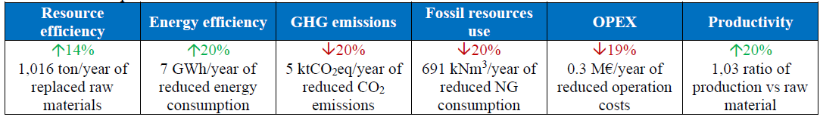
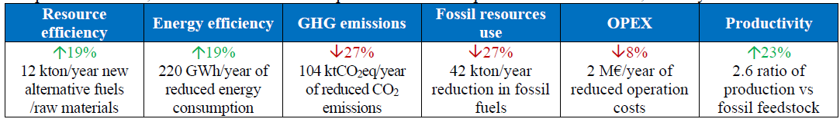
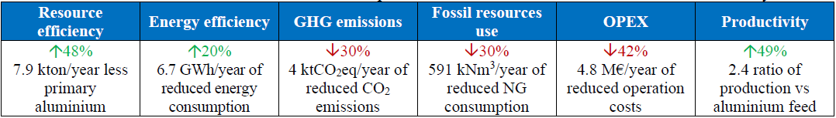
Expected impacts
TORRECID
SECIL
ASAS
www.retrofeed.eu

Slide 75
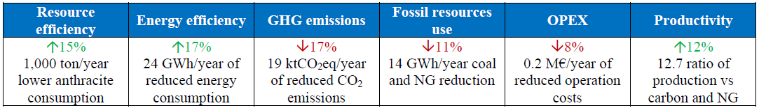
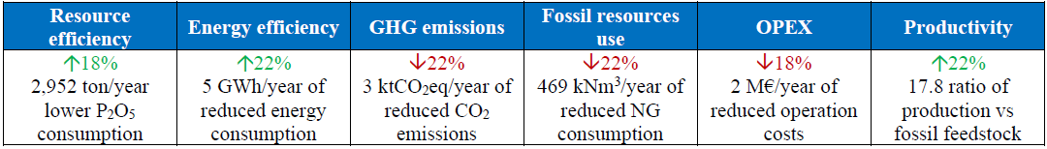
Expected impacts
Resource efficiency | Energy efficiency | GHG emissions | Fossil resources use | OPEX | Productivity
↑20% 700 ton/year lower raw material consumption | ↑18% 10 GWh/year of reduced energy consumption | ↓10% 2.2 ktCO₂eq/year of reduced CO₂ emissions | ↓15% 6.48 GWh/year coal reduction | ↓5% 0.1 M€/year of reduced operation costs | ↑10% 11.6 ratio of production vs carbon
SILCOTUB
FENO
FERTIBERIA
www.retrofeed.eu
Notes:
@GEO feel free to change the graphics of this slide

Slide 76
Group Activity:
Are these indicators relevant also for the sustainable future? What changes would you recommend?
www.retrofeed.eu

Slide 78
Chapter 4: Digital Twin (DT) Development
Notes:
In chapter 4.1. we will go through what digital readiness level means, and why it is done.
In chapter 4.2 you will learn about digital twins and the basics to create one. Digital twins are integrated into a decision support system when implementing the retrofeed solution.
In chapter 4.3 an example of digital twin for the agrochemical sector is presented.
Nina notes, erase later:
Concrete actions..
Development of digital twins of the core process to be retrofitted.
Implement circular economy by introducing by-products and waste streams as alternative feedstock.
Adapt equipment for the provision and use of bio-based and recycled feedstock whether as fuel or raw material, thus replacing traditional feedstock.
Improve the control system of the retrofitted processess.
Develop a Decision Support System for assessing the best retrofitting options and operation plan of the improved processes.
Is it possible to draw a flowchart of the steps to do the retrofitting/retrofeed? /Nina
What are the latest developments in digital twins for industrial processes?
How can a digital Decision Support System be used to monitor, analyze and simulate the potential impact of retrofitting solutions?
To provide knowledge on methods for assessing the best retrofitting options to achieve a high impact over the whole production chain, for example Decision Support System and Life Cycle Analysis.
Introtext:

Slide 79

Overview of Chapter 4
  In this chapter, we will learn about:
  Chapter 4.1 Digital Readiness Level
  Chapter 4.2 Digital Twins and how to create one
  Chapter 4.3 Example of digital Twin for Agrochemical Sector
www.retrofeed.eu
Notes:
In chapter 4.1. we will go through what digital readiness level means, and why it is done.
In chapter 4.2 you will learn about digital twins and the basics to create one. Digital twins are integrated into a decision support system when implementing the retrofeed solution.
In chapter 4.3 an example of digital twin for the agrochemical sector is presented.

Slide 80
Chapter 4.1
Digital Readiness Level
Notes:
The first step to check whether the plant is able to implement retrofeed solutions is to check the digital readiness level which is defined and described in this chapter.

Slide 81
RETROFEED- Digital Readiness Level
It is an assessment done on the industrial plants where potential gaps between their current level and their requirements for implementing retrofitting solutions are identified. This is done to avoid process disruptions or product quality variations.
It is the starting point to develop a step-by-step digital retrofitting development plan covering hardware, software as well as data management aspects. Investment and technical and organizational risks are also estimated as well as the strategic fit with broader industry 4.0 plans.
How “RETROFEED-Ready” are the industrial plants?
What steps are to be taken to make the industry ready to replicate RETROFEED solutions?
www.retrofeed.eu
Notes:
European resource- and energy-intensive industries aiming to replicate RETROFEED solutions need to be “RETROFEED-Ready” to avoid process disruptions or unplanned product quality variations. This requires the use of an advanced monitoring and control system and a Decision Suport System (DSS) which also includes the ability to collect certain information (data capture, ….) as well as skilled staff to use such systems.
The digital maturity level shows great variations not only between sectors but also within ranging from industry 1.0 to industry 4.0 with the latter using advanced optimization and analytical tools as required for RETROFEED solutions.
The intention behind outlining a RETROFEED Digital Readiness Level (hereinafter RF-DRL) is to leverage the well-known and accepted readiness level concept for the RETROFEED replication methodology and for engagement activities with stakeholders being able to:
a) deliver a first quick indication of possible gaps between the current state-of-play of a company and the requirements for implementing retrofitting solutions as proposed and tested by RETROFEED project, and
b) at the same time highlight the steps to be taken to be ready to replicate RETROFEED solutions.

Slide 82
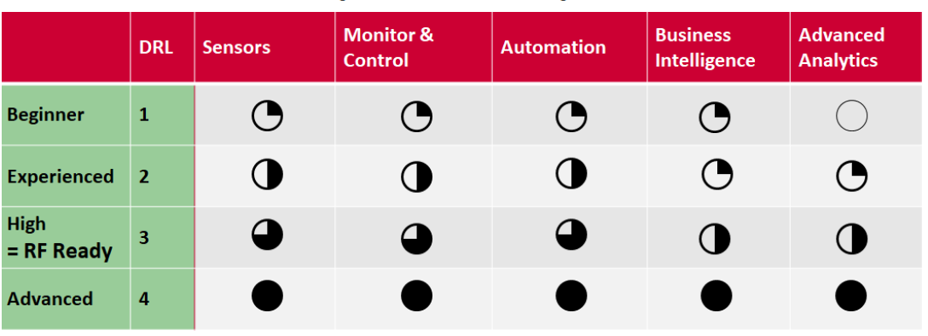
Overview of RETROFEED- Digital Readiness Levels
DRL:Digital Readiness level
RF: Retrofeed
www.retrofeed.eu
Notes:
Digital readiness level – DRL 3 is needed for retrofit solutions.
If the plant for example is assessed to be experienced a step by step digital readiness development plan is needed.
The RF-DRL is a deviation from the known concept of a DRL which in itself is a deviation from the TRL concept. Using the RF-DRL should give you enough clarity what steps would be needed to be able to replicate a RF solution. In case the gap is big, that has a direct impact on cost (high investment needed = negative impact on business case) and risk (system failure due to lack of skills and experience).

Slide 83
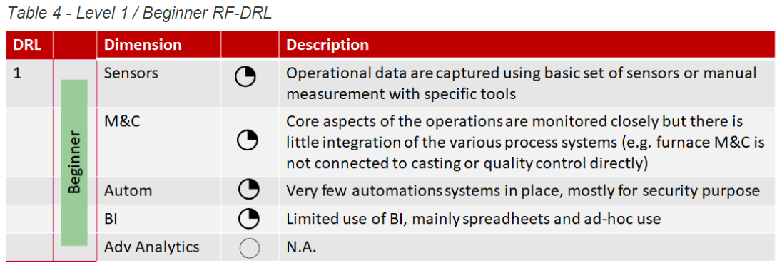
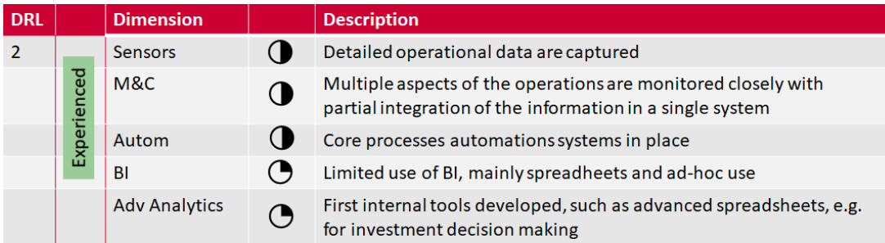
Detailed description of the RF-DRL
www.retrofeed.eu
Notes:
Interpretation of the levels:
Major digital enhancements are needed on all dimensions. That does not only require high investments in digital infrastructure, but likely also in skill development of staff as well as a review and redesign of entire operations. The investment need to move from RF-DRL 1 to 3 is likely so high, that the RETROFEED business case appears economically unattractive. However, a company could decide on replicating a RETROFEED solution using its implementation as a driver and supporting use-case for the implementation of an overall digital development strategy
Digital enhancements are needed. However, a RF-DRL 2 means that progress has been made on all dimensions already, not only on the digital infrastructure side, but also on processes and skill level. Learnings generated through the use of tools and data should have reassured the organisation of the benefits of moving towards a digital factory and built trust in the benefits and capability to further progress on digital development. Replication of RETROFEED solutions could act as a lighthouse project within the organisation. Investment needs might differ on individual dimensions and a positive business case is possible even for a RETROFEED solution alone.

Slide 84
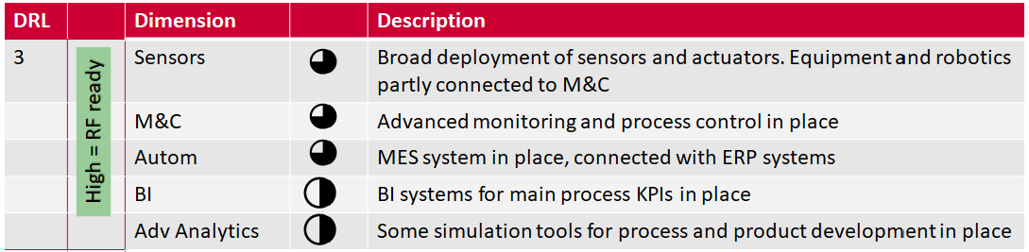
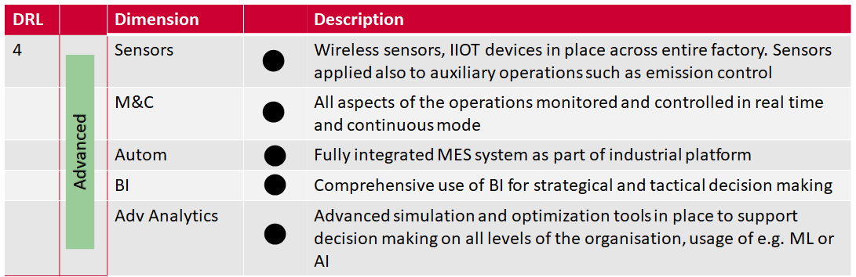
Detailed description of the RF-DRL
www.retrofeed.eu
Notes:
3) In principle, the company or plant is digitally mature enough on all dimensions to replicate a RETROFEED solution. Investment needs should be limited and ideally a RETROFEED solution should be implementable as another use-case leveraging an already existing digital foundation with a high likelihood of a positive business case. Time to implement should be short.
The outcome of the RF-DRL assessment can be used in two ways: as a starting point providing guidance for the steps to be taken towards becoming “RETROFEED Ready” and as an input to the RETROFEED decision matrix as a tool of the RETROFEED replication methodology to assess the tactical and strategic relevance of a RETROFEED solution towards increasing the competitiveness of an REII factory.

Slide 85
Chapter 4.2
Digital Twins in Industrial Retrofitting

Slide 86

What is a Digital Twin?
A Digital Twin (DT) is a model in the form of computer program that uses real world data to create simulations that can predict how a product or process will perform.
In the RETROFEED project DT corresponds to computational model of the core processes, whose retrofitting is the main focus.
Examples of techniques utilized in development of digital twins:
  Machine Learning
    Capture the system behavior with data history
    Identify new patterns of data and predict the behavior of systems more quickly and effectively
  Computational Fluid Dynamics (CFD) model
    Useful in smelters, combustion chambers, boilers
    Predicts the thermal profile, chemical composition and
    melting conditions
www.retrofeed.eu

Slide 87
Where is a Digital Twin used?
DT are meant to be integrated in the software infrastructure of the Decision Support System (DSS), to provide it with information on the functioning of the relevant processes in the respective demo-site.
A DSS is an information system that helps the operators and engineers in a plant to make changes and take decisions in the process with more certainty.
This means that the DSS includes also other processes at plant level, in addition to the core processes.
www.retrofeed.eu
Notes:
A DSS based on digital twins are used to
Digital twins: characterise the behaviour of this equipment and their interaction with upstream and downstream processes, as well as to analyze the impact of several retrofitting scenarios and the modification of the process conditions without affecting the product quality. This is complemented by installing monitoring sensors that provide information to the digital twin
DSS:
pre-diagnose inefficiencies and bottlenecks in terms of resource and energy efficiency and to simulate several retrofitting scenarios in order to select the most suitable investment from a technical and economic perspective; and
support to plant operation once the retrofitting actions have implemented, facilitating the decision-making for alternative raw materials purchasing and utilization and the modification of the process conditions accordingly.

Slide 88
How to create a Digital Twin

Slide 89
MODELLING SPECIFICATIONS
Inputs 𝑢
Model
Outputs 𝑦
Parameters 𝑝
A simulation model is intended as a digital representation of a real system by means of appropriate algorithms or equations aimed at characterizing some specific features of its functioning. Specifically, a model is meant to establish a meaningful relation between a given set of input and output signals. Given a set of input data 𝑢 and parameters 𝑝, a model outputs a set of data 𝑦. The development of a digital model consists therefore in implementing computationally a set of equations of the form 𝑦 = 𝑓(𝑢, 𝑝) that mimic the behavior of the real system.
www.retrofeed.eu
Notes:
In this context, a simulation model is intended as a digital representation of a real system by means of appropriate algorithms or equations aimed at characterizing some specific features of its functioning (G. Dubois, Modelling and Simulation: Challenges and Best Practices for Industry, CRC Press, 2018.). Specifically, a model is meant to establish a meaningful relation between a given set of input and output signals. With reference to Figure, given a set of input data 𝑢 and parameters 𝑝, a model outputs a set of data 𝑦. The output values 𝑦 computed by the model should resemble as closely as possible the values that the corresponding physical quantities assume when the real system undergoes the same conditions. The development of a digital model consists therefore in implementing computationally a set of equations of the form 𝑦 = 𝑓𝑓(𝑢, 𝑝) that mimic the behaviour of the real system.

Slide 90
Getting started with modelling of a Digital Twin
Step 1: Identify the boundaries of the system to be described by means of the model
Step 2: Verify that enough data is available for the development and validation of the model
www.retrofeed.eu

Slide 91
CRITERIA FOR IDENTIFICATION OF BOUNDARIES
The processes that need to be modelled are those that have an impact:
on the key resource indicators (KRI)
on the key performance attributes (KPA)
www.retrofeed.eu
Notes:
The boundaries of such analysis, and hence the processes to be represented (up to a given level of accuracy) in a digital form, depend on the decisions that the DSS (Decision Support System) is supposed to aid the end-users in making. Indeed, to the aim of supporting decisions, the DSS will need to elaborate a certain amount of information, among which that related to the functioning of processes will be supplied by the corresponding digital models. The processes that need to be modelled are those that have an impact: on the key resource indicators (KRI) and on the key performance attributes (KPA)

Slide 92
Step 1: Boundaries identification
Boundaries identification for the sites.
Steel sector
Steel sector
Cement sector
Ceramic sector
Aluminium sector
Agrochemical sector
www.retrofeed.eu
Notes:
@geo: Notice the hyperlinks on the logos

Slide 93
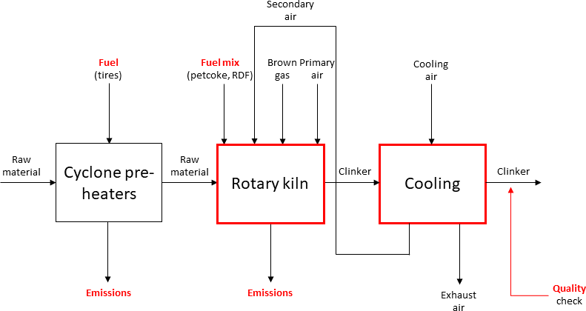
CRITERIA FOR BOUNDARIES IDENTIFICATION AT
PC model | Purpose
Fuel mix optimization model | Select the best fuel mix, considering availability and price of different fuels
Cooling and quality model | Predict the quality of the clinker produced
Emissions model | Predict the overall amount of pollutants
1,
2
3,
The main processes and variables to be considered in the DSS (in red)
www.retrofeed.eu
Notes:
The RETROFEED project at SECIL demo-site will focus on the clinkering process, sketched in Figure, and will be aimed at reducing the CO2 emissions by increasing the percentage of bio-based feedstock (such as RDF) in the fuel mix consumed by the main burner of the rotary kiln.
In this case, the DSS should provide indications on the best fuel mix to be employed and on the regulation of some process parameters, such as the Brown gas and cooling air injection rate, to favour the increase of bio-based feedstock, without compromising the quality of the final product.
The core process, i.e. the rotary kiln, will be modelled by the DT, consisting in a CFD model of the combustion, including the effects of the multi-fuel burner. Upstream of the core process, the cyclone pre-heaters, where the raw material is heated up before entering the kiln, affect the emission of pollutants, whereas downstream, the cooling process has an impact on the quality of the clinker produced. The quality of the product is currently checked by laboratory analysis (XRD, XRF) carried out on samples collected after the cooling process for each batch every two hours. Within the RETROFEED project, a new monitoring system based on multispectral image analysis will also be deployed, to estimate clinker composition, phase distribution and grain size. Since the aforementioned effects are relevant to the analysis of the DSS, those need to be modelled, even if in a simplified form. The resulting list of PC models is reported in Table .
1.The digital twin of rotary kiln consists of a one-dimensional balances-based model, fed with accurate combustion information from Computational Fluid Dynamics (CFD) simulations. Cyclone pre-heaters are also modelled to correlate inputs to DSS to inputs to DT. Upstream of the core process, the cyclone pre-heaters, where the raw material is heated up before entering the kiln, affect the emission of pollutants, whereas downstream the clinker outlet composition and temperature are predicted.
2. The cooling process has an impact on the quality of the clinker produced.
3.The quality of the product is currently checked by laboratory analysis carried out on samples collected after the cooling process for each batch every two hours. Within the RETROFEED project, a new monitoring system based on multispectral image analysis will also be deployed, to estimate clinker composition, phase distribution and grain size.
Production Chain (PC): Models that represent processes that are upstream or downstream of the core processes are referred to as “production chain” (PC) models.

Slide 94
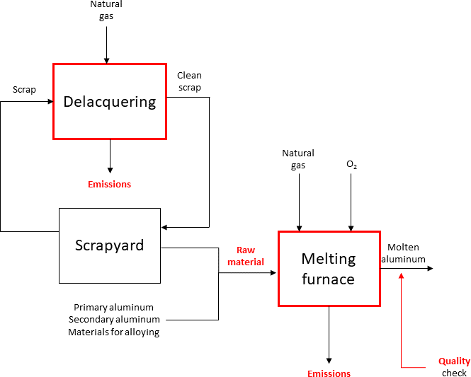
CRITERIA FOR BOUNDARIES IDENTIFICATION AT
PC model | Purpose
Feeding model | Select the best mix of raw material, considering availability and economic aspects
Delacquering model | Predict energy consumption and level of contamination of the treated raw material
Quality model | Predict the quality of the molten aluminum
2
1,
3,
The main processes and variables to be considered in the DSS (in red)
www.retrofeed.eu
Notes:
The RETROFEED project at ASAS demo-site will focus on the melting process, the main goal being to increase the amount of scrap used as raw material in the melting furnace. To this aim, the smelter will be retrofitted, through the modification of the burner head, including the installation of a new oxygen injector. Furthermore, a new delacquering system will be designed and installed. An overview of the resulting smelting process is provided in Figure. The main processes and variables to be considered in the DSS are shown in red.
The Decision Support System (DSS) is expected to support the best mixture of raw materials to be fed to the melting furnace. Raw material management is currently not automatized. The increased amount of scrap used as raw material should not determine a decrease in quality of the molten aluminum. The Digital Twin (DT) will consist in a Computational Fluid Dynamics (CFD) model of the core process, i.e. the combustion occurring in the melting furnace, and will include the effects of the new oxygen injector.
In order to provide the Decision Support System (DSS) with information concerning the functioning of the delacquering system, the constraints on the selection of raw material, the level of emissions and the quality of the resulting product, additional Production Chain (PC) models will be developed.
3. The quality of the product is measured in terms of chemical composition and hydrogen level, and it is also significantly influenced by temperature.
Production Chain (PC): Models that represent processes that are upstream or downstream of the core processes are referred to as “production chain” (PC) models
In this context, the main decision the DSS is expected to support concerns the best mixture of raw materials to be fed to the melting furnace. Raw material management is currently not automatized. At the same time, the increased amount of scrap used as raw material should not determine a decrease in quality of the molten aluminum, which is assessed by means of laboratory analyses carried out on samples taken at the exit of the melting furnace. The quality of the product is measured in terms of chemical composition and hydrogen level, and it is also significantly influenced by temperature. The DT will consist in a CFD model of the core process, i.e. the combustion occurring in the melting furnace, and will include the effects of the new oxygen injector. In order to provide the DSS with information concerning the functioning of the delacquering system, the constraints on the selection of raw material, the level of emissions and the quality of the resulting product, additional PC models will be developed, that are listed in Table.

Slide 95
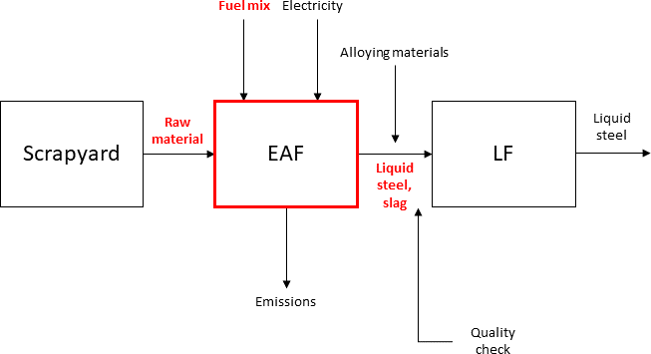
CRITERIA FOR BOUNDARIES IDENTIFICATION AT FENO
2,
PC model | Purpose
Feeding model | Select the best mix of raw material, based on desired recipe and economic aspects
Fuel mix selection model | Select the best mix of alternative fuels
Quality model | Correlate the quality of the produced steel to the mixture of scrap employed
1,
The main processes and variables to be considered in the DSS (in red)
www.retrofeed.eu
Notes:
The RETROFEED project at Ferriere Nord’s demo-site will focus on support is the selection of the best fuel mix to be fed to the new burner. Based on the tests done so far, besides significantly reducing the melting costs, burning alternative fuels is expected to contribute to the reduction of fossil-CO2 emissions, as burning biochar is environmentally neutral. However, this change should be made in such way that productivity or product quality are not affected.
1.The replacement of raw materials is aimed at decarbonizing the process, without compromising its energy efficiency, nor the quality of the product. The selection of scrap is driven by two key factors: the results of the liquid steel analysis carried out on samples of the previous batches and economic considerations. Information concerning these two aspects will be provided to the Decision Support System (DSS) by two different Production Chain (PC) models, i.e. the “quality model” and the “feeding model”, respectively. The DSS will orchestrate such information to select the most suitable mixture of scrap. The Digital Twin (DT) is meant to simulate the reactions occurring in the Electric Arc Furnace (EAF).
2. The term “Fuel mix” means anthracite, plastic/biochar/tyre-grains, LF slag recycle, CaO injection, and other slagging agents
Production Chain (PC): Models that represent processes that are upstream or downstream of the core processes are referred to as “production chain” (PC) models
The quality of the product is currently checked downstream of the EAF, by taking samples from the LF furnace and checking their composition through laboratory analyses.
Although the DT considers the composition of the mix of scrap entering the EAF as a deterministic input, in practice such quantity is significantly affected by uncertainty. This operation might be supported by a ML model, aimed at correlating the presence of copper contaminations in the molten steel to the scrap mix that is fed to the EAF. This parameter is indeed an important indicator of the quality of the product: if copper exceeds a certain threshold percentage, in fact, the steel needs to be declassified. On the other hand, the presence of copper is not directly influenced by the process occurring in the EAF, but it rather depends on the presence of copper in the various types of scrap, whose composition is hardly known. In order to provide the DSS with additional information on the functioning of the plant, the PC models listed in Table will be developed.

Slide 96
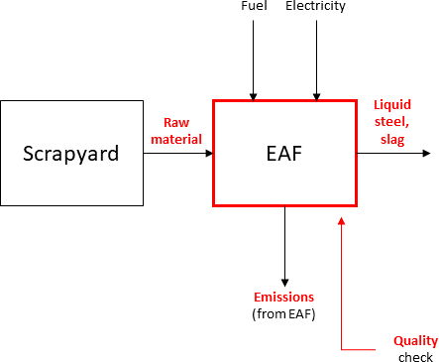
CRITERIA FOR BOUNDARIES IDENTIFICATION AT
PC model | Purpose
Feeding model | Select the best mix of raw material, based on desired recipe, volumetric constraints, economic aspects
Energy/fuel model | Select the best mix of energy sources to be fed to the EAF, considering also economic aspects
EAF emissions model | Predict composition of EAF exhaust gases
1,
The main processes and variables to be considered in the DSS (in red)
www.retrofeed.eu
Notes:
The RETROFEED project at TENARIS SILCOTUB demo-site will focus on the EAF, which will be retrofitted in such a way to allow the use of industrial residues, such as rubber and plastics, to replace coal and natural gas as carbon and chemical energy sources. In this case, the main decision to be supported by the DSS is the selection of the raw materials to be introduced in the EAF. The replacement of raw materials is aimed at decarbonizing the process, without compromising its energy efficiency, nor the quality of the product. The selected scrap should also satisfy additional requirements concerning density. The selection of scrap is driven by two key factors: namely, the results of the liquid steel analysis carried out on samples of the previous batches and economic considerations. Information concerning these two aspects will be provided to the DSS by two different PC models, i.e. the “quality model” and the “feeding model”, respectively. The DSS will orchestrate such information to select the most suitable mixture of scrap. The DT is meant to simulate the reactions occurring in the EAF. The quality of the product is assessed by analysing samples of liquid steel taken from the EAF. Samples are collected once per heat, before the tapping operation. Although the laboratory analysis is manual, results are available after only approximately 5 minutes. The uncertainty on the chemical composition of scrap affects the results quite significantly.
Developing a model that correlates such composition (at the EAF output) to the raw material composition, the combustion temperature and other relevant parameters might be useful to have an indication on the amount of pollutants produced when using the alternative raw materials. In order to provide the DSS with additional information concerning the selection of raw material and energy sources, as well as the emissions, some additional PC models have been envisaged, that are listed in Table.
1.The replacement of raw materials is aimed at decarbonizing the process, without compromising its energy efficiency, nor the quality of the product. The selection of scrap is driven by two key factors: the results of the liquid steel analysis carried out on samples of the previous batches and economic considerations. Information concerning these two aspects will be provided to the Decision Support System (DSS) by two different Production Chain (PC) models, i.e. the “quality model” and the “feeding model”, respectively. The DSS will orchestrate such information to select the most suitable mixture of scrap. The Digital Twin (DT) is meant to simulate the reactions occurring in the Electric Arc Furnace (EAF).
Production Chain (PC): Models that represent processes that are upstream or downstream of the core processes are referred to as “production chain” (PC) models

Slide 97

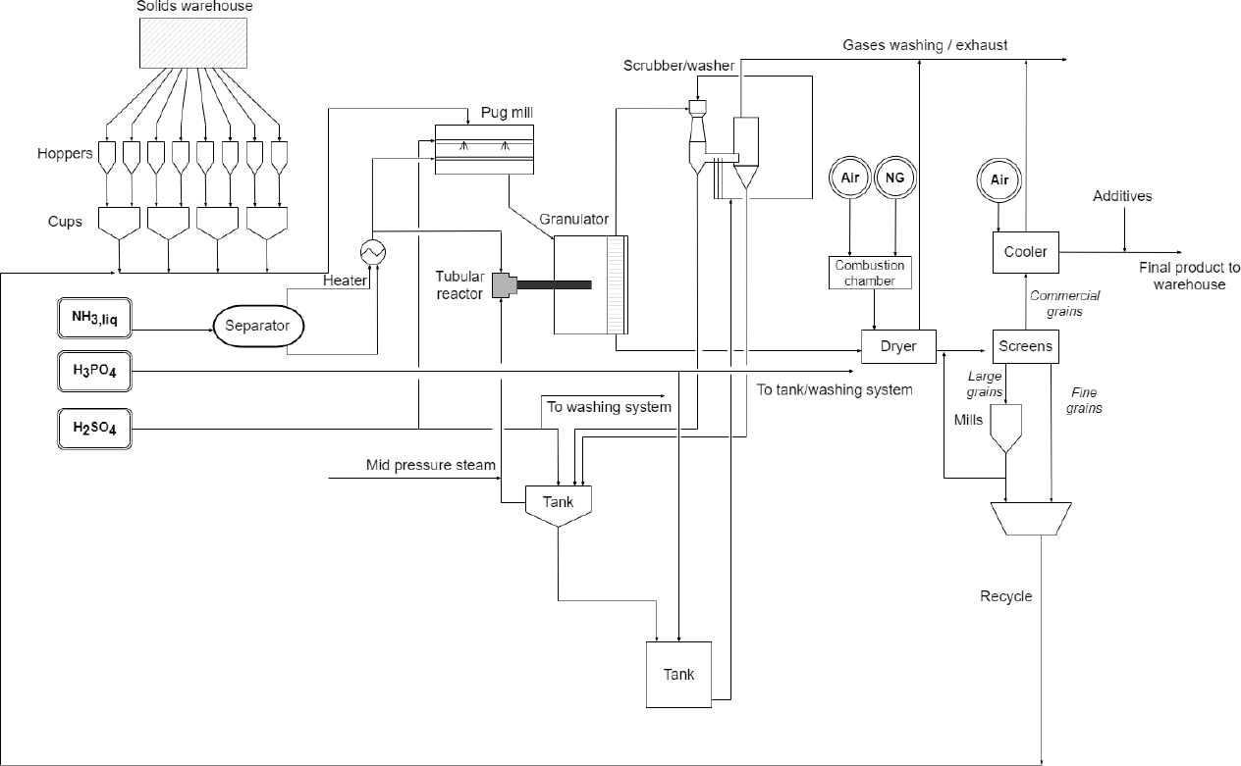
CRITERIA FOR BOUNDARIES IDENTIFICATION AT
UNIT 1
PC model | Purpose
Process deviations model | Predict process deviations from nominal operating conditions, based on raw material mix
Diagram of the NPK fertilizers production line
www.retrofeed.eu
Notes:
The RETROFEED project at FERTIBERIA demo-site will focus on the operation with increasingly variable sources of phosphorus: ashes and struvite. The usage of ashes in which the phosphates are in insoluble form poses a problem: to be incorporated into the fertilizer granules, phosphates need to be solubilized, which requires a significant amount of heat. To this aim, the tubular reactor, that supplies heat to the reaction occurring in the granulator by reacting ammonia with phosphoric acid, will be substituted by a new reactor, where ammonia will be reacted with concentrated sulphuric acid instead, giving rise to a highly exothermic reaction. The new tubular reactor will be implemented in a pilot plant to run preliminary trials on its operation and modelled by the DT at both pilot and full scale.
The DSS should give indications on deviations from the nominal operating conditions in the pug mill, granulator and drier, based on the mix of materials fed to the line, so as to warn the operators in case something goes wrong, such that they can intervene before the material reaches the end of the production line. However, in order to offer such feature, the DSS needs to rely on predictions of the deviations from the normal operating conditions, which cannot be provided by the DT, that only simulates the behaviour of the tubular reactor. To this aim, an additional PC model has been envisaged to be integrated in the DSS, illustrated in Table.
Production Chain (PC): Models that represent processes that are upstream or downstream of the core processes are referred to as “production chain” (PC) models

Slide 98
Step 2: Data verification and model validation
Once the model is developed, its effectiveness in predicting the behavior of the real system needs to be verified, by comparing the results of the simulated system to the measurements collected from the real system.
A validation dataset needs to be available, including input and output data measured from the real system that were not employed in calibrating/training the model.
The validation process consists in feeding the measured input data to the model and comparing the obtained outputs to the real output data measured from the real system.
The closer the simulated and the measured output signals, the better the model accuracy.
www.retrofeed.eu

Slide 99

SOFTWARE INTEGRATION
Schematics of the integration of the models within the DSS software architecture
www.retrofeed.eu
Notes:
The digital models developed within the RETROFEED project will eventually be integrated in the DSS architecture. Figure shows a detail of the DSS main diagram, illustrating schematically where the models are located and how they interact with the DSS (the Retrofeed tool). Specifically, the models will be located on a dedicated server, separate from the server that will host the DSS.
ML = Machine learning

Slide 100
Chapter 4.3
Digital Twin for Agrochemical Sector
Notes:
In the following part of the course, you will learn how a digital twin was developed for a demo-site in the agrochemical sector within the RETROFEED Project.

Slide 101

Group discussion
Discuss in groups of 3:
What possible risks are associated to digital twins?
How can these risks be minimized?
www.retrofeed.eu
Notes:
Accuracy? Reliability?

Slide 102
Digital Twin at
Type of Digital Twin (DT): Reduced order model (ROM) of tubular reactor for production of NPK fertilizer based on CFD simulations of the reaction process.
Goal: Predict temperature and pH at outlet of tubular reactor for specific compositions of the recipes.
Input: Material flows and stream properties based on recipes and data from Fertiberia’s pilot plant and laboratory tests.
Benefits: Achieve a higher process flexibility in terms of feedstock, reducing energy consumption and increasing process predictability
www.retrofeed.eu
Notes:
We describe an example from Fertiberia (agrochemical sector; demo-site in RETROFEED project) on how to develop a digital twin.
Reduced order model (ROM)
The Reduced Order Model (ROM) is built from the simulations run with the CFD-model under different scenarios. It can be thought of as a complex interpolation scheme between the desired input values and the outputs obtained from the simulations run with those inputs. Once the ROM is obtained, new scenarios can be calculated in real time.
Fertiberia’s core process Digital Twin
The Digital Twin of Fertiberia core process is in the form of a ROM, in a functional mock-up unit (fmu) format.
Why is a ROM needed:
CFD has the disadvantage that it requires a license and can take hours to DAYS to converge. Not useful for day-to-day decisions or for control purposes. Therefore, a simplified, faster mathematical model is needed. This is ROM.
Computational Fluid Dynamics (CFD)
Computational fluid dynamics (CFD) is a branch of fluid dynamics where simulations and analysis are performed in computer-aided design (CAD) software to calculate the flow of fluids in a certain system. CFD can for example be used to simulate the mixing of chemicals in a pipe, the reaction throughout a reactor or the turbulence in a turbulent flow.

Slide 103
Steps to build digital twin at
Develop CFD model: Analyze the tubular reactor and develop a strategy for building the CFD model. Build a CFD model of the full-scale reactor. Validate the model using results of pilot plant data and laboratory test results. Obtain pH and temperature at the reactor outlet for inlet conditions representing different recipes.
Produce a DT from the ROM: Export the ROM to a format that is appropriate to be used in control environments (such as SIMULINK).
Produce a reduced order model (ROM) from CFD simulations: ROM is a mathematical representation that reduces the complexity and time of the CFD simulation. The ROM is built from the outputs of several CFD simulations covering a range of values for the inputs of interest. For new set-points, the ROM gives immediate responses.
www.retrofeed.eu
Notes:
Digital Twin (DT) and Reduced order model (ROM)
Explanation of the DT: the strategy to build the ROM consists in running CFD simulations in many different scenarios representing different operations of the reactor, relating to different recipes.
The results of such simulations are used to produce a mathematical representation of the CFD model with reduces complexity.
The advantage of the ROM is that it can be used to simulate new scenarios in real time, instead of hours or days necessary to run a CFD simulation.
The ROM can be exported using standard libraries to a format usable by control environments. In this way it will be integrated in the decision support system (DSS), allowing the user to run simulations in real time of new scenarios an assess their suitability before implementing them.
Computational Fluid Dynamics (CFD)
Computational fluid dynamics (CFD) is a branch of fluid dynamics where simulations and analysis are performed in computer-aided design (CAD) software to calculate the flow of fluids in a certain system. CFD can for example be used to simulate the mixing of chemicals in a pipe, the reaction throughout a reactor or the turbulence in a turbulent flow.

Slide 104
Step 1:
Develop a CFD model

Slide 105


- Development of CFD model of Fertiberia’s reactor
  There are 3 inputs (blue) to the tubular reactor: ammonia, sulfuric acid, and phosphoric acid. Due to the geometry of the reactor it can be modeled as half a reactor with a symmetry plane, resulting in a great reduction of computational cost.
The mesh is refined in areas adjacent to the reactor walls in order to more accurately capture the effects of the boundary layer on the circulation of liquid flow in the reactor.
GEOMETRIC MODEL
MESH
www.retrofeed.eu
Notes:
A geometric model of the reactor is built (left image).
Thereafter, a mesh is applied to the geometric model in order to divide it into a finite number of volumes (right image).
The equations that are solved in the simulation will be numerically solved in each volume in order to obtain a final solution.
The physics inside the reactor could in this way be modelled in Ansys Fluent.
Comment to Geometric model (left image): Modelling half the reactor
Modelling half the reactor reduces the number of elements needed to obtain accurate results. Therefore, the computational cost of the simulation is reduced.
About Ansys Fluent
Ansys Fluent is a Computational Fluid Dynamics (CFD) software used to model fluid flow, heat and mass transfer, chemical reactions, and more.
For example, Ansys Fluent may simulate a combustion process in a reactor to analyze the variations in concentrations and temperatures.

Slide 106


CFD Simulation using Turbulence Models
The input flow mixture had a strong influence on product formation and reactor temperature in the Fertiberia reactor.
The selection of a suitable turbulence model was crucial for accurate CFD simulations after the reactor geometry had been developed.
H2SO4 contours for different simulations with laminar flow (top) and two (bottom two) turbulence models.
Example of results from turbulence modelling
www.retrofeed.eu
Notes:
Since the mixture of the reactants have a strong influence on product formation and reactor temperature, it is important that the model accounts for the mixing.
Mixing of the reactants in the reactors is facilitated by turbulence.
The selection of a suitable turbulence model is therefore important in order to obtain accurate results from the simulation.
A turbulence model is a mathematical model used to include the effects of turbulence in the CFD simulation.

Slide 107
Types of Turbulence Models
There are several types of turbulence models. The two different types of models used in this study was LES and RANS turbulence models. A comparison of the methods can be seen here:
LES | RANS
Large eddy simulations | Reynolds-averaged Navier–Stokes: A group of equations that can be used to describe turbulent flow
Solves the large scales of turbulence, while modeling the small scales | Models small and large scales of turbulence
More accurate results since it solves the large scales of turbulence | Less accurate results then LES
High computational cost | Lower computational cost then LES
www.retrofeed.eu
Notes:
A turbulence model is a mathematical model used to include the effects of turbulence in the CFD simulation.
There are several types of turbulence models. The two different types of models used in this study was LES and RANS turbulence models.
A comparison of the methods can be seen in the table.

Slide 108

Selecting Turbulence Model
Turbulence models
In order to select a turbulence model for further simulations, a sensitivity analysis was performed by running several simulations with different models.
The LES model is accurate but computationally expensive, so a RANS model was chosen. The results of simulations with different RANS models were compared with the results of the LES model (see figure).
The RANS model with the closest match was selected for further simulations, which varied from case to case.
LES model
H2SO4 contours in the reactor from simulations using LES modelling, laminar flow modelling and different RANS models (within the red box).
www.retrofeed.eu
Notes:
In order to select a turbulence model for further simulations, a sensitivity analysis was performed by running several simulations with different models.
The LES model is accurate but computationally expensive, so a RANS model was chosen. The results of simulations with different RANS models were compared with the results of the LES model (see figure).
The RANS model with the closest match was selected for further simulations, which varied from case to case.

Slide 109
Step 2:
Produce a ROM from CFD simulations

Slide 110
- Creating the Fertiberia ROM
The ROM is built from the outputs of several CFD simulations.
9 experiments were simulated using the built CFD model to create the ROM.
The cases were selected from real operational values used in Fertiberia demosite.
Reactants [kg/s]
  Ammonia
  Sulfuric acid
  Phosphoric acid
Temperature of reactants [°C]
Temperature at outlet [°C]
pH at outlet
Input to ROM
Output from ROM
www.retrofeed.eu
Notes:
Explanation of the creation of the ROM
The ROM is built from the outputs of several CFD simulations covering a range of values for the inputs of interest.
To create the ROM, 9 experiments were simulated, using the built CFD model.
The cases were selected from real operational values used in Fertiberia demosite, meaning that all simulated experiments corresponded to real fertilizer recipes.
The inputs and outputs used to create the ROM are presented below in the boxes (Input to ROM and output from ROM).
Repetition: Reduced order model (ROM)
The ROM is built from the simulations run with the Computational Fluid Dynamics (CFD) model under different scenarios. It can be thought of as a complex interpolation scheme between the desired input values and the outputs obtained from the simulations run with those inputs. Once the ROM is obtained, new scenarios can be calculated in real time.
Repetition of previous steps
After a geometric representation of the reactor had been built and turbulence models had been chosen, simulations of the mixing and reactions inside the reactor could be run in ANSYS Fluent in order to create a ROM.

Slide 111

Evaluation of ROM - Quality
In order to use a mathematical model as a digital twin and a tool for DSS, it must be verified. This is done by checking its quality and accuracy.
Goodness of fit: Compare the outputs of the CFD simulations with the outputs calculated by the ROM.
The graph compares predicted (ROM) and observed (CFD) results for pH (red) and temperature (blue).
Normalization allows comparison despite different magnitudes.
Closer to the diagonal indicates a better prediction.
Temperature predictions are excellent, while pH predictions are slightly less accurate but still within an acceptable range.
The ROM is of high quality.
www.retrofeed.eu

Slide 112

Evaluation of ROM - Accuracy
When the DT, in the form of the ROM, has been developed and the quality verified it is necessary to check accuracy with the complete CFD simulation.
Validation of Digital Twin (ROM)
Two cases are selected at random within the operating range that the DT has been trained on.
The turbulence model which was best adjusted in all operating conditions is selected
CFD simulations of the two cases are carried out.
The digital twin and the CFD results are compared.
www.retrofeed.eu
Notes:
The turbulence model which was best adjusted in all operating conditions is selected → SST-Transition in the case of FERTIBERIA

Slide 113
Step 3:
Integrate Digital Twin in control environment

Slide 114
- Decision Support System
Control platforms
i.e. Simulink
ROM
.FMU file
The final step is to convert the Digital Twin (ROM) into a format compatible with a control environment.
This is achieved by exporting the ROM to a Functional Mock-up Unit (FMU) file using ANSYS software. FMU files can be read by tools such as Simulink.
www.retrofeed.eu
Notes:
Functional Mock-up Unit (FMU) modules are created to be recalled by Descrete Event Simulation (DES) and constitues of a FMU zip-file composed of:
An XML file to define the variables inside the FMU
The equations used by the model (set of C functions)
Other data, such as tables or comments about the model.
This is how the FERTIBERIA Reduced Order Model (ROM) is exported to be used by the Decision Support System (DSS).

Slide 115
QUIZ
Which turbulence model is the most computationally heavy?
  Large Eddy Simulation (LES)
  Reynolds Averaged Navier-Stokes (RANS)
2. Which of the following techniques could be utilized in the development of a digital twin?
  Machine Learning
  Computational Fluid Dynamics (CFD)
3. What needs to be verified to assess the quality of a ROM?
  Goodness of fit
  Ease of use
www.retrofeed.eu
Notes:
Correct answers
1. Which turbulence model is the most computationally heavy?
Large Eddy Simulation (LES)
2. Which of the following techniques could be utilized in the development of digital twin?
Machine Learning
Computational Fluid Dynamics (CFD)
3. Which parameters need to be verified to assess the quality of ROM?
Goodness of fit

Slide 117
Chapter 5:
Life Cycle Assessment
(LCA)

Slide 118

Overview of Chapter 5
  In this chapter, we will learn about:
  Chapter 5.1 Life Cycle Assessment (LCA)
  Chapter 4.2 Environmental Life Cycle Cost (eLCC)
  Chapter 4.3 Social LCA (S-LCA)
www.retrofeed.eu
Notes:
.

Slide 119
Types of LCA
Environmental LCA – E-LCA
Assess the envionmental impact of a product/service
Life cycle costing – LCC
Quantifying the costs that will be incured during the life cycle of a product/service
Social LCA – S-LCA
Assessing the social impact of a product/service
www.retrofeed.eu
Notes:
Normally when one talks about LCA, it normally refer to an environmental LCA which quantify the environmental impact of a product or service. However, there are also other types of LCA which quantify other aspect of sustainability.
Life cycle costing or LCC – quantify the costs that will be incured during the life cycle of a product/service
Social LCA – assessing the social impact of a product/service
The three different types of LCA follows the four steps given in 5.1
Goal and scope definition
Inventory analysis
Impact assessment
Interpretation
Therefore, LCC and S-LCA also is mentioned in this chapter.

Slide 120
5.1 Life Cycle Assessment

Slide 121
Introduction to LCA
Life Cycle Assessment (LCA) is a methodology used to assess the environmental impact of a product or service throughout its life cycle i.e. from raw material extraction to its waste management (cradle-to grave).
www.retrofeed.eu
Notes:
Introduction of LCA is to introduce the concept of LCA and what the method is used for.
LCA is a a methodology used to assess the environmental impact of a product or service throughout its life cycle i.e. from raw material extraction to the disposal/recycling of it.

Slide 122

The concept of LCA
Cradle-to-Grave
Life cycle of a wooden chair, starting from growing the trees (cradle) and ending by incineration of the chair after its use stage (grave).
www.retrofeed.eu
Notes:
This is an example for the life cycle concept “cradle-to-grave”. The picture depicts life cycle of a wooden chair, starting from growing the trees and ending by incineration of the chair after its use phase. What’s happen after the product is discarded is called “end-of-life” (EoL). The product can be disposed of in different ways e.g. through incineration, recycling or landfill.
Other normal terms used when refer to different stages in life cycle is upstream and downstream. The part from raw material extraction process up to the production of the product is usually referred to as upstream processes and from use stage to end-of-life is called downstream processes.

Slide 123
Why LCA?
LCA identifies the main sources of environmental impact and areas for product improvement.
It supports decision making by different stakeholders.
By taking a life-cycle perspective, all stages of a product's life are considered, avoiding burden shifting and negative impacts caused by isolated improvements in one part of the system.
www.retrofeed.eu
Notes:
LCA can be useful for many reasons:
The first obvious reason is that it can be used to quantify the environmental impact of the product. By knowing how much different life cycle stages contribute to the environmental impact, it is then possible to identify the main contributor (source) of the impact, we call this a hotspot analysis. The hotspot analysis can then be used to identify the areas (e.g. in terms of materials and energy in the life cycle stages) that can be improved.
Using life-cycle perspective is also important for product development as isolated improvement in part of the system can cause an undesireable effect in another.
LCA provides useful information which can be used to support in decision making.

Slide 124

LCA: What is best for the environment
in a life cycle perspective?
LCA can be used to compare the environmental impact of different products or scenarios. For example:
  Paper bags, plastic bags or textile bags?
  Paper towels or electric hand driers?
  Paper, plastic or porcelaine cup?
  Eating meat or vegetables?
  Recycling or combustion of waste?
www.retrofeed.eu
Notes:
Link to ”Life cycel assessment” figure: https://stich.culturalheritage.org/life-cycle-assessment-explained/
One common use of LCA is to compare the environmental impact of different products or scenarios. However, for the product to be comparable, the LCA needs to be done with the same LCA method e.g. system boundary, functional unit, allocation methods etc. The question whether a product i better than other also can depend on how the LCA is calculated so one need to be careful and understand how the LCA calculation is performed.

Slide 125

ISO – standards for LCA
There are two international standards for LCA:
14040:2006, Environmental management – Life cycle assessment – Principles and framework
Contains, for example, methodology, requirements for reporting and review of LCA studies
ISO 14044:2006, Environmental management – Life cycle assessment – Requirements and guidelines
Specifies the requirements for performing an LCA
.
www.retrofeed.eu
Notes:
14040:2006: https://www.iso.org/standard/37456.html
ISO 14044:2006: https://www.iso.org/standard/38498.html
There are two ISO standards that are relevant for LCA. One is ISO 14040 which provides a general principle and framework of LCA and the other is ISO 14044 which provides more specific requirements when performing LCA.
The methods are general which is why for a specific product category there shall be a specific LCA rules that dictate how LCA shall be done.

Slide 126
4 steps of LCA
Goal and scope definition
  Define the product system and the purpose of the study.
Inventory analysis
  Calculate the amount of resource use and emission of the system in relation to the functional unit.
Impact assessment
  Convert the result from the inventory step into environmental impact of the product throughout its life cycle.
Interpretation
  Assessing results in order to reach conclusions and recommendations.
  Interpretation is an iterative process, so it is possible to reformulate the goal and scope in case unexpected result is encountered.
Goal and scope definition
Interpretation
Inventory analysis
Impact assessment
Further reading: The Hitch Hiker's Guide to LCA : an orientation in life cycle assessment methodology and application by Henrikke Baumann, Anne-Marie Tillman
www.retrofeed.eu
Notes:
This is the general framework of LCA
There are four steps.
Goal and scope: in this step the goal and target audience are identified and all methodological choices for performing LCA are determined.
Inventory analysis: a flow chart according the system boundary is constructed where all environmental relevant flows are mapped and quantified.
Impact assessment : the quantified environmental flows are converted into environmental impact. In other words in means that the flows i.e. emissions that contribute to a certain environmental impact e.g. climate change or acidification are grouped together and they are converted into one common unit. An example for this can be CO2, CH4 and N2O which are greenhouse gases, theses emissions are converted into one common unit, which is CO2-equivalent.
Interpretation: the results are processed to make it more useful and comprehensible for the target audience. It can be done by e.g. present the result per life cycle stages, per material and energy used, per types of emissions or by changing format of the presentation etc. By doing this, a conclusion is drawn and recommendations can be done.
As it can be seen in the from the framework diagram, the process of performing LCA is an iterative process, sometimes you need to go back and reformulate the goal and scope when obtained result is unexpected and not in line with the goal and scope.

Slide 127
Step 1: Defining goal and scope
The requirements of on modelling to be done are specified in goal and scope definition. In this step, the purpose of the study and the question to be answered are formulated.
Goal
Purpose of the study: the reason why LCA is carried out and who are the intended audience
Scope
System boundary: include which processes in the product life cycle are to be included. The boundaries should be set in relation to natural system (cradle-to-grave, cradle-to-gate. Cradle-to-cradle etc.), geographical location, time, within technical boundary itself (infrastructure, personnel to be included or not, allocation problem etc.).
The system boundary is then visualized by a flowchart/system diagram.
Functional unit: a measure of the performance of the output of the study in which the environmental performance of the product is related to. All input-, output- and intermediate flows are quantified with the functional unit as reference.
Examples
  LCA of paint: The functional unit could be a unit area covered by the paint in a special environment during a specific time e.g. 1 m² of a wall covered by the paint for 1 year.
  LCA of packaging: Functional unit could be the unit of the packages e.g. 1 piece of a packaging that can contain 1 liter of packaged drink).
www.retrofeed.eu
Notes:
No further comments.

Slide 128
Step 1: Defining goal and scope
Scope cont.
Choice of impact categories and method of impact assessment:
  Environmental impact categories that are considered relevant to the life cycle of the studied product are selected. Some examples of impact categories are: Climate Change, Eutrophication, Acidification, Ozon depletion and Depletion of abiotic resources.
  An impact assessment method also need to be selected. There are several different assessment methods.
Type of LCA: Attributional LCA (ALCA) and Consequential LCA (CLCA).
Further reading: The Hitch Hiker's Guide to LCA : an orientation in life cycle assessment methodology and application by Henrikke Baumann, Anne-Marie Tillman.
www.retrofeed.eu
Notes:
No further comments

Slide 129
Impact assessment methods
Impact assessment methods are different ways of assessing the environmental impact of a product throughout its life cycle. Example of some impact assessment methods are:
CML (Centrum voor Milieuwetenschappen in Leiden/Centre of Environmental Science at Leiden University in the Netherlands)
IPCC (Intergovernmental Panel on Climate Change)
EF (Environmental Footprint)
EN15804+A2 (European standard for the sustainability of construction work and services)
www.retrofeed.eu
Notes:
No further comments

Slide 130
Product system
In LCA, a system boundary is defined in order to create a product system.
Product systems are divided into a set of unit processes.
Unit processes are the smallest element in the product system for which input and output data are quantified.
Flows between unit processes are called intermediate flows.
Unit process
Unit process
Unit process
Input flows
Output flows
Intermediate flows
Input flows
Output flows
Intermediate flows
Input flows
Output flows
Reference: ISO 14040-2006
www.retrofeed.eu
Notes:
No further comments

Slide 131
Unit process
Unit process
Inputs and outputs
For each unit process we collect the inputs and outputs that are shown in the figure.
Material
Emissions
Energy
Wastes
Products
Co-products
www.retrofeed.eu
Notes:
Unit process can be a processes needed for the production of a product. But it can also be the process that are part of the life cycle for exampel
Extraction of raw materials
Transport
Use stage of the product
Waste handling of the product/packaging of the product
Etc.
In each of this process, the input flows which comprise of materials and energy and output flows comprising the product of interest, co-products, wastes and emissions are identified and quanitified.

Slide 132
Step 2: Life Cycle Inventory analysis (LCI)
Create a flowchart according to defined system boundaries
Collect data for all activities depending on the type of assessment
Calculate the amount of resources used and emissions from the system in relation to the functional unit
The Life Cycle Inventory (LCI) phase involves the data collection and the calculation procedure for the quantification of inputs and outputs of the studied system.
LCA
LCC
S-LCA
www.retrofeed.eu
Notes:
Step 2 of LCA framework is life cycle inventory analysis. In this step, the input flows and output flows are identified and quantified according to the defined system boundary and later according to the defined functional unit. Normally the calculation of the quantified flows in relation to the functional unit is not necessary when the LCA modelling is done in a software.
The amount of data needed can also depends on what kind of LCA is performed. For LCC, apart from the the quantity of the flows, the cost data is also needed including all the fixed and variable costs. For social-LCA, data depends om which approach is used but normally the flows quantity and cost are combined and used in the assessment. The country of origins och the input materials and energy also need to be known.
See further information in the next slides

Slide 133
Data needed for LCA
LCA – Life-cycle assessment
  Material and energy consumption
  Co-products and losses
  Direct emissions
  Waste flows and handling method
  Transport type and distance
  Country of origin of material and energy
www.retrofeed.eu

Slide 134
Data needed for LCC
LCC – Life-cycle costing
  Capital costs (CAPEX): New equipment, installation …
  Operational costs (OPEX): Raw material cost, energy costs, wages, maintenance…
  Overhead costs: Costs not directly related to goods or services (example: insurances)
  Externalities: Indirect cost or benefit to an uninvolved third party (example: Air pollution from motor vehicles)
www.retrofeed.eu

Slide 135
Data needed for S-LCA
S-LCA – Social Life-cycle assessment
  What type of stakeholders are relevant for the study e.g. children, worker, consumer, value chain actors, local community and society
  In addition to data needed for LCA and LCC, S-LCA can include site specific information (country of origin, laws, politics) as well as subjective information (what are the employees’ opinions, interview with managers).
  Result is not only quantitative, but also qualitative.
www.retrofeed.eu
Notes:
monitoring, visualization, DSS
Focus: unit operation

Slide 136
Step 3: Life Cycle Impact Assessment (LCIA)
Life cycle impact assessment describes the impact of resource use and emissions quantified in the inventory analysis i.e. convert the results of the data collection into environmentally relevant information (environmental impact rather than emissions and resource use).
Classification
Characterization
Weighting and normalisation etc.
Required according to LCA standard
Optional
www.retrofeed.eu
Notes:
Step 3 of LCA is life cycle impact assessment. It contains two mandatory steps and some optional steps. The two mandatory steps are classification and characterisation.
Classification
The data from the inventory analysis is assigned to different, selected, impact categories. An example of impact category is Climate Change which is indicated by Global Warming Potential (GWP). Emissions that contributes to GWP are for example CO₂, CH₄ and N₂O.
2. Characterization
Characterization factors or equivalence are applied to relevant data in order to unify them into each selected impact category. For example, using the impact assessment method CML 2001 baseline, all emissions contributing to global warming are converted into CO₂-equivalents (CO₂eq.) and summed up:
1 kg CO₂ equals 1 kg CO₂eq.
1 kg CH₄ equals 28 kg CO₂eq.
1 kg N₂O equals 265 kg CO₂ eq.
3. Weighting
After calculating characterization results for all environmental impact indicators (GWP, Acidification potential. Eutrophication potential etc.) you can normalize and weight them to reach a single score, however, this stage is not mandatory.

Slide 137
Step 4: Life cycle interpretation
In the interpretation stage, we reach meaningful conclusions and recommendations using our results. For example, if the results show that a specific chemical causes most of the burdens in our production stage we can suggest changing that chemical with its environmetally friendly counterpart.
Results are analysed in relation to the goal and scope definition, where conclusions are made
Scenario and sensitivity analysis are performed.
Communication of the results: readily understandable, complete and consistent presentation of the material are provided.
Explain limitations and provide recommendations
www.retrofeed.eu

Slide 138
Keep in mind…
LCA result is not definitive and can depend on a lot of things which lead to different results.
  Different assumptions and scenarios
  Different scope in terms of system boundaries and the studied impact categories
  Different approaches in LCA
Interpretation can depend on which environmental impact is in focus. One product may do better in one impact category but not in other categories.
There are always uncertainties in the LCA results.
In order for the LCA results to be comparables, methodology needs to be harmonised.
www.retrofeed.eu
Notes:
No further comments

Slide 139
A quick question
Which is more environmentally friendly?
Single-use diapers
Reusable (washable) diapers
Well, it depends ….
www.retrofeed.eu
Notes:
Both have some disadvantages
Electricity is consumed while washing the reusable diapers, the total impact during the life cycle of the reusable diaper will be high if the renewable energy share in the electricity mix is low.
Single-use diapers contribute to plastic pollution
Some preventive measures:
Good waste collection and disposal practices for single use diapers
Good laundering practices (below 60˚C, full machine etc.)
For detailed information: Single-use nappies and their alternatives-Recommendations from Life Cycle Assessments, report by UNEP

Slide 140



Group activity
Products with multiple functions
  Smart phones
  All-in-one printers
  Beer
Main function: high relevance to the LCA`s goal
In small groups you will discuss
  What is the function of a ”beer”?
  What is your suggested functional unit for beer?
  Each group will present their notes from the discussion
www.retrofeed.eu
Notes:
The aim of this activity is to think about how to define system function and functional unit especially when the system has multiple functions or the function is hard to define (the beer example).

Slide 141
5.2 Environmental Life Cycle Cost (eLCC)

Slide 142

Environmental Life Cycle Cost (eLCC)
Costs are evaluated using a life cycle perspective including externalities and damage cost.
It is built upon data used in the LCA, but also incorporate financial data specific for the items being evaluated.
Fixed and operational cost of the product system are considered and for the Retrofeed project the cost given in the table is included.
WHAT IS IT?
Fixed cost
 | Investment and interest
 | Maintenance
 | Cost of staff
 | Other: cost of permits, contracted costs and overhead e.g. R&D
Variable cost
 | Energy
 | Raw materials
 | Auxiliaries
 | Waste management
 | Transportation
 | Revenue from by-products (income)
www.retrofeed.eu
Notes:
The LCC for this project takes into consideration both fixed and operational costs of the product system. Table 1 outlines the cost items that are included and provides further details. For the fixed and operational cost calculations of the current installation, full-year data from 2019 is preferred, based on the operations of the studied product system. In the event that 2019 data is unavailable, the latest full year data should be used instead.
Fixed costs are expenses that remain constant regardless of whether the process is operational or not. These costs include investment costs, maintenance costs, staff costs, permit costs, contracted costs, and R&D costs.
When calculating the investment cost for equipment, it is recommended to spread it over the equipment's lifespan, assuming linear depreciation. When the equipment's useful life ends, the cost of disassembling the equipment is considered zero in the assessment as used equipment generates no income.
The cost of interest is included in the financial evaluation for activities involving borrowed money, such as initial investments and periodic maintenance, and based on current country practices.
The maintenance cost should include both continuous and periodic maintenance, as well as investments. The project partners responsible for retrofitting the demo sites' core processes should specify the interval for periodic maintenance and investments. The cost of periodic investments is depreciated linearly and follows the time interval for the periodical investment needs.
The cost of staff should consider site and country-specific conditions and be based on the number of full-time equivalents (FTEs) required to operate the retrofitted core processes during the project.
The costs that vary based on the operation status of the equipment are known as variable costs. These costs decrease when the equipment is not operating or is operating at a reduced capacity. The expenses in this category include raw materials, energy and auxiliaries, waste management costs, and transportation costs.
While maintenance costs can be linked to the operation of the processes, it is recommended to categorize all maintenance costs under fixed costs for the sake of simplicity.
The assessment considers the potential revenue generated by recovered products, which mainly represents the market value of similar products in the market. The specific cost data utilized in the evaluation should mainly reflect prices in the local or regional market. In cases where this is not possible, market averages should be used instead. As the project aims to evaluate RETROFEED at an industrial scale (full-scale implementation), the cost assessment should consider the prices of large purchasing volumes by the industry. This will ensure that the evaluation, particularly the variable costs, is not overrated by utilizing the price of small volume purchases such as those required for operating pilot plants.
Furthermore, the LCC assessment considers external costs, which are also referred to as externalities and damage costs. These costs are not directly incurred by the organization but are instead incurred by society because of environmental damage and emissions. To evaluate external costs, it is recommended to use the Environmental Priority System (EPS) and to present the results along with fixed and variable costs. The impact is expressed in Environmental Load Units (ELUs) or Euros, which demonstrates the total external costs' magnitude relative to fixed and operational costs. The EPS version 2015dx should be used, which is available in software tools like GaBi.

Slide 143


Environmental Life Cycle Cost (eLCC)
The goal in this project is to assess the core processes life cycle cost before and after retrofit to identify financial hot spots and then to compare the LCC before and after the retrofit to assess the impact.
Evaluate the retrofit action from a life cycle cost perspective.
Takes the cost of environmental impacts into account caused by the product (externalities).
WHY?
What are the hot spots regarding cost?
Will the retrofit solution lead to a decrease or increase in LCC?
ISSUES IN FOCUS
www.retrofeed.eu

Slide 144
The importance of eLCC
The importance of eLCC
Identifying financial hotspots – allow company to understand where to improve and minimise costs.
Contributing to sustainable development when taking externalities into consideration.
Complements LCA with cost in focus.
Can be used for making well-founded decisions.
www.retrofeed.eu

Slide 145
5.3 Social LCA (S-LCA)

Slide 146
Social life cycle assessment (S-LCA)
A method used to assess the social impacts of a product or service throught out its life cycle.
It provides information on social and socio-economic aspects which can be used to improve the organisation’s social performance.
WHAT IS IT?
S-LCA is becoming relevant as the awareness about the social issues in organisations and the organisations’ related value chain increases and there is a need to identify areas of improvement.
WHY?
What are the social hotspots in the life cycle of a product?
What are the potential social impact of using recycled material vs virgin material?
What are the potential positive social impacts of the product?
ISSUES IN FOCUS
www.retrofeed.eu
Notes:
No further comments

Slide 147
Social life cycle assessment (S-LCA)
The importance of S-LCA
Identifying social risk and opportunities – allow company to understand where to improve and minimise negative social impacts
Improving supply chain management
Contributing to sustainable development
Improving brand reputation
Meeting stakeholders expectations – consumers, government
Documenting positive social impacts of the investigated system
www.retrofeed.eu

Slide 148
Social life cycle assessment (S-LCA)
No official standard yet. Work in progress.
UN Guidelines for Social Life Cycle Assessment, 2020
  Methodological sheets for subcategories in social life cycle assessment, 2021
Two approaches have been applied in Retrofeed:
Database – General data for each sector in each country. Same background data used as for LCA and LCC. Applied for all six demo sites.
Interviews – Site specific, based on the UN Guidelines. Applied on SECIL and SILCOTUB.
www.retrofeed.eu
Notes:
There is no official ISO-standard for S-LCA yet but the work is in progress.
UN Guidelines for Social Life Cycle Assessment, 2020 is a known guideline document hat describe the frameworks of assessing social impacts. In 2021, another document is published, which is called Methodological sheets for subcategories in social life cycle assessment.
S-LCA can be done using different approaches. In the Retrofeed project the approaches that were used are by using database and by doing an interviews at the specific demosites.

Slide 149










Social life cycle assessment (S-LCA)
Stakeholders and impact subcategories
Workers
Local community
Value chain actors
Consumers
Society
Children
Child labor
Fair salary
Health and safety
Social benefits/security
Working hours
Fredom of association and collective bargaining
Etc.
Access to material resources
Local employment
Delocalization and migration
Community engagement
Secure living conditions
Etc.
Fair competition
Promoting social responsibility
Supplier relationship
Respect of intellectual property
Wealth distribution
Etc.
Health and safety
Consumer privacy
Transparency
End-of-life responsibility
Etc.
Public commitments to sustainability issues
Technology development
Contribution to economic development
Etc.
Education provided in the local community
Health issues for children as consumers
Children concerns regarding marketing practices
Etc.
To assess each subcategory several indicators can be used.
www.retrofeed.eu
Notes:
In S-LCA, the social impacts are categorised by using stakeholders and impact sub-categories. In general there are six stakeholders whcih are
Workers
Local community
Value chain actors (exclusive consumers)
Consumers
Society
Children
If other stakeholders that are relevant in the life cycle,ddition stakeholder can be added as well.
For each stakeholder, different relevant impact subcategories are identified. See examples in the slides.
When using database, all of these sub-categories may not be available.

Slide 150
Social life cycle assessment (S-LCA)
Completed S-LCA tasks in Retrofeed:
Site-specific social impact study
Relevant stakeholders and impact subcategories were chosen based on:
  Materiality assessments
  Literature review on social impacts of the chosen industries
  Industry and country specific social impacts (hot spot analysis using database)
  Expert workshop
For each subcategory relevant indicators were chosen
For each subcategory reference scales were developed
For each indicator, questions for specific roles were prepared (in total more than 200 questions were prepared)
Interviews with different roles and stakeholders (production manager, HR, local community representatives etc)
The interviews transcribed
The answers to questions related to each indicator analysed
For each subcategory reference scales were used to assess where the relevant process stands
How will the retrofitting activities affect the social impacts of the processes analysed
www.retrofeed.eu

Slide 151



Social life cycle assessment (S-LCA)
For each subcategory results will be presented using a reference scales. Changes due to Retrofeed will be discussed.
Selected impact subcategories, SECIL
www.retrofeed.eu
Notes:
Reference for pictures: UNEP, 2020. Guidelines for Social Life Cycle Assessment of Products and Organizations 2020. Benoît Norris, C., Traverso, M., Neugebauer, S., Ekener, E., Schaubroeck, T., Russo Garrido, S., Berger, M., Valdivia, S., Lehmann, A., Finkbeiner, M., Arcese, G. (eds.). United Nations Environment Programme (UNEP).

Slide 152


Social life cycle assessment (S-LCA)
Social hot spot analysis study for all sites
The data collected for LCA and LCC is used for S-LCA hot spot analysis
Based on the worth of inputs used from different sectors, social impacts are calculated using social hotspots database (SHDB)
In the graphs (based on SHDB) it is seen that 73% of the social impacts are due to health and safety issues and 74% of health and safety issues are sourced from injuries and fatalities
The results of social hot spot analysis will show the impact of retrofitting activities on social impacts
www.retrofeed.eu

Slide 153
5.4 Example of LCA from Agrochemical Sector

Slide 154
LCA of FERTIBERIA plant
In the following part of the course, you will learn how a comparative LCA was performed (using the software GaBi), comparing the environmental impact before and after the retrofit of a demo-site in the agrochemical sector within the RETROFEED Project.
If you would like to revise your knowledge about processes at the FERTIBERIA plant, please click here.
www.retrofeed.eu
Notes:
@GEO: please link to module 1, introduction to FERTIBERIA

Slide 155
- Step 1: Goal and scope definition
Purpose of the study and System boundary:
FERTIBERIA’s retrofitting activities are focused on implementing and integrating a new reactor that is capable of meeting process specifications, reduce energy (steam) consumption, cut-down costs associated to feedstock purchasing and diversify raw materials intake.
The purpose of the LCA is to compare the environmental impact of Fertiberia’s plant before and after the retrofitting activities.
The approach to the study is a cradle-to-gate approach, starting at the production of raw materials and energy and ending with the production of fertilizer. The use stage of fertilizer is not included in the LCA study since it is not affected by the retrofitting actions.
Functional unit: 1 tonne NPK fertilizer
www.retrofeed.eu
Notes:
FERTIBERIA’s retrofitting activities are focused on implementing and integrating a new reactor that is capable of meeting process specifications, reduce energy (steam) consumption, cut-down costs associated to feedstock purchasing and diversify raw materials intake.

Slide 156
- Step 1: System boundary
Production of raw material.
Generation of electricity
Production of Utilities
Transportation
Transportation
Tubular reactor
Granulator
Drying and screening
Cooling and screening
NPK fertilizer
Scrubber
Production process of NPK fertilizer
System boundary
www.retrofeed.eu
Notes:
The flowchart shows the system boundary. The production and transport of raw material and energy used for the production of Fertiberia’s fertilizer, as well as the production plant process steps are included in the study.

Slide 157
- Step 2: Inventory analysis
Create a flowchart according to defined boundary conditions:
The flowchart included all inputs and outputs of each step of the system. This included upstream processes such as production of raw material and energy, as well as the transport of raw material and the production of fertilizer.
Collect data for all activities
The in- and outputs required for the model were collected through discussions with contacts at Fertiberia. A model, based on the flowchart, was made in GaBi and the data collected was added to the model.
Calculate the amount of resources used and emissions in relation to the functional unit
The amount resources used and emissions from the system were calculated in relation to the functional unit (tonne fertilizer) by using the model developed in the GaBi software.
www.retrofeed.eu

Slide 158

- LCA model of Fertiberia’s plant
The GaBi LCA software is a tool used for impact assessment. The image shows the model made in GaBi of the Fertiberia plant before the retrofit was made. Press the different units to learn more about what is included in an LCA-model.
Waste heat
Waste heat
Waste heat
Waste heat
Ammonium phosphate
Ammonium phosphate
5.
Ammonium phosphate
Diammonium phosphate
Diammonium phosphate
Diammonium phosphate
Wet product
Wet product
Wet product
Dry product
Dry product
Electricity grid
Dry product
Electricity grid
Electricity grid
Electricity
Utilities
Utilities
UNIT 3
Utilities
4.
Utilities
Tubular reactor
Utilities
Tubular reactor
Tubular reactor
4.
Raw materials and transport
Raw materials and transport
Raw materials and transport
Utilities
Utilities
Granulator
Utilities
Granulator
2.
3.
Granulator
Dryer and screener
Dryer and screener
Dryer and screener
Cooler and screener
Cooler and screener
Cooler and screener
2.
Ammonia (NH3)
Ammonia (NH3)
Ammonia (NH3)
Raw materials
1.
1.
Raw materials
Raw materials
4.
1.
1.
Utilities
1.
Boiler
Boiler
Utilities
4.
Boiler
Recycled material
Recycled material
Recycled material
Recycled material
Recycled material
Recycled material
3.
Exhaust gas
Exhaust gas
Exhaust gas
Exhaust gas
Exhaust gas
Exhaust gas
Raw materials and transport
1.
Raw materials and transport
Raw materials and transport
2.
Scrubber
Scrubber
Scrubber
www.retrofeed.eu
Notes:
The GaBi model, developed for Fertiberia, is presented next. This slide shows LCA model before the retrofit.
Each step in the process is modelled as a block called a unit process. The unit processes are connected by flows. Material and energy flows enter the different unit processes.
Upstream processes: Production of raw material (ammonia, urea, potassium cloride etc…).
Upstream process: Transportation of raw material to plant.
Upstream processes: Production of utilities used in the plant (natural gas, compressed air, etc.).
Upstream processes: Generation of electricity. (The electricity mix depends on the geographical scope of the studied product).

Slide 159

- LCA model of Fertiberia’s plant
The image shows a model made in the LCA-tool GaBi of the Fertiberia plant after the retrofit was made. Press the different units to learn what was changed in the retrofit.
3.
Electricity grid
UNIT 3
Electricity
Ammonium sulphate
UNIT 2
Wet product
Dry product
Cooling and screening
Sulfuric acid
Waste heat
Drying and screening
Utilities
Tubular reactor
Granulator
Utilities
Raw materials
Ammonia (NH3)
Raw materials and transport
2.
Recycled material
Recycled material
Exhaust gas
Exhaust gas
1.
UNIT 1
Raw materials and transport
Scrubber
www.retrofeed.eu
Notes:
The numbers are covering the red boxes in the figure
1. Replacement of part of the phosphoric acid (H3PO4) with concentrated sulfuric acid (H2SO4) for the reaction with NH3.
The H2SO4 is sourced from residues of nearby copper production facility.
Part of the P is sourced from waste streams from nearby industries and combined with P obtained from the plant’s wastewater treatment unit. This reduces the demand of H3PO4 further.
2. Replacement of reactor for a new one. The new tubular reactor is placed inside the granulator. This makes it possible to recover the heat from the reactions occurring in the tubular reactor by providing the waste heat to the granulator. The increased energy recovery results in that no additional heat is required in the granulator (i.e. no natural gas to the boiler is needed to heat the granulator).
3. Ammonium sulphate could be synthesized in-situ by the new reaction in the tubular reactor.

Slide 160
- Step 3: Impact assessment
When the amount of resources used and emissions from the product system had been calculated in relation to the functional unit (tonne fertilizer). The results were converted, using the GaBi software, into environmental impact per tonne of fertilizer throughout the life cycle.
The interesting environmental impact category was Climate Change, which is indicated by Global Warming Potential (GWP).
By using the CML2001 - Aug. 2016 impact assessment method, all emissions contributing to GWP were converted into CO₂-equivalents (CO₂eq) per functional unit and summed up in GaBi.
www.retrofeed.eu

Slide 161
- Step 4: Interpretation
The results, and the interpretation of the results from the comparative LCA performed on the Fertiberia plant will be further presented in Chapter 6.2.
www.retrofeed.eu
Notes:
The results, and the interpretation of the results from the comparative LCA performed on the Fertiberia plant will be further presented in chapter 6.

Slide 162

A quick QUIZ
Which is more environmentally friendly?
Single-use diapers
Reusable (washable) diapers
Well, it depends …
A comparative LCA-study could be done to evaluate which option is the most environmentally friendly.
www.retrofeed.eu
Notes:
Both have some disadvantages
Reusable diapers
Electricity is consumed while washing the reusable diapers, the total impact during the life cycle of the reusable diaper will be high if the renewable energy share in the electricity mix is low.
Preventive measure: Good laundering practices (below 60°C, full machine etc.
Single-use diapers
Single-use diapers contribute to plastic pollution.
Preventive measure: Good waste collection and disposal practices for single-use diapers.
For detailed information: Single-use nappies and their alternatives-Recommendations from Life Cycle Assessments, report by UNEP

Slide 163

A quick QUIZ
Which functional unit is generally used for a wind turbine?
1 kWh – generated electric energy
1 m/s – wind speed
1 t – turbine weight
www.retrofeed.eu
Notes:
The function of a wind turbine is to generate electricity and the functional unit generally used is 1 kWh electricity.

Slide 164
We can together find quantitative answers to:
Did we reach the CO2 reduction objectives?
Did we increase any other impacts while decreasing GWP?
Did we reduce the total waste?
Did we reduce the cost?
Did we decrease the overall environmental performance of the processes?
What can we do to boost the environmental performance?
What are the hot spots of our processes (In all aspects)?
What are our social impacts?
Did we increase the positive social impacts?
Did usage of alternative feedstocks make a change on the social impacts?
www.retrofeed.eu

Slide 166
Chapter 6: Results from Retrofitting Actions

Slide 167
Chapter 6.1
Demo-sites retrofitting actions, goals and results

Slide 168

Demo-Sites retrofitting actions, goals and results
There were six demo-sites in the RETROFEED project.
Steel sector
Steel sector
Cement sector
Ceramic sector
Aluminium sector
Agrochemical sector
www.retrofeed.eu
Notes:
There are six demo-sites in the Retrofeed project, within the cement, ceramic, steel, agrochemical and aluminum sector.
Two demo-sites within steel sector. This slide will give you an overview where the demo-sites are located.
NOTE:
The following slides gives you a presentation for each demo-site. You can include the demo-sites you want to present in the lectures.

Slide 169
ASAS

Slide 170
Actions, goals and results at
Goals
50% increment in the amount of scrap
Reduction of the energy consumption 15 times
More efficient combustion
Reduction of the GHG emissions
Improved M&C system
Retrofitting actions
Delacquering system
O₂ injection system
New burner head design
O₂ and TOC analyzers
www.retrofeed.eu
Notes:
ASAS, which is one of the leader aluminum manufacters in Europe, persues to increase the amount of scrap in the melting process maintaining product standards. In this manner, a redcution of the primary aluminum billet use can be reduced. For this regard, a O2 injection system and head burner Will be desing and installed to improve the combustión performance inside the furnace.. In adittion, a delacquiring system Will be installed to remove the coated layers as Paint, oil and so on to allow to increase the share of low quality scrap in the feeding line. O2 and TOC analyzers Will be installed also to support in the process management and to ensure the adequate emission level which lead to an improved M&C system. The expected goals are related with the increment of the share of the scrap up 50% which Will reduce the energy consuptiom in 15 times. Besides, these actions Will generate a more efficient combustión and so, a reduction of the GHG emissions.

Slide 171


Actions, goals and results at
Delacquering system
Delacquering Process: a) Material filling is performed, b) Material is conveyed through a conveyor, c) Material is transferred to the drum furnace, d) Lacquer removal process is completed inside the drum furnace with the specified parameters, e) The system has comprehensive automation, f) Waste materials (dust, etc.) are separated, g) Material exit occurred, h) Delacquered material is obtained.
www.retrofeed.eu
Notes:
The expected goals are related with the increment of the share of the scrap up 50% which will reduce the energy consuptiom in 15 times.
Delacquering Process: a) Material filling is performed, b) Material is conveyed through a conveyor, c) Material is transferred to the drum furnace, d) Lacquer removal process is completed inside the drum furnace with the specified parameters, e) The system has comprehensive automation, f) Waste materials (dust, etc.) are separated, g) Material exit occurred, h) Delacquered material is obtained

Slide 172




Actions, goals and results at
O₂ injection system
CFD Analysis
Development
Integration
www.retrofeed.eu
Notes:
ASAS, which is one of the leader aluminum manufacters in Europe, persues to increase the amount of scrap in the melting process maintaining product standards. In this manner, a reduction of the primary aluminum billet use can be reduced. For this regard, an O2 injection system and head burner will be designed and installed to improve the combustión performance inside the furnace. In addition, a delacquiring system will be installed to remove the coated layers as paint, oil and so on to allow to increase the share of low quality scrap in the feeding line. O2 and TOC analyzers will be installed also to support in the process management and to ensure the adequate emission level which lead to an improved M&C system.

Slide 173





Actions, goals and results at
New burner head design
Refractory Change
ASAS Reverberatory Melting Furnace
Burners Location
Old Burner
Novel Burner
www.retrofeed.eu
Notes:
Besides, these actions will generate a more efficient combustion and so, a reduction of the GHG emissions.

Slide 174
Actions, goals and results at
 | GOAL | RESULT
Scrap usage increase | 48% | 57%
Reduction in energy consumption | 20% | 18,55%
Reduction in CO2 emissions | 30% | 75%
Reduction in fossile resource | 30% | 19%
All of the output materials have been investigated and they have showed properties admissible for proceeding with upcoming processing.
www.retrofeed.eu
Notes:
Preliminary results for ASAS:
Scrap usage (resource efficiency)
An impressive milestone has been reached in the utilization of alternative raw materials, with a notable improvement in the use of coated scrap until 27%. Besides, total percentage of the scrap materials used was aimed to reach 48.6% in the Grant Agreement, but thanks to all the implementations, this aim was surpassed, obtaining a 57%. These results are very interesting taking into account that before the delacquering drum furnace solution, lacquer/coated scraps could not be used for the casting process. The reason is that the use of scrap forms high rates of impurities, resulting in a low casting quality and high flue gas emissions. Also, after melting operations the output products have been analysed. As a result, both retrofitted and before retrofitting trials showed similar dross formation, cast metal and process loss amounts.
Reduction in energy consumption
Main energy resource of the melting furnace is natural gas and electricity has been used only to first ignite burners and operate digital sensors. In any case, the outcomes of the implemented development have revealed an expected outcome, as no significant electricity savings have been observed. As a result, monthly energy consumption of the before and after retrofitting solution on the furnace caused 18.55% energy efficiency gain.
Reduction in GHG emissions
GHG emissions analysis have been carried out with respect to TS ISO 7935 flue gas standard. As a result, emission values differ with respect to charge type. Before retrofitting and after retrofitting values for melting furnace have been measured. For the delacquering systems there is not any before value before delacquering system has been established within RETROFEED project. In any case, the results are in line with Regulation on Control of industrial Air pollution which is published by Ministry of Environment and Forestry of Turkey, according to environmental regulations. Regarding melting furnace trials, a reduction of the emissions of the parameters has been observed to be 75 % reduction. But for complete retrofit, 19 % reduction.
Reduction in fossile resource/ fuel consumption – Natural gas:
The implementation of a new generation burner has yielded significant results in terms of natural gas savings. Through this upgrade, a remarkable reduction of 19% in natural gas consumption has been achieved for the melting furnonace process. This outcome highlights the positive impact of the burner change on energy efficiency with respect to natural gas consumption which is the main energy resource of energy for melting system used at ASAS. The utilization of the new generation burner has proven to be a successful strategy in optimizing energy usage, allowing for the same level of performance while significantly reducing natural gas consumption.
All of the output materials have been investigated and they have showed properties admissible for proceeding with upcoming processing.

Slide 175
SECIL

Slide 176
Actions and goals
Retrofitting actions
Full-scale multi-fuel burner design
Image based combustion diagnosis tool
Alternative fuels properties determination
Real time clinker optical characterization
Goals
CO₂ emissions reduction
Replacement of fossil fuel close to 80%
Increment in energy efficiency
M&C improvement
www.retrofeed.eu
Notes:
Secil is one of the Portugal’s cement producer leader. In this case, retrofitting actions will be centered in the core equipment, the rotatory kiln.
Unfortunately , Secil could not finish there implementation on time and the results were therefore not available when the student material was developed. For more information please visit the Project website to check the deliverables.

Slide 177




Actions
Full-scale multi-fuel burner design
New secondary burner
RDF
Fuel Oil
Ignition
Aluminium sector
H2
a) Satellite burner
Petroleum coque
Hydrogen injector for the main burner.
b) Inject H2 in the main burner
www.retrofeed.eu
Notes:
A full-scale multifuel burner will be designed to be used with alternative fuels.
Based on CFD models and trials on a prototype burner, Secil defined the new design of the main burner.
Figure a). Use two different RDF streams in the main burner
Figure b): Use a high calorific fuel to increase RDF rate.

Slide 178


Actions
New sensors for combustion diagnosis , alternative fuel properties determination and real time clinker optical characterization
www.retrofeed.eu
Notes:
New innovative sensors will be developed and installed to monitor the combustion process based on flame images and characteristics of the clinker composition by means optical techniques. In addition, alternative fuel will be also characterize to support the kiln performance.

Slide 179




Actions
New sensors for combustion diagnosis , alternative fuel properties determination and real time clinker optical characterization
1
5
2
7
www.retrofeed.eu

Slide 180

Results
Clinker Quality: no changes in quality parameters during trial and higher stability in the manufacturing process.
Alternative Fuel Rate:
Energy Efficiency:
+13% to +34%
-5%
www.retrofeed.eu

Slide 181
Results
CO₂ emissions from combustion:
Other atmospheric emissions: all continuously monitored parameters comply with legal limit values during trial: dust, NO_{X}, SO₂, CO, NH₃, HCl, HF, TOC.
-7% to -11%
www.retrofeed.eu

Slide 182





Impact
Optimization:
  Reduce carbon footprint
  Reduce energy consumption
  Improve productivity
  Improve quality
Validation of hydrogen combustion trials at industrial scale.
Development of machine learning models.
Development of replication strategy.
www.retrofeed.eu

Slide 183
Fertiberia

Slide 184
Actions, goals and results at
Goals
Replace at least 10% of the currently used phosphorous sources.
Recover valuable raw materials from wastes such as ashes, struvites, etc.
Reduction of cost and energy consumption (reduction of CO2 emission).
M&C system improvement.
Retrofitting actions
New design of an in-line reactor for alternative phosphorus sources.
www.retrofeed.eu
Notes:
Fertiberia, is a Spanish fertilizer producer and one of the leading international providers of fertilizers and related industrial products. In this case, the retrofitting activities are centered in the phosphorous reactor. The idea is to replace the imported phosphorous designing a new reactor with sulfuric acid to be able to incorporate P2O5 from bio sources. This modification will lead to a substitution of at least 10% of the currently used of phosphorous sources and most of the ammonium sulfate, integrating raw material from waste and reducing cost. New sensors to monitor and control the new system will improve the M&C system.

Slide 185



FERTIBERIA Demo-site
Actions, goals and results at
New design of an in-line reactor for alternative phosphorus sources.
GRANULATOR MODIFICATIONS
NEW & MODIFIED EQUIPMENT
www.retrofeed.eu

Slide 186

Actions, goals and results at
New design of an in-line reactor for alternative phosphorus sources.
The pilot plant, showed that the design is very good for the new process, and it runs very well according to expectations. So, it complies with the goals of:
energy saving (5 GWh/year of reduced energy consumption ~ 22 %)
water balance
by-products use
new sources of P2O5 in circular economy use (2,952 ton/year lower P2O5 consumption ~ 18 %)
www.retrofeed.eu
Notes:
A pilot plant was set up to make tests that were needed for the design of the real reactor. The pilot plant suffered initially from corrosion problem and other issues related to valves, instrumentation and pumps. These problems were later on solved and the pilot plant could be run and get results valid for the real demonstation reactor.
The pilot plant, showed that the design is very good for the new process, and it runs very well according to expectations. So, it complies with the goals of:
energy saving (5 GWh/year of reduced energy consumption ~ 22 %)
After pilot plant results:
Expected value for steam reduction: 0.5 t/h
Expected value of Natural Gas reduction due to higher temperature and concentration in slurry: >40% (dryer + boiler)
Expected value for electricity reduction: 10% (mainly funs control)
Water balance
In the pilot plant, the need of water to control the reaction has been demonstrated → Water Balance is guaranteed
by-products use
Sulfuric acid and ammonia to replace Ammonia sulfate. --> Successfully demonstrated in pilot plant
new sources of P2O5 in circular economy use (2,952 ton/year lower P2O5 consumption ~ 18 %)
Diversify raw materials intake (ashes vs phosphoric acid) → Acidic slurry at high concentration resulted from pilot test will allow other P₂O₅ sources from Circular Economy (ashes, struvite…)
without jeopardizing the real plant and current production.

Slide 187
FENO (Pittini)

Slide 188
Actions and goals
Goals
Reduction of GHG emissions
Use of alternative feedstock
M&C system improvement
Retrofitting actions FENO
Burner modification for feeding biochar and plastic grains
Injection system
www.retrofeed.eu
Notes:
In the steel sector, two end users are involved: FENO and SILCOTUB. In both cases the activities will be centered in the Electrical Arc furnace where circular economy concepts will be applied. In the case of FENO, biochar and plastic grains will substitute the use of fossil fuel for combustion. At the same time, anthracite will be replaced by biochar as Carbon source, so that the injection system and burner are required to be modified. This will lead to a reduction of GHG are expected and as mentioned previously the implementation of circular economy concepts will support the reduction of feedstock.

Slide 189




Carried out activities
Injection test with alternative materials
Burner test with polymers
Slag sent for thermal buffer tests
Alternative Material Injection System | Time slot
Year of retrofitting | 2021/2022
Silo capacity | 100 m³
Dispenser capacity | 3 m³
Material injector | Up to 40 kg/min
Annual consumption | Up to 4’000 t/y
EAF Burner
Methane Test
Polymers Test
www.retrofeed.eu
Notes:
Substitution of fossil sources in electric arc furnace (EAF) as slag foaming agent and chemical energy sources.
Slag sent to RINA-CSM for thermal buffer tests

Slide 190
Carried out activities
Trials with different material used as foaming agent and natural gas replacement as burner. Several products has been tested in FENO plant such as:
Material​ | Time slot​ | Quantity​ | Biogenic C content [%]​ | N° Heats​
Polymers​ | 04/22​ | 20 t​ | 30 % ​ | 100​
Tire grain​ | 05/22 - 12/22​ | 886 t​ | 35 %​ | 6’500​
 | 01/23 – 09/23​ | 1’300 t​
Blended polymers​ | 04/23​ | 150 t​ | 25 %​ | 500​
Biochar​ | 09/23 - 10/23​ | 75 t​ | 100 %​ | 250
FERRIERE NORD electric arc furnace (EAF), position of burners and injectors
www.retrofeed.eu
Notes:
Trials with different material used as foaming agent and natural gas replacement as burner. Several products has been tested in FENO plant such as:
Polymers​
Tire grain​
Blended polymers​
Biochar​

Slide 191
Results - Anthracite Substitution rate with Tire Grain
Materials injected | Time slot | Specific Tire Grain Consumption | Specific Anthracite Consumption | Substitution rate (Tire Grain : Anthracite)
Anthracite | 05/22 - 12/22 | 0 kg/t_{steel} | 7,8 kg/t_{steel} | 3
Anthracite + TG |  | 2,4 kg/t_{steel} | 7,0 kg/t_{steel}
Anthracite | 01/23 – 10/23 | 0 kg/t_{steel} | 7,5 kg/t_{steel} | 1,3
Anthracite + TG |  | 2,0 kg/t_{steel} | 6,0 kg/t_{steel}
Results:
  Reduction of substitution rate: positive aspect, optimal value → 1
  Reduction of global anthracite consumption
www.retrofeed.eu
Notes:
Data analysis for TG use:
Large trials with TG injection in 2022 and 2023
Heats with TG injection and no TG injection
More information see the workshop for researchers available at the project website, click here.

Slide 192
Results - Anthracite Substitution rate with Biochar
Materials injected | Time slot | Specific Biochar Consumption | Specific Anthracite Consumption | Substitution rate (Biochar : Anthracite)
Anthracite | 09/23 – 10/23 | 0 kg/t_{steel} | 7,0 kg/t_{steel} | 1,5
Anthracite + Biochar |  | 1,5 kg/t_{steel} | 6,0 kg/t_{steel}
Results:
  Substitution rate better than TG for initial trials: 1,5 vs 3
  Reduction of global anthracite consumption
www.retrofeed.eu
Notes:
More information see the workshop for researchers available at the project website, click here.

Slide 193
Impact - CO₂ reduction with alternative materials
Materials injected | Specific fossil CO2 reduction | Specific Fossil fuel reduction | Forecasted percentage of anthracite substituted
Anthracite + Tire Grain | 0,6 kg_{CO2}/t_{steel} | 880 t_{CO2}/y | 20 %
Anthracite + Biochar | 3,0 kg_{CO2}/t_{steel} | 4’500 t_{CO2}/y | 30 %
www.retrofeed.eu
Notes:
Trials with biochar and Tire Grains
Data are compared with only anthracite injection

Slide 194
Tenaris-Silcotub

Slide 195
Actions and goals
Goals
Reduction of GHG emissions
Use of alternative feedstock
M&C system improvement
Retrofitting actions SILCOTUB
Feeding injection system
www.retrofeed.eu
Notes:
In the steel sector, two end users are involved: SILCOTUB and FENO. In both cases the activities will be centered in the Electrical Arc furnace where circular economy concepts will be applied. In the case of Silcotub, rubber and plastic injection will be used as energy provider in the melting process. In addition, SILCOTUB will intend to replace raw materials incorporating sludges and dust in the furnace. In both cases a reduction of GHG are expected and as I mentioned previously the implementation of circular economy concepts will support the reduction of feedstock. ​

Slide 196

Carried out activities
www.retrofeed.eu
Notes:
The injector was installed and ENVIRONMENTAL test part showed very positive.
More than that, we managed to find a local company which develops plastic grains from PET’s recycling, which is a great opportunity for our project, and we are thinking about the possibility to shred the plastic bought from them and rubber material in our plant, which may provide further benefits and advantages in terms of logistics, availability and quality.
Next we will go into Industrial testing and full validation of the long term benefits.
Integrate the methodology in our operations world wide.

Slide 197

Results
www.retrofeed.eu

Slide 198
Outcome and Benefits
Circularity
Resource conservation
Reduction of residues sent to landfill and increase of recovery rate of the produced wastes and by-products.
30% replacement of raw material (anthracite) with polymers.
The utilization of steel and other industry residues will allow saving natural resources as lime, coal and iron.
150 Kg of Polymers used per 100 Tons of Steel
CO2
Reduction of CO2 emissions due to the use of co-products and improving process performances on energy
Estimated 15% reduction in a mass ratio of 1:1 replacement
www.retrofeed.eu
Notes:
The specific benefits of using alternative materials, in SILCOTUB are:
One benefit is referring to an important environmental aspect, namely ‘circular economy’.
In case of plastic and rubber, there is a financial benefit considering that raw materials are far more expensive than this alternative solutions.
Another benefit refers to a reduction of anthracite consumption, in a mass ratio of 1:1 with plastic or rubber grains. The CO2 impact in this change may be a reduction of 15%. This is based on the EU-ETS calculation we use in Romania. And here we saw also other differences on how the EU legislation was transposed in each country. In Romania we do not see the flexibility of considering in the CO2 calculation the biogenic component of a material, this compared to Italy.
The utilization of steel industry residues and of residues from other sectors will allow saving natural resources as lime, coal and iron.
To allow efficient loading of valuable residues in the EAF, a dedicated injection system was designed and will be installed to test the use of these materials into the steelmaking process.

Slide 199
RESULTS

Slide 200



Digitalisation for circular resource-intensive industries: Final results from RETROFEED project 25 October 2023
Impacts
22%
19%
30%
+ RESOURCE EFFICIENCY
+ ENERGY EFFICIENCY
- REDUCTION GHG EMISSIONS
ALUMINIUM +57% scrap +18,5% -75%
CEMENT +13-34% Alternative material +5% -11%
CERAMIC -50% frits waste +18% -12%
STEEL 1 -15-20% anthracite +2% -4%
STEEL 2 -30% anthracite - -15%
www.retrofeed.eu

Slide 201
Chapter 6.2
Analyzing LCA & LCC Findings for Fertiberia: Demo's Perspective

Slide 202
Recap: 4 steps of LCA
Goal and scope definition
Interpretation
Inventory analysis
We are here!
Impact assessment
Further reading: The Hitch Hiker's Guide to LCA : an orientation in life cycle assessment methodology and application by Henrikke Baumann, Anne-Marie Tillman
www.retrofeed.eu
Notes:
Goal and scope definition
Define the product system and the purpose of the study.
Inventory analysis
Calculate the amount of resource use and emission of the system in relation to the functional unit.
Impact assessment
Convert the result from the inventory step into environmental impact of the product throughout its life cycle.
Interpretation
Assessing results in order to reach conclusions and recommendations.
Interpretation is an iterative process, so it is possible to reformulate the goal and scope in case unexpected result is encountered.

Slide 203
Step 4: Interpretation
In the interpretation stage, we reach meaningful conclusions and recommendations using our results. For example, if the results show that a specific chemical causes most of the burdens in our production stage we can suggest changing that chemical with its environmentally friendly counterpart.
Results are analysed in relation to the goal and scope definition, where conclusions are made
Scenario and sensitivity analysis are performed.
Communication of the results: Provide readily understandable, complete and consistent presentation of the material
Explain limitations and provide recommendations
www.retrofeed.eu
Notes:
recap

Slide 204
Module 3
- Step 4: Interpretation
The goal of the LCA that was performed on the Fertiberia demo site is to compare the environmental, economic and social impact performance between pre- and post-Retrofeed.
Goals
Replace at least 10% of the currently used phosphorous sources.
Recover valuable raw materials from wastes such as ashes, struvites, etc.
Reduction of cost and energy consumption (reduction of CO2 emission).
M&C system improvement.
Retrofitting actions
New design of an in-line reactor for alternative phosphorus sources.
www.retrofeed.eu
Notes:
In-line reactor
This novel reactor allows more exothermic reaction of sulfuric acid and ammonia to take place which will lead to less steam consumption and greater flexibility in sources of raw materials.

Slide 205

– LCA results
The graph shows the change in the eight impact categories that were assessed in the LCA of Fertiberia’s demo site before and after the retrofit actions.
www.retrofeed.eu
Notes:
The following section will focus on the evaluation of the climate change category.
However, it is important to understand that there are several different impact categories and that not all changes can be expressed with only one impact category.
Use of non-renewable primary energy
Total use of non-renewable primary energy sources, or PENRT, is an indicator that sums up two sub-indicators, namely Use of non-renewable primary energy (PENRE) and Use of non-renewable primary energy as raw materials (PENRM). Given that primary energy sources in this case were used as energy carries, PENRM is equal to zero, which in turn means that PENRT is identical to PENRE.
PENRT = PENRE + PENRM
This is why the increase in the two categories are the same.

Slide 206

– LCA results
www.retrofeed.eu
Notes:
Note: The line in the legend shows the division between the big and small pie-chart
Natural gas
The natural gas, which was one of the targets of the retrofit actions, was reduced from 1.18% to 0.64% of the total impact.
Raw materials
Raw materials and auxiliary materials are the major contributors to the GWP (88.83% before and 92.35% after).
Ammonia and ammonium sulfate
Ammonia and ammonium sulphate are the largest contributors to the GWP in the raw materials and auxiliary materials category.
Sulphur compounds, such as ammonium sulphate, are purchased from a third party, although they could potentially be produced on-site if adequate raw materials are available.
The purchased ammonium sulfate is a by-product from caprolactam production. The caprolactam production requires ammonia as an input, which is provided by Fertiberia.
Instead, Fertiberia could use that ammonia to synthesize ammonium sulphate in-situ by reacting it with H₂SO₄ from a nearby Cu-production
After the retrofit activities the ammonium sulfate is removed and ammonia is the major impact of the raw materials (65% of total impact) and the sulfuric acid impact increased from 2% to 11% of the total impact.
Phosphorous compounds
Phosphorous compounds are a major concern since they are widely used across all NPK fertilizer formulations. These are obtained from a Moroccan supplier whose manufacturing practices are based on extraction of P₂O₅ from phosphoric rock, known to be a highly polluting process.
The current focus is placed on industrial symbiosis opportunities such as utilizing ashes resulting from incineration of food production waste from nearby producers as a P source, and combining products obtained from the plant’s wastewater treatment (WWT) unit with other waste products from neighbouring industries. “Carbolita”, a proprietary P source, could result from the latter, combining WWT residues with ferrous sulphate by-product from titanium oxide production

Slide 207


– LCA results
www.retrofeed.eu
Notes:
Replacement of ammonium sulfate
Ammonium sulphate was replaced by sulfuric acid and ammonia to produce ammonium sulphate in-situ.
The impact of ammonia increased by 128%, taking it from 30% to 65% of the total GWP.
The retrofit action resulted in a large percental increase of sulphuric acid, taking it from 1% of GWP to 11%
Replacement of phosphoric aicd
A reduction of climate change impact from phosphoric acid with 10%
The reduction was done by utilizing ashes resulting from incineration of food production waste from nearby producers as a P source, and combining products obtained from the plant’s wastewater treatment (WWT) unit with other waste products from neighbouring industries. “Carbolita”, a proprietary P source, could result from the latter, combining WWT residues with ferrous sulphate by-product from titanium oxide production

Slide 208

– LCA results
The new reactions between ammonia and sulfuric acid replaces the previous reaction between ammonia and phosphoric acid. The new reaction is more exothermic than the previous reaction. The higher energy yield results in that steam (from natural gas) is no longer needed in the tubular reactor.
www.retrofeed.eu

Slide 209

– LCA results
www.retrofeed.eu
Notes:
Energy: A total decrease of impact from energy usage with 18% - Reduce energy consumption (steam from natural gas) – This is mainly due to that the reactions are more yields more energy than the old ones.
Raw materials: An increased impact due to raw materials and auxiliary materials, this is mainly due to the increased impact of sulfuric acid.
Transport: Reduced impact from transport due to usage of H₂SO₄ from nearby Cu-production (-13%)
Site emissions: Reduced emissions during the production of fertilizer (because a reduction in NG demand) (-43%)
Total: Increased total impact (+4%), mainly due to the need of sulfuric acid as a raw material when producing ammonium sulfate in-situ from ammonia and sulfuric acid. +4%

Slide 210

- Life cycle assessment (LCA)
The importance of system boundaries and allocation of impact when performing an LCA.
The dashed, blue line represents the changed ammonia usage due to the retrofit action.
The impact due to ammonia will seem higher after retrofit since ammonia is included after retrofit but not before.
Burden of ammonium sulphate is underestimated since it is seen as a by-product of caprolactam production.
To solve the problem the system boundary was expanded and the impact of ammonium sulphate recalculated.
www.retrofeed.eu
Notes:
The LCA-results dependence on system boundaries
The system boundaries for LCA and LCC are set around Fertiberia’s Huelva Plant. The utilities and input of raw material, as well as output of product and emissions are included within the system boundary. Furthermore, the production and transportation of the raw materials and utilities to the site are included within the system boundaries.
The retrofit actions taken by Fertiberia include changing the input of ammonium sulfate, purchased from a third party to the production of ammonium sulfate on-site from sulfuric acid and ammonia. The ammonium sulfate purchased from a third party is the byproduct of caprolactam production for which Fertiberia provides the ammonia. As a result of the retrofit action, Fertiberia will use the ammonia on-site for production of ammonium sulfate, instead of selling it as a raw material for caprolactam production and using the ammonium sulfate byproduct.
If the impact from ammonium sulfate would have been calculated on the assumption that it is a byproduct from caprolactam production, there would have been a underestimation of the impact.
Since Fertiberia are the providers of the ammonia for the caprolactam production, but the caprolactam production is not included in the system boundary, the impact of the ammonia would not be included in the result. However, when Fertiberia did their retrofit actions they started to use the ammonia within their own plant instead. In this case, the ammonia production is included in the results. This would result in a larger impact after the retrofit actions due to Ammonia, even though there was no change in ammonia production.
This is a problem related to allocation of impact and system boundaries. To try to avoid this problem, the burden associated with ammonium sulfate were calculated from the impact of producing ammonium sulfate from ammonia and sulfuric acid, instead of allocating some of the burden from the caprolactam production to ammonium sulfate. In this way, the impact of ammonia is included in the BAU-case and the retrofitted case.

Slide 211

- Life cycle assessment (LCA)
The importance of system boundaries and allocation of impact when performing an LCA.
The dashed, blue line represents the changed ammonia usage due to the retrofit action.
The impact from ammonium sulphate before retrofit action was calculated as the impact of producing it from ammonia and sulfuric acid.
The fictive ammonium sulphate production is marked with a red square.
In this way, the ammonia is included both before and after the retrofit action.
www.retrofeed.eu
Notes:
The LCA-results dependence on system boundaries
The burden associated with ammonium sulfate were calculated from the impact of producing ammonium sulfate from ammonia and sulfuric acid (red square), instead of allocating some of the burden from the caprolactam production to ammonium sulfate. In this way, the impact of ammonia is included in the BAU-case and the retrofitted case.

Slide 212
Module 3
- Life cycle assessment (LCA)
Conclusion of the LCA-results
The retrofit action resulted in the reduction of steam demand and as a result a reduce need for natural gas and reduced site emissions.
It also enabled more diverse raw material intake.
Change in raw materials resulted in an increased climate impact. This was mainly due to the increased demand of sulfuric acid.
5 out of 8(7)* impact categories saw a reduction due to the retrofit actions. This shows the importance of investigating several impact categories when performing an LCA.
*Two of the impact categories (PENRT and PENRE) showed the same impact, meaning that 5/7 impact categories saw a reduction.
www.retrofeed.eu
Notes:
Two of the impact categories (Total use of non-renewable primary energy sources (PENRT), and Use of non-renewable primary energy (PENRE)) showed the same impact, meaning that 5/7 impact categories saw a reduction.

Slide 213

– LCC results
www.retrofeed.eu
Notes:
Total cost
Before retrofit, externalities are the main contributor, followed by raw materials and auxiliary materials.
After the retrofit actions, the externalities contribution is reduced and the major contributor to the overall cost are the raw materials and auxiliary materials.
Externalities are costs linked to the product, service or works during its life cycle, provided their monetary value can be determined and verified; such costs may include the cost of emissions of greenhouse gases and of other pollutant emissions and other climate change mitigation costs.
Repetition: Externalities are indirect costs or benefits to an uninvolved third party (example: Air pollution from motor vehicles).
Raw materials and auxiliary materials
Phosphoric acid is the largest contributor of the raw materials, followed by potassium chloride and ammoniuim sulphate.
10% of the phosphor (P) of the phosphoric acid was replaced with phosphor from other P-sources such as waste streams from other industries.
Ammonium sulphate was replaced by ammonia and sulfuric acid.

Slide 214


– LCC results
www.retrofeed.eu
Notes:
Ammomium sulfate, ammonia and sulfuric acid
A large percental increase of sulphuric acid, taking it from 0.07% of total cost to 3.74%
Removal of ammonium sulphate
An increase with 127% of the ammonia, taking it from 0.93% to 9% of the total cost
Phosphoric acid
A reduction of phosphoric acid with 10%, taking it from 6% to 25% of the total cost
Addition of carbolita from waste water treatment residue, making it 0.52% of the total cost.

Slide 215

– LCC results
The new reactions between ammonia and sulfuric acid replaces the previous reaction between ammonia and phosphoric acid. The new reaction is more exothermic than the previous reaction. The higher energy yield results in that steam (from natural gas) is no longer needed in the tubular reactor.
www.retrofeed.eu

Slide 216

– LCC results
The graph shows the contribution of each activity and each flow to Fertiberia’s demo site before and after the retrofit actions.
www.retrofeed.eu
Notes:
Left graph
The graph shows the contribution of each activity to the external costs before and after the retrofit action.
From the graph we can see that ammonium sulfate is the main contributor to the externalities before the retrofit action.
The reduction of ammonium sulfate is the main cause to the reduced impact of externalities.
Right graph
The graph shows the contribution of different categories to the external cost.
We can see that the major contributor before the retrofit action is the resources.
After the retrofit activities, the resources and emissions to air share an equal contribution to the impact.
Conclusion
The result suggests that the resource usage connected to ammonia production is the main contributor to the external costs
and the removal of ammonium sulfate is what causes the reduction in external cost.

Slide 217

– LCC results
www.retrofeed.eu
Notes:
Energy: A total decrease of cost from energy usage with 25% - reduce energy consumption (steam from natural gas) – This is mainly due to that the reactions are more yields more energy than the old ones.
Raw materials: A decreased impact due to raw materials and auxiliary materials, this is mainly due to the replacement of phosphoric acid with phosphor from industrial waste streams
Externalities Decreased cost due to externalities. (-89%)
Internal cost: Decreased total internal cost (-5%), mainly due to decreased natural gas consumption and replacement of phosphoric acid with phosphor from industrial waste streams.
Total cost: Increased total cost (-77%). The decrease in total cost is due to the reduced externalities.

Slide 218
Module 3
- Life cycle costing (LCC)
Interpretation of the LCC-results
The reduction in steam demand reduced the cost for energy
Change in raw materials resulted in a reduced raw material cost
The cost due to externalities decreased due to the retrofit action
The total internal cost was reduced with 5%
However, if externalities are included, the total cost was decreased by 77%
www.retrofeed.eu

Slide 219
Module 3
- Step 4: Interpretation
Results was analyzed and compared to the goal and scope definition.
The comparison can be seen below.
Goals
Replace at least 10% of the currently used phosphorous sources.
Recover valuable raw materials from wastes such as ashes, struvites, etc.
Reduction of cost and energy consumption (reduction of CO2 emission).
Results
The GWP impact and cost related to the use of phosphoric acid was reduced by 10%.
This was done by the use of recoverable raw materials from wastes such as ashes, struvites, etc.
The cost and impact of natural gas consumption was reduced by 43%, resulting in a reduced total impact and cost for energy by 25%.
www.retrofeed.eu

Slide 220
Module 3
- Conclusions
As a result of the LCA/LCC made of the retrofit actions taken by Fertiberia the follow main conclusion can be drawn.
Life cycle assessment (LCA)
The increased GWP impact due to raw material change was greater than the reduction due to transport, emissions and natural gas demand.
The retrofit actions resulted in an increase in GWP by 4%.
5 out of 8(7) impact categories saw a decreased impact due to the actions.
Life cycle costing (LCC)
The total internal cost was reduced by 5%
If externalities are included, the total cost decreased by 77%
www.retrofeed.eu

Slide 221
Chapter 6.3
Navigating Challenges: The Demo Experience

Slide 222
Technical challenges

Slide 223
Technical challenges in agrochemical sector
Ammonia Pressure challenge:
The existing reactor (NH3 +H3PO4) works with raw materials in the following conditions:
  NH3 gas phase at 5 bar a pressure
  Diluted H3PO4 25-35% P2O5
New reactor (NH3 + H3PO4 +H2SO4) working conditions:
  NH3 pressure: 13 bar a
  Diluted H3PO4
  H2SO4 98%
Existing ammonia tank pressure: 8.5 -9.5 bar and fluctuating
Existing ammonia evaporator pressure: 6 bar
→ Not enough pressure in the ammonia line (gas or liquid) for the new reactor
Ammonia Pressure challenge solution:
Design the new reactor using liquid ammonia instead of gas and install new liquid ammonia pump to increase pressure to 13 bar.
www.retrofeed.eu

Slide 224
Technical challenges in agrochemical sector
Extraction air fan capacity challenge:
The existing reactor (NH3 +H3PO4) produce low quantity of steam due to less reaction energy and lower concentration of acid.
New reactor (NH3 + H3PO4 +H2SO4) will produce more steam from higher energy reaction and concentrations.
Existing extraction flow rates of the dryer, granulator and cooler are lower than new design values.
The final fan would have limit capacity of the plant with the new reactor.
Extraction air fan capacity challenge solution:
Installation of a speed variator to reduce the air flow of the cooler fan and thus increase the flow from the granulator, since all the air flows emerge in the final fan.
www.retrofeed.eu
Notes:
Main challenges
Reactor design. Material replacement after pilot corrosion results.
Substitution of energy yielding reactions Energy balance, temperatures and concentrations confirmed calculations.
Emissions level to be kept or reduced.
N and S emissions were not detected.
F emissions will be reduced as phosphoric acid consumption will be lower.

Slide 225
Technical challenges in steel industry
Challenges associated to successful adoption of the proposed changes are summarized below:
achieving a balance between the energy supplied by the burning of plastics and rubber
designing an injector versatile enough to blow material with different granulometry, fine powders, sludges and grains;
establishing the optimal injection spot to the electric arc furnace (EAF).
leaving quality of the final product unaffected by the substitution of traditional sources.
www.retrofeed.eu
Notes:
achieving a balance between the energy supplied by the burning of plastics and rubber, thus reducing fossil fuels consumption, and the energy consumed by the sludges and dust to recover valuable metals;
designing an injector versatile enough to blow material with different granulometry, fine powders, sludges and grains;
establishing the optimal injection spot to the electric arc furnace (EAF). The most promising option is to blow the materials at the steel/slag interface where mass transfer rates are the highest, thus ensuring most of the valuable compounds reach the steel bulk, lowering the chances of entrainment in the slag. Supersonic jets are typically used for this purpose, although different alternatives are currently under consideration;
leaving quality of the final product unaffected by the substitution of traditional sources. The blowing of rubber can introduce undesired sulfur, for instance. The acceptable ranges of the characteristics of the materials to blow will be defined during the experimentation.

Slide 226





Technical challenges in Silcotub
Technical challenge with the rubber injection.
Problem definition:
Safety major events due to EAF roof water leakage.
Extreme heat effect over the water cooled panels
Corrective actions:
Increase PoliJet angle from 43º to 45º
Reduce injection intensity during Refining
Anticipate rubber injection during Melting
www.retrofeed.eu

Slide 227
Technical challenges in cement industry
The major technical challenges faced in Secil demo-site:
Complexity of a cement kiln: chemical process, physical process, and thermodynamic process (large number of parameters).
Lack of model necessary inputs, whether due to lack of technical solution (sensor) or cost.
Difficulty in calculating the benefits of developing a digital twin.
The cement sector is still “change resistant”, especially in the kiln operating processes (mindset).
The plant management need a digital twin to support the kiln operation (control strategy), with fast reaction to process problems, and not for process simulations.
www.retrofeed.eu

Slide 228
Digital twin challenges

Slide 229
Implemented digital solutions
This section is presenting the challenges the solution developers were facing during development of the digitals solutions. The digital solutions for each site and the developers are presented in the table below.
Solution | Demo | Solution developer
Digital Twins | Secil, Fertiberia, Torrecid Feno, Silcotub Asas | Circe CSM IEN
Machine learning models | Torrecid, Secil, Asas, Feno and Silcotub | AIMEN
Monitoring models | Torrecid and Secil | Circe
Clinker quality model | Secil | AIMEN
Recipes melting temperature prediction model | Torrecid | Circe
www.retrofeed.eu

Slide 230
Digital twin challenges
For the Fertiberia case, the challenges in developing the Digital Twin were the following:
Accurate capture of mixing of reactants in T-shaped inlets in the gas reactor.
  To overcome this, a set of simulations covering the operating range with a complex and precise turbulent model (Large Eddy Simulation – LES) was used.
Reducing computational cost by using less complex turbulent models.
  To beat this challenge, different RANS (Reynolds-Averaged Navier Stokes) turbulent models were compared with the LES results, and the closest solution was chosen.
The challenge was to account for the competing kinetic rate between the three reactants in the CFD simulation.
  To solve this, a User Defined Function (UDF) was created and introduced into the CFD software.
www.retrofeed.eu
Notes:
Accurate capture of mixing of reactants in T-shaped inlets in the gas reactor. To overcome this, a set of simulations covering the operating range with a complex and precise turbulent model (Large Eddy Simulation – LES) was used.
Reducing computational cost by using less complex turbulent models. To beat this challenge, different RANS (Reynolds-Averaged Navier Stokes) turbulent models were compared with the LES results, and the closest solution was chosen.
The challenge was to account for the competing kinetic rate between the three reactants in the CFD simulation. To solve this, a User Defined Function (UDF) was created and introduced into the CFD software.

Slide 231
Digital twin challenges
For the Secil case, the main challenges for developing the Digital Twin were the following:
  Characterise the RDF properties:
    Chemical and combustion properties: performed a statistical analysis of all the supplies during 2020 and 2021 and sorted them by moisture content (most relevant value). Three statistically representative mixtures were used (1st quartile, median and 3rd quartile samples).
    Shape, size and combustible species: performed in-house granulometry analysis for different samples of RDF sent by Secil. We then matched them with literature studies, and stablished a quantity of each component in a final RDF mixture.
  Modelling of cyclones tower: not enough information for modelling in a discretized way, so no possible to compute conversion of raw material into clinker material within the tower. For overcoming this, we performed a historical analysis of conversion of components depending on the final Calcium Carbonate (CaCO3) content measured at the entrance of the kiln. With the analysis, a linear trend approximation was found for correlating each other chemical component.
  Secondary air mass flow: since this is an input to the model, it had to be added to the optimization algorithms to find this flow for each validation point together with the empirical tuneable parameters.
  Large set of empirical parameters to be tuned. To overcome this challenge, a metaheuristic algorithm was developed to find out the best combination of all the parameters for fitting to the validation points measured by Secil.
www.retrofeed.eu
Notes:
Characterise the RDF properties:
Chemical and combustion properties: performed a statistical analysis of all the supplies during 2020 and 2021 and sorted them by moisture content (most relevant value). Three statistically representative mixtures were used (1st quartile, median and 3rd quartile samples).
Shape, size and combustible species: performed in-house granulometry analysis for different samples of RDF sent by Secil. We then matched them with literature studies, and stablished a quantity of each component in a final RDF mixture.
Modelling of cyclones tower: not enough information for modelling in a discretized way, so no possible to compute conversion of raw material into clinker material within the tower. For overcoming this, we performed a historical analysis of conversion of components depending on the final Calcium Carbonate (CaCO3) content measured at the entrance of the kiln. With the analysis, a linear trend approximation was found for correlating each other chemical component.
Secondary air mass flow: since this is an input to the model, it had to be added to the optimization algorithms to find this flow for each validation point together with the empirical tuneable parameters.
Large set of empirical parameters to be tuned. To overcome this challenge, a metaheuristic algorithm was developed to find out the best combination of all the parameters for fitting to the validation points measured by Secil.

Slide 232
Digital twin challenges
For the ASAS case, the main challenges for developing the Digital Twin were the following:
The most important challenge in DT development, is lack of sufficient data (operational, design) for model building and measurements (temperatures, flows, emissions) for model validating and fine-tuning. Without this DT and DSS will always be inadequate. Everything else (sub-models, computation power, implementation, programming) can be taken care of.
www.retrofeed.eu

Slide 233
Digital twin challenges
The main challenges for developing the Digital Twin of the Electric Arc Furnace were the following:
Data process and collecting. The process is transient and involve a lot of input data, which varies during time. Sometimes data had to be converted to a format suitable for the DT and for the analysis.
Many parameters to be tuned.
  A subset of parameters has been selected as the most correlated to the desired output (steel temperature) and to overcome plant specific process (e.g. roof removal during basket loading)
  Due to the large amount of data, tuning was performed on a subset of batch data. Later, fine tuning was performed on the whole data set.
  Temperature tuning. The temperature is measured before the end of the batch, thus it was necessary to match the simulated temperature at the right timing.
New injected material. We added model to simulate plastic injection, plastic combustion was simulated by taking into account data from solid fuels analysis (proximate and ultimate analysis).
www.retrofeed.eu

Slide 234
LCA, LCC and Social LCA challenges

Slide 235
Challenges with LCA and LCC
Data collection
Time consuming data gathering from partners that are not familiar LCA methodology. Usually the data given contains quantities but not information about the detailed origin and how it was extracted or produced. Furthermore, the cost data is very sensitive information for the sites which makes hard to gather and present data related to costs of the process.
Since the project was conducted over several years the prices of raw material and energy may vary due to external factors which is hard to predict. This makes it difficult to estimate the real impact of the project actions.
External factors
www.retrofeed.eu

Slide 236
Challenges with Social LCA
Database challenges
Data collection was a challenge similar to the ones for LCA/LCC since it is based on LCA/LCC data.
Constructing relevant reference scales specific to each site under investigation has proven to be challenging. These scales need to account for industry-specific factors, local and national standards, as well as a global perspective. However, this challenge is likely to diminish over time as the databank of reference scales continues to grow.
Site specific challenges
Limited availability of site-specific social data makes things hard to understand. The cultural differences has not been adequately considered between different countries. For instance, it's essential to understand if the local community is comfortable with voicing complaints or to what degree they are annoyed by certain issues. Addressing these cultural nuances may require further research and resource allocation.
Time consuming analysis
- Interview results are highly dependent to transcriptions and the same people should assess the results together. The time for the study took more time than expected.
Methodology
- Many of the social indicators are related to the entire workplace and do not specifically address individual processes. Consequently, the methodology lacks a clear way to assess changes in specific processes.
- There is a scarcity of literature examples that compare the social aspects of process changes before and after implementation, especially in the context of retrofitting. To conduct the S-LCA a new set of questions to understand the post-RETROFEED situation had to developed .
- Determining how to assess changes in social impacts resulting from retrofitting activities was challenging, as these implementations are relatively new, and the full scope of their social impacts has yet to be realized.
www.retrofeed.eu

Slide 237
Chapter 6.4
Future Outlook:
Replicability and Legislation

Slide 238
Retrofeed Replicability and Commercialization
Notes:
Replicability of agrochemical sector/fertilizer production

Slide 239
Replication and Exploitation
European Commission considers that the commercialisation and exploitation of H2020 developments are essential to:
Maximise investment in research and development
Drive innovation
Generate economic growth
Address global challenges
Contributing to the well-being of the European Union and its position on the world stage
www.retrofeed.eu

Slide 240






Demosite | Technology | TRL | Owner | Digital Twin
 | New reactor for alternative phosphorus sources | 6
 | Multi-fuel burner | 8 | *
 | Image based combustion diagnosis tool | 7
 | Real time clinker optical characterization | 7
 | New burner head design | 9
 | O₂ injection system | 9
 | New burner head design | 9
 | Redesign of the flue gases recovery system | 9 | *
 | Height of frit visual tool | 7
 | Burner modification for feeding biochar and plastic grains | 9
 | Feeding injection system for plastic grains | 7
 | Feeding injection system for polymer | 9 | *
* | Decision Support System (DSS) | 8 |  | *
www.retrofeed.eu

Slide 241

The pathway to commercialization
Commercialization of the results
Increasing market demand towards more green and more automatized solutions
Horizontal results: DSS
www.retrofeed.eu

Slide 242
The pathway to commercialization
Commercialization of the results
Easy replication
  Some RETROFEED results can be easily applied into the same company:
    Other furnaces, kilns, EAFs, burners, etc. in the same facilities or in the same group
  But also, in other project industrial sectors:
    Flame monitoring system developed by CIRCE in SECIL: ceramic, steel
    Outlet material monitoring system developed by AIMEN in SECIL: ceramic
    Visual camera for raw material melting rate inside the furnace developed by CIRCE in TCID: steel, agrochemical
    Heat exchange with cooling air to preheat air combustion in TCID: agrochemical
www.retrofeed.eu

Slide 243




The pathway to commercialization
TRL 9
Some solutions already TRL9 because there are industrial and engineering companies within Consortium
Industrial-grade level and higher TRL upscaling is expected within 6-12 months after project closure
New burner head
Delacquering system
New burner/injector
Multi-fuel burner
www.retrofeed.eu

Slide 244

The pathway to commercialization
Barriers
Legislative
  Different legislation in each country even in each region
  Use of waste is not always allowed
  Bureaucratic procedures
  High cost of permits (fee + preparation)
  Transportation of external feedstocks, with strict regulations around residual materials often complicating the process
www.retrofeed.eu

Slide 245


The pathway to commercialization
Barriers
Functional
  Joint ownership of partners with different geographical location
  Developments from research centers are difficult to be exploited
  Demo sites need results of large trials to implement R&D solutions
Technical
  Demo sites need results of large trials to implement R&D solutions
  Adaption of installation are needed with a high cost
  Availability of resources in substantial volumes to support the production processes
  Variability of alternative raw materials, in terms of their chemical composition
www.retrofeed.eu

Slide 246

Aluminum Sector Situation & Replicability
More than 600 plants in EU, EFTA, UK and Turkey, contributing to covering a demand of 9 million tons per year that is foreseen to grow up to 18 million tons per year in 2050.
The most important EU Member States are Germany (554 thousand tons/y), France (433 thousand tons/y) and Spain (401 thousand tons/y).
1 ton of aluminum is responsible of GHG emissions for 6.8 tCO2e in EU
→ Total GHG emissions for the EU production ~292 million tCO2e/y.
KRI | Change in KRI
Electricity consumption | 1.4%
Natural gas consumption | -19.1%
Primary energy consumption | -18.5%
CO₂ emissions | -75%
Replicability within the aluminum sector, according to the Consortium knowledge and experience:
RETROFEED solution | Replicability
Integrated retrofitting of furnace: replacement of burner and refractory material | YES
Installation of delacquering system to allow use of alternative feedstocks | YES
Map of Aluminium Plants in the EU. alumina plants in grey, primary aluminum plants in light blue, extrusion plants in purple, rolling plants in yellow and recycling plants in green
www.retrofeed.eu
Notes:
There are more than 600 plants in EU, EFTA, UK and Turkey, contributing to covering a demand of 9 million tons per year that is foreseen to grow up to 18 million tons per year in 2050.
The most important EU Member States in terms of aluminum production are Germany (554 thousand tons/y), France (433 thousand tons/y) and Spain (401 thousand tons/y).
On average, in the EU the production of 1 ton of aluminum is responsible of GHG emissions for 6.8 tCO2e (compared to a global average of 16.1 tCO2e/t), which means that the total GHG emissions for the EU production of aluminum are approximately of 292 million tCO2e/y.
Changes in KRIs due to retrofit actions (Result from Retrofeed project):
Electricity consumption increased with 1 %.
Natural gas consumption, primary energy consumption and CO2 emissions decreased with around 19 %.

Slide 247


Steel Sector Situation & Replicability
Employing more than 310,000 persons, producing on average 153 million tons of steel per year and generating revenues for 125 billion € per year.
The most important EU Member are Germany (40.1 million tons/y, i.e. 26.2% of EU total), Italy (24.4 million tons/y, i.e. 16.0% of EU total), Spain (14.2 million tons/y, i.e. 9.3% of EU total) and France (13.9 million tons/y, i.e. 9.1% of EU total).
Out of the total production, 56.4% is realized through Basic Oxygen Furnace and 43.6% through Electric Arc Furnaces; 77.5% is carbon steel-non alloy, 17.9% is carbon steel-other alloy and 4.6% is stainless steel.
1 ton of steel is responsible of GHG emissions for 1.91 tCO2e
→ Total GHG emissions for the EU production of steel are ~292 million tCO2e/y.
KRI | Change in KRI
Electricity consumption | 0.9%
Natural gas consumption | -13.0%
Primary energy consumption | -1.9%
CO₂ emissions | -3.8%
Replicability within the steel sector, according to the Consortium knowledge and experience:
RETROFEED solution | Replicability
Injection system and new burner for alternative material | YES
www.retrofeed.eu
Notes:
The steel sector is one of the most important industrial sectors in Europe, employing more than 310,000 persons, producing on average 153 million tons of steel per year and generating revenues for 125 billion € per year.
The most important EU Member States in terms of steel production are Germany (40.1 million tons/y, i.e. 26.2% of EU total), Italy (24.4 million tons/y, i.e. 16.0% of EU total), Spain (14.2 million tons/y, i.e. 9.3% of EU total) and France (13.9 million tons/y, i.e. 9.1% of EU total).
Out of the total production, 56.4% is realized through Basic Oxygen Furnace and 43.6% through Electric Arc Furnaces; 77.5% is carbon steel-non alloy, 17.9% is carbon steel-other alloy and 4.6% is stainless steel.
On average, the production of 1 ton of steel is responsible of GHG emissions for 1.91 tCO₂e, which means that the total GHG emissions for the EU production of steel are approximately of 292 million tCO₂e/y.

Slide 248

Agrochemical Sector Situation & Replicability
Total production in EU of 17.3 million tons/y (out of a worldwide value of 259.1 million tons/y), of which 72% nitrogen-based, 12% phosphorus-based and 16% potassium-based. The sector employs 76,000 persons and generates 12.3 billion €/y of revenues.
Fertilizers is responsible of GHG emissions of 1.909 tCO2e/tN (value referred to urea and excluding CO₂ captured in the product)
→ Total GHG emissions for the EU production ~33 million tCO2e/y.
KRI | Change in KRI
Electricity consumption | -10%
Natural gas consumption | -43%
CO₂ emissions | -24.5%
Replicability within the fertilizer sector, according to the Consortium knowledge and experience:
RETROFEED solution | Replicability
Novel reactor for ammonia reaction with concentrated sulphuric acid | YES
Map of Main Fertilizers Production Plants in Europe
www.retrofeed.eu
Notes:
The fertilizers sector in the EU is characterized by a total production of 17.3 million tons/y (out of a worldwide value of 259.1 million tons/y), of which 72% nitrogen-based, 12% phosphorus-based and 16% potassium-based. The sector employs 76,000 persons and generates 12.3 billion €/y of revenues.⁴ On average, the production of fertilizers is responsible of GHG emissions of 1.909 tCO₂e/t_{N} (value referred to urea and excluding CO₂ captured in the product)⁵. Therefore, the fertilizers produced in the EU are indicatively responsible of 33 million tCO₂e/y of GHG emissions.
Changes in KRIs due to retrofit actions (Result from Retrofeed project – Fertiberia ):
Sources:
⁴ .https://www.fertilizerseurope.com/wp-content/uploads/2023/07/Industry-Facts-and-figures-2023.pdf
⁵https://www.fertilizerseurope.com/wp-content/uploads/2020/01/The-carbon-footprint-of-fertilizer-production_Regional-reference-values.pdf

Slide 249

Cement Sector Situation & Replicability
Total production in Europe of 171.5 million tons, which accounts for 6.1% of the total produced worldwide.
The largest producers of cement in Europe are Germany, Spain, Italy, and France.
The European cement industry has reduced its net CO₂ emissions per ton grey clinker by -21.2%, and net per ton cementitious by -23.2%. The Carbon Neutrality Roadmap aims for carbon neutrality along the cement and concrete value chain by 2050 . Deep CO₂ cuts between now and 2030 is required.
Measures includes, the use of non-recyclable and biomass waste to replace fossil fuels; more energy-efficient kilns; the development of innovative low-clinker cements; etc.
Kiln and cyclone pre-heaters view at SECIL plant in Maceira Liz.
www.retrofeed.eu
Notes:
Due to delay Secil does not have any results to present.
In 2020, the cement production in Europe was approximately 171.5 million tons, which accounts for 6.1% of the total produced worldwide. The largest producers of cement in Europe are Germany, Spain, Italy, and France.
According to the latest data available, the European cement industry has reduced its net CO2 emissions per ton grey clinker by -21.2%, and net per ton cementitious by -23.2%. The Carbon Neutrality Roadmap aims for carbon neutrality along the cement and concrete value chain by 2050 and this will already require deep CO2 cuts between now and 2030. The measures include, for instance, the use of non-recyclable and biomass waste to replace fossil fuels; more energy-efficient kilns; the development of innovative low-clinker cements; etc.
After a strong contraction in 2020 due to COVID-19, an impulse to the economic activity has certainly been given through the EU’s Recovery and Resilience Facility (RFF), making available €723.8Bn. [1]
References:
[1] CEMBUREAU. 2021 ACTIVITY REPORT. (s.f.).

Slide 250
Replicability of Retrofeed Solutions Between Sectors
RETROFEED Solutions | SECIL (cement) | FENO/SILCOTUB (steel) | ASAS (aluminum) | Fertiberia (fertilizer)
Flame monitoring system (visual): | X | (X) |  | (X)
Outlet material monitoring system: | X |  | (X) | (X)
Satellite burner to increase share of alternative material to be burned: | X | (X) | (X) | (X)
Novel sensors installed (for fuel feeding process control, kiln process control and output material quality control): | X |  |  | (X)
Integrated retrofitting of furnace: replacement of burner and refractory material: |  | X | X
Installation of delacquering system to allow use of alternative feedstocks: | X | X | X
Injection system and new burner for alternative material: | X | X | X
Novel reactor for ammonia reaction with concentrated sulphuric acid: |  |  |  | X
X = RF solutions taken for the demo-site within Retrofeed project.
X = RF solutions already implemented in the context of Retrofeed project. Ex. Secil has already allow use of alternative feedstocks.
(X) = RF solutions that could be implemented but further studies are needed.
www.retrofeed.eu
Notes:
Within the Retrofeed project the replicability potential has been studied. This means that a retrofit action for one site is evaluated in order to decide if the action is possible to apply to the other demo-sites. The conclusion of the evaluation was for example for Fertiberias retrofit solution could not be replicated in other project demo sites, while the retrofit actions taken by Secil could be applied to other demo-sites. In the table the Secil retrofit actions that could be replicated in other demo-sites are presented.

Slide 251
Business models for retrofitting actions
Notes:
One of the key objectives of RETROFEED is to ensure the exploitation and commercialization of the knowledge and technical results obtained from the execution of the technical work packages in order to pave the way for the successful market uptake of RETROFEED in the industrial environment around Europe. These business models were developed to support the commercialisation of each individual project result. The deliverable focuses on Identifying the value proposition, i.e. products/services offered to the possible customer and the value they bring. The document also identifies the value proposition, cost structure and and the competition landscape and the characterisation of the configuration of the value creation. The Business Model Canvas method was applied to ensure the optimum exploitation of business opportunities and the associated business models for the exploitable results of RETROFEED.

Slide 252
Business Model Canvas (BMC) as tool
Key Partners | Key Activities | Value Proposition |  | Customer Relationships | Customer Segments
Partners that the organisation can’t do business without. This includes partnerships such as joint ventures and non-equity strategic alliances as well as typical relationships with buyers, suppliers, and strategic partners. | What does the organisation do every day to run its business? The areas that the organisation excels to create value for its customers. | What are the values the business provides to its customers and partners? |  | How does the organisation maintain customer relationship? | Who are the customers? Who are the people the business is aiming at?
 | Key Resources |  |  | Channels
 | What unique strategic assets must the business have to compete? The people, knowledge, means, and money that the organisation needs to run its business, they can be: physical resources, intellectual resources, human resources, financial resources or other type of resources. |  |  | How are values promoted, sold and delivered? What are the communication channels with the customers (partners)? This includes both the channels that customers want to communicate with the organisation as well as how they receive the products and/or services.
Cost Structure |  |  | Revenue Streams
What are the major costs of the organisation's activities and resources? |  |  | How does the business earn revenue from the value propositions?
www.retrofeed.eu
Notes:
The Business Model Canvas is a structured visual map of a business comprised by nine blocks first described by Alexander Osterwalder [1]. It offers an insight to the business logic of why customers will buy a product or service and how cooperation with partners benefits the business. It also provides a way to understand the different elements’ connections and interrelations to deliver the products or services a business offers. The nine building blocks are: Se PP slide.
[1] https://www.decisiondatabases.com/ip/27121-ceramic-frit-market-analysis-report

Slide 253
Why using Business Model Canvas (BMC)?
To ensure the exploitation and commercialization of the knowledge and technical results from the RETROFEED project.
  Successful market uptake of RETROFEED in industrial environment.
  A BMC was conducted for the Retrofeed results, in this material four BMC for different actions has been selected and will be presented in the following slides.
Notes:
One of the key objectives of RETROFEED is to ensure the exploitation and commercialization of the knowledge and technical results obtained from the execution of the technical work packages in order to pave the way for the successful market uptake of RETROFEED in the industrial environment around Europe. These business models were developed to support the commercialisation of each individual project result. The deliverable focuses on Identifying the value proposition, i.e. products/services offered to the possible customer and the value they bring. The document also identifies the value proposition, cost structure and and the competition landscape and the characterisation of the configuration of the value creation. The Business Model Canvas method was applied to ensure the optimum exploitation of business opportunities and the associated business models for the exploitable results of RETROFEED.

Slide 254
BMC of the Valorisation of Bio-based Phosphorus
Key Partners | Key Activities | Value Proposition |  | Customer Relationships | Customer Segments
RTOs Financial bodies Engineering and equipment manufacturers End users of chemical reactors New material suppliers, not easy to pick a good one /bones, meat, etc. to ashes that are riches in nutrients/ | Further R&D to improve the solutions Pilot-plant development based on laboratory tests Real demonstration reactor, many problems due to pandemia and natural gas, urea and plant parts price | The integration of a novel H₂SO₄ reactor will allow to valorise alternative sources for sulphur and phosphorus for NPK production in a cost and energy efficient manner |  | Technical and consultancy service; updates of the DT with more accurate versions, new inputs/ouputs and new functionalities Circular economy and sustainabilty angle/advantage to provide to possible customers | REIIs plants manager and operators, engineers who can use the DSS, DSS developers in which the DT can be integrated Farmers
 | Key Resources |  |  | Channels
 | Pioneering the technology Know-how on how to design the reactor Calcualting the reactions, simulating the process Highly qualified staff Special software to the essential installations Internal tool to process the data /toxic materials, security reasons/ |  |  | It cannot be online /security reasons/ RETROFEED network REIIs technology suppliers. Conferences and special sessions where the innovations are presented and where we can reach interested clients.
Cost Structure |  |  | Revenue Streams
Software license costs IPR costs Human resources /engireening, sales, etc,/ Installation Instrumentation Commissioning Like building a new plant partly Equipment |  |  | Selling the products Implementation of different versions of the sofware (DT) Carbon footprint will be lower Price of sulphudic-acid is lower than ammonia-sulphate, it is another revenue Prices of recovered nutrients could be lower than the cost of the mineral Green image /indirect revenue/
www.retrofeed.eu
Notes:
Analysis of the business model:
The business model of FERTIBERIA will include a third-party specialized company, INCRO, which is one of the leading Spanish engineering companies, providing a full range of engineering, procurement and construction services, particularly in lump sum turnkey projects. INCRO will be put in charge by FERTIBERIA of the technology transfer based on commercial transation to other plants that are producing bio-based phosphorus. It should ne noted that INCRO can only engage into commercialisation activities after the approval of FERTIBERIA and once a business deal is established, FERTIBERIA will automatically receive a certain percentage of INCRO's turnover. The other restriction that was initiate by FERTIBERIA is that the whenever the DSS will be applied to a new plant, the process cannot be done online because of security reasons. This is a very important aspect of the business model as INCRO also has direct access to FERTIBERIA laboratories and agreements with third parties to conduct research and testing of different processes / applications. This way FERTIBERIA will expand its customer base from agriculture to engineers who can use the Decision Support System and DSS developers in which the Digital Twin can be integrated.
Result owners: FERTIBERIA and CIRCE

Slide 255
BMC – the use of Bio-based Feedstock and Internal Wastes in EAF
Key Partners | Key Activities | Value Proposition |  | Customer Relationships | Customer Segments
RTOs Financial bodies Engineering and equipment manufacturers Bio-based material procuders Used processed tires / processed plastic providers | Further R&D to improve the solutions Building the supply chain and to consolidate it. Supply chain is needed to the bio-based input material. The availability to the further development of the product from the side of the supplier. | A novel flexible combustor and injector coupled to the EAF will allow to exploit the use bio-based materials and fuels for steel production. E.g.: tires, polymers, etc. |  | Automation and intergration needed for the management of the material for the utilization of the burner and the inectors. Cyber-security protocols to be taken into consideration. Technical support on the integration related to the EAf. Later on consultancy regarding HW and SW services /DSS/. New material testing at facilities, requirements gathering with key stakehoders, definition of adaptation and integration project. | REIIs plants manager and operators. Electric arc furnace (EAF) providers and owners in steel making sectors. Industral burner provider in heavy industry.
 | Key Resources |  |  | Channels
 | Know-how Highly qualified staff Design of the solutions Silo truck Various silos to various stocks and materials Bio-based material |  |  | RETROFEED network REIIs technology suppliers. Earlier contact with designers. Conferences and special frontal sessions where the innovations are presented and where we can reach interested clients.
Cost Structure |  |  | Revenue Streams
Technology construction Patents and industrial secrecy costs Salaries Material |  |  | Selling the solution Consultancy fees Indirect: CO2 reduction Indirect: More flexible compared to conventional processes/
www.retrofeed.eu
Notes:
Analysis of the business model:
The proposed business model by CSM and FENO is based on the automation and intergration service needed for the management of the material for the utilization of the burner and the injectors in the heavy industry, not necessarily exclusively in the steel sector. CSM and FENO will be electric arc furnace (EAF) service providers to other players in the steel making sectors and also in other sectors for possible customers that are in need of an industral burner. The service provision business model will also cover IT engineering fees for the inclusion of cyber-security protocols in the service portfolio.
Result owners: CSM, FENO, HTT, SILCOTUB

Slide 256
BMC of the CFD Based Digital Twins For Combustion Systems
Key Partners | Key Activities | Value Proposition |  | Customer Relationships | Customer Segments
RTOs Financial bodies Engineering and equipment manufacturers End users of equipment such as furnaces, boilers. | Further R&D to improve the solutions Design of the solutions Contact with potential customers Continue technology validation | These models allow to perform real-time simulation using data from the kiln and use the results to diagnose malfunction, problems or test new operation modes that can be passed to the kiln via the DSS. Depending on the specific equipment and needs, these models can be used as support for the decision-making process and/or for the generation of digital twins. |  | Technical and consultancy service; DT updates with more accurate versions, new inputs/ouputs and new functionalities. | REIIs plants manager and operators. Furnace and boilers providers (e.g. SUGIMAT), end users (e.g. Ebroacero), engineering companies (e.g. Solute), HVAC sector.
 | Key Resources |  |  | Channels
 | Know-how Highly qualified staff Human resources |  |  | RETROFEED network REIIs technology suppliers; Conferences and special sessions where the innovations are presented and where we can reach interested clients.
Cost Structure |  |  | Revenue Streams
Technology construction IPR costs Salaries Marketing and commercial costs |  |  | Consultancy fees Selling the solution Licensing, annual fee all-included
www.retrofeed.eu
Notes:
Analysis of the business model:
Result owners:

Slide 257
BMC – RETROFEED Decision Support System (DSS)
Key Partners | Key Activities | Value Proposition |  | Customer Relationships | Customer Segments
OPTIT RTDs Industrials | Digital Models Development Software Development Consulting | We help industrial plant managers optimize their energy efficiency and reduce costs by providing context-based decision support systems that leverage digital twins of their manufacturing processes. |  | Project Base plus SaaS for results navigation and what-if analysis | Industrial Players Research Centers Original Equipment Manufacturer
 | Key Resources |  |  | Channels
 | Specialized Personnel Computing Power External Databases Updated third party data |  |  | Direct qualified contacts Website Partner’s website Social Media Fair / Conferences
Cost Structure |  |  | Revenue Streams
Hardware Highly Specialized personnel Third party licensing (e.g. commercial solvers) Data purchase from external sources |  |  | Consulting Fees for specific project SaaS recurrent fee for the use of the tool
www.retrofeed.eu
Notes:
The business model canvas is a very useful template to summarize the main aspects that define the key features of any entrepreneurial activity in a very concise form. The following table shows the RETROFEED offering and business plan using this standard.
General overview and RETROFEED delivery model
The tool is considered to have reached a general TRL 6, having been applied in relevant environments represented by the 6 use cases.
The delivery model designed for the RETROFEED exploitation builds on a long-lasting experience of Optit in delivering cloud-based Decision Support Systems in a variety of industries and can be described as System Setup + SaaS delivery. Specialized consultants and advisors (mostly provided by Optit and the RTDs) will develop and deploy solutions to setup the system, based on a consulting approach, where the RETROFEED DSS is used as enabling platform in order to solve clients’ problems and meet their goals.
This type of business model ensures that the very delicate early phases of, systems integrations, data collection and preparation can be managed by skilled resources capable of managing diverse starting points (for instance in terms of data availability and reliability) and ensures that customizations can be applied to the models, in case this is required to respond to the end users’ specific needs. After the initial setup, a Software as a Service (SaaS) agreement will be offered to the customers, to run simulations (single batch or production plans), review results and monitor the process. Maintenance and support will be guaranteed for the duration of the agreement.
The actual scope, duration and functional coverage of the tool is expected to grow in time, as the value proposition expands and consolidates, providing interesting perspectives to early adopters and future up-selling opportunities.
For clarity, we assume that hardware and sensors design, production and installation (including connectivity of field data to monitoring systems) is already in place. Optit scope may include (support to) system integration.

Slide 258

Delivery process of Retrofeed projects
www.retrofeed.eu
Notes:
A RETROFEED typical project can be carried following the process summarized in the following diagram.
As already outlined, a core project is consulting based, with the capacity to provide direct use of the tool to the final user/customer in the final phases and, where of interest, the activation of a SaaS fee to retain ongoing capacity to access the tool, visualize solutions in detail and, in perspective, run autonomously analyses.
In detail, we expect the project to be structured around the following phases:
Initial set-up and analysis
Together with a kick-off meeting, where key assumptions, rules of engagement, project plan and team member presentation will be shared with the customer references, the objectives, scenarios of interests and key business issues will be discussed, based on what was already shared during the preparation of the proposal, to ensure that correct expectation are shared amongst all project participants and identify eventual elements on the critical path.
Data availability and quality is invariably a significant challenge on such projects, and each source of data and means of retrieval will be defined in specific terms, integrating data from public or open sources, datasets already available to one of the consortium partners and customer specific data to be provided to the project team, specifying data definition, informative content, exchange templates and means for sharing. This process may highlight needs for ETL (Extraction, Transformation and Loading) requirements, that will be integrated in the project plan.This project task will be usually performed by the RTDs together with Optit for the digital section.
Data Collection and Analysis
Once data starts to be available, it will typically be object of a series of analysis to ensure its compliance with standards and requirements, triggering activities to ensure eventual gaps are overcome. Data formatting and normalization may be performed, together with the generation or elaboration of data preparation procedures that are not part of the engineered platform.
Model developers (RTDs and Optit) will follow this task closely together with the IT department of the industrial users.
System Creation
A project-specific environment will be set-up, by Optit, including all resources necessary to realize the project’s activities. As soon as the previous phase generates the appropriate input datasets, the data will be uploaded in the system in order to load the internal databases creating the digital twin baseline. A series of system configurations will normally be required in this delicate phase, including setting parameters and eventual system integration with current legacy tools of the customer. In case specific models needed to be adjusted or customized to achieve the project’s objectives, this will be initiated by model specialists, ensuring the correct configuration is integrated to the platform.
Model and Tool Validation
After the system is fully configured and the first version of the model is integrated, the team, together with the final users’ support, will run simulations and tests in order to validate the results and get feedbacks about possible deviations or errors. Iteratively, adjustments and bug fixing will be performed in this phase trying to reach an optimal level of accuracy in the analysis. During this phase, the final users will have access to the platform (Beta Testing) in order to adjust not only the model but also the automations and the procedures embedded within the solutions and reach a high enough quality to support the real production process.
SaaS agreement for ongoing access to the RETROFEED platform
Upon agreement with the end-user, the solution, will be installed in a preferred production environment, with IT security requirements that will be decided before deployment, and given to the users to support their process. The agreement will cover every aspect of the service level such as: maintenance included and excluded, security layers and approach, response time, tariffs for future upgrades, costs and length of the service.

Slide 259
Recommendations and proposed legislative improvements
Notes:
Replicability of agrochemical sector/fertilizer production

Slide 260
Recommendations and proposed legislative improvements
Agrochemical sector
Cement sector
Aluminium sector
Steel sector
www.retrofeed.eu
Notes:
The environmental regulatory framework was identified for each sector involved in the project. In addition, regulatory conflicts or legislative gaps that may have an impact on the selected industries and the development of their activities were found. Once this information had been obtained, the impact that standards and barriers have on the development of the project's technologies was analyzed. Finally, ideas and proposals for improvement are provided to try to ensure that environmental regulations have a more positive impact on the progress of the technologies developed. In this section you can read more about the ideas and proposals for legislative improvements. Click on the demo-site below that you are interested in.

Slide 261
Recommendations and proposed legislative improvements
Standards can set minimum recycled material quotas for products in sectors like vehicles, aviation systems, and appliances. ASAS takes a central role in organizing and participating in panels where academics and industry leaders collaborate on actionable initiatives within this framework.
National or Europe-wide incentives about investing on machines/systems about recycling can motivate the industry partners. Standards can define a minimum annual recycled material use to guarantee it.
www.retrofeed.eu

Slide 262
Module 3
Recommendations and proposed legislative improvements
The cement industry has its own decarbonization roadmap, that includes the fossil fuel reduction (alternative fuels) and the use of secondary materials, and the decisive political action in key areas. Companies are also establishing technology partnerships to develop decarbonisation solutions and new business models.
In 2020, the members of the Global Cement and Concrete Association (GCCA) commit to producing carbon neutral concrete by 2050, in line with global climate targets. The 2050 Net Zero Roadmap sets out in detail how collectively, in collaboration with built environment stakeholders and policymakers, the companies will fully decarbonise the cement and concrete industry and provide net zero concrete for the world. (https://gccassociation.org/concretefuture/wp-content/uploads/2022/10/GCCA-Concrete-Future-Roadmap-Document-AW-2022.pdf)
The European Cement Association (CEMBUREAU) also has the ambition to reduce the CO2 intensity to reach carbon neutrality along the value chain by 2050. CEMBUREAU’s Carbon Neutrality Roadmap establishes how the European cement industry can reduce its carbon emissions by 2050, and align with the objectives of the European Green Deal (cembureau-2050-roadmap_final-version_web.pdf).
Additionally, the dissemination of such proposals should be made through scientific and industry specific congresses, publications in magazines and journals, information journeys, promotion workshops, and any other kind of dissemination events that can lead to the promotion and awareness of EU entities and general public, which might provide high impact on the implementation of the technologies.
www.retrofeed.eu

Slide 263
Recommendations and proposed legislative improvements
Proposals to achieve a greater impact on the implementation of the project's technologies in each sector.
The EU waste policy should be reviewed to ensure greater circularity
Waste landfilling should be prohibited or highly taxed;
The export of waste outside of the EU should be minimized;
Promote the collection, sorting, pre-treatment, recovery, recycling and co-processing of waste.
An harmonized model for separate waste collection could simplify waste management, improve efficiency of resource flows and ensure better access to secondary materials.
Improve the access to waste and by-products as alternative fuels and materials
Support R&D and innovation through public funding and risk sharing investment mechanisms
Standardisation of new cements.
At regional level it is important that the permitting application is facilitated;
New standards and public procurement rules to accelerate the adoption of low carbon cements and concrete products
Support carbon capture utilisation and storage, providing fair recognition of all carbon capture technologies with adapted carbon accounting
Recognize in national greenhouse gas accounting and in lifecycle analysis the natural CO2 uptake in concrete over its lifetime and at end of life (recarbonation) as a permanent CO2 sink and facilitate access to concrete demolition waste to enable the industry to maximise CO2 uptake (recarbonation).
Promote the carbon capture, utilisation and storage (CCUS) in the EU Emissions Trading System Directive (EU ETS), supporting the CO2 circularity and the possibility of cost dilution in cement value chain.
Ideas or action to overcome the impact that legislation or the lack of it has on your sector
Historic landfills are a source of waste which can be recovered for cement production (raw materials and fuels).
Construction and demolition wastes offer quantities of suitable raw materials.
Establish a waste management system which assures the collection, sorting and fractioning of the desirable waste.
Industrial symbiosis to find new suitable secondary materials
www.retrofeed.eu

Slide 264
Recommendations and proposed legislative improvements
The Fertilizers sector is very much compromised to overcome the mentioned barriers, being very active through association such as Fertilizers Europe (European Level) and IFA (International Level). Fertiberia belong to both of them and participate in many tasks related to circular economy such as reuse of phosphogypsum, ashes, struvites, wastewater, etc.
The sector is taking many actions related to energy efficiency, other sources of energy with less impact in the environment, new sources of nutrient raw material and best practises in the use of fertilizers. For example, this is a related communication from Fertilizers Europe:The EU's Farm to Fork Strategy aims to reduce fertiliser use and nutrient losses while maintaining yields by 2030, but abrupt reductions in nitrogen fertiliser use driven by geopolitical factors could harm yields and grain quality, highlighting the need to safeguard Europe's role in food availability and affordability amid ongoing uncertainties and rising food prices in the EU.
Fertiberia aims to achieve net-zero emissions in fertilizer production by 2030, using green hydrogen projects and circular economy initiatives such as NewFert, B-Ferst, Retrofeed and Coralis. At the NPK plant in Huelva, efforts include improving energy efficiency, incorporating non-hazardous waste into production and using low-carbon raw materials to reduce the carbon footprint of products
www.retrofeed.eu

Slide 265
Recommendations and proposed legislative improvements
From Fertilizers Europe association, Fertiberia is working to simplify the current legislation at European level. Also is working with the National and Regional Administrations to get authorization as manager of non-hazardous waste in order to incorporate biobased and other waste as raw materials into the production process.
The greater impact can be achieved by coordinating circular projects with regulations in order to overcome the mentioned barriers in our sector and not to discourage good initiatives from the circular economy application to the production process.
www.retrofeed.eu

Slide 266
Recommendations and proposed legislative improvements
Ideas or action to overcome the impact that legislation or the lack of it has on steel sector
Facilitating the import/export of waste only for the purpose of recovery
The clarify the definitions of some terms used in both European and National legislation (e.g. significant impact on the environment)
Facilitate the authorization step for industrial tests of new materials and processes. If there is no European regulation regarding the end-of-waste of a product, it is the local authority that must take charge of defining the arrangements on a case-by-case basis. This is a very lengthy process that slows down circular economy activities.
Dissemination in different national groups and with environmental authorities of the results regarding the positive impact and benefits (circular economy, CO2 emissions reduction, energy efficiency) obtained through implementing project’s technology.
www.retrofeed.eu

Slide 268
Summary
This learning material has been developed as part of the RETROFEED project: Implementation of a Smart RETROfitting Framework in the Process Industry towards its Operation with Variable, Biobased and Circular FEEDstock.
This course has covered:
What drives the industry to retrofit their traditional processes.
Why & where is retrofitting needed, with concrete examples from five resource and energy intensive sectors - ceramic, cement, aluminium, steel, and agrochemical.
How can a digital Decision Support System be used to monitor, analyze and simulate industrial processes with aim to reduce environmental impact.
Latest developments in digital twins for industrial processes.
Which tools that are used to evaluate the environmental and social impacts of retrofitting (LCA, LCC, S-LCA).
What the challenges are in retrofitting the industry and some of the results of retrofitting in the project.
Replicability of solutions and their commercialization. Business models for Retrofeed solutions.
The project has received funding from the European union’s Horizon 2020 research and innovation programme under Grant Agreement nº869939.
www.retrofeed.eu

Slide 269
References
D2.1 - Report on RETROFEED industrial plant characterization. Author: Martina del Cerro (CIRCE) [Confidential]
D2.3 - Description and rationale of KRI and KPA. Authors: Sofia Klugman, Diego Peñaloza, Christin Liptow and Tomas Ekvall (IVL) [Public]
D2.4 - RETROFEED Baseline Scenario. Authors: Giorgio Bonvicini, Sara Abd Alla and Iris Xhani (RINA-C), Sofia Klugman, Diego Peñaloza and Yasna Acevedo (IVL) [Confidential]
D2.5 - Report on retrofitting drivers for the EU industry. Authors: Juergen Ritzek and Rod Janssen (EEIP) [Public]
D2.8 - Modelling specifications towards retrofitting. Author: Silvia Manara (ODYS) [Confidential]
D4.6 - Final version of the RETROFEED solution. (Draft v.7 2023-09-11) Author: Angelo Gordini (OPTIT) [Confidential]
D7.6 - Preliminary results on the ASAS aluminium operation. (Draft 2023-09-08) Author: ASAS [Confidential]
8. D9.3 - Results from the validation of the H2SO4 reactor prototype. Author: Francisca Galindo (FERTIBERIA) [Confidential]
D10.2 – Best practices and lessons learnt from RETROFEED demonstration. (Draft 2023-09-18) Author: CIRCE [Public]
D10.3 – Report on the energy and environmental performance of the retrofitted processes. (Draft 2023-09-18) Author: IVL [Confidential]
D10.4 – Report of the cross-sectorial replication of RETROFEED technologies. (Draft 2023-09-18) Author: CIRCE [Public]
D11.7 - Definition of RETROFEED environmental framework. (Draft 2023-09-22). Author: CIRCE. [Public]
https://retrofeed.eu
www.retrofeed.eu
Notes:
- RETROFEED

Slide 271
9
Thank you!
www.retrofeed.eu

Slide 272




Training program for students and researchers
@retrofeedEU #retrofeed
This project has received funding from the European Union’s Horizon 2020 research and innovation programme under grant agreement No 869939.
The responsibility for the information and the views set out in this presentation lies entirely with the authors. The European Commission is not responsible for any use that may be made of the information it contains.
www.linkedin.com/company/retrofeed
Project coordinator
Ana Isabel Gonzalez Espinosa, Fundaciòn CIRCE
aigonzalez@fcirce.es
www.retrofeed.eu

